Slide 1



Primary KS1

Slide 2





Learning from home?
Here are some ideas of how to get the most out of this lesson at home.
Share your thoughts with the parent, family member or caregiver who’s helping you!
Talk to someone else in your family, like a brother or sister, and find out their opinions!
For some of the activities, you might need a pen & paper as you get creative!
How to use this lesson…
Use these buttons to get the most out of your lesson.
Find this button in the bottom right of you screen to start your lesson.
Use the arrow keys to go forwards and backwards through your lesson.
To go back to your normal screen, press the esc key on your keyboard.
In the classroom?
You need the same things, but will need to swap the parent for a partner!
Parents’ & Carers’ Note:
Please see the Notes section below each slide for any further guidance.
Don’t forget to vote…
You can find the link to do this on the final slide. Get your whole household involved!
Notes:
Images:
https://icons8.com/

Slide 3



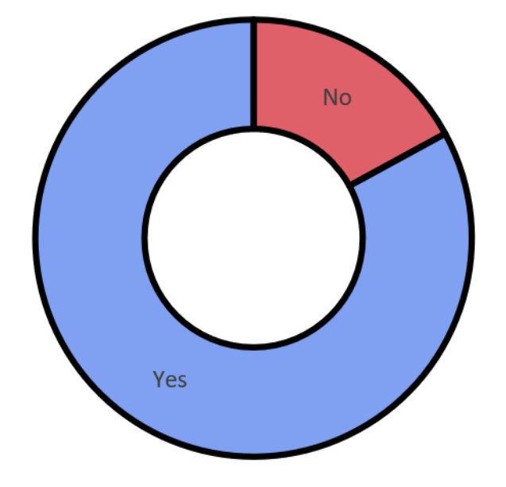






Last week’s vote:
Do we appreciate uniqueness?
17%
83%
Primary national vote result
Notes:
Images
iStock

Slide 4

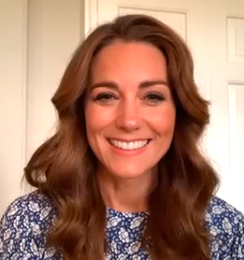

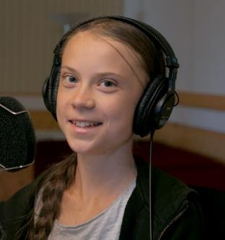
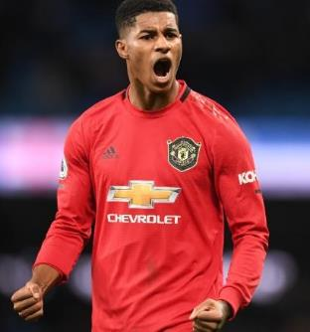
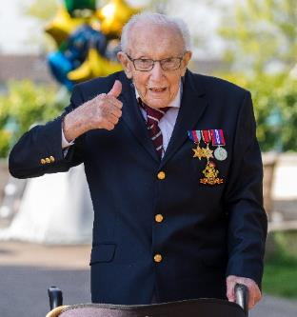


Starter: Who are they?
Do you know? (2-3 mins)
The four people have all been in the news recently, trying to help different causes! Do you know who they are and what they were trying to help?
Cause:
An issue that’s supported by people who want to see change, such as charities.
Notes:
Images
https://www.scmp.com/news/world/europe/article/3089935/black-lives-matter-protests-show-world-has-reached-tipping-point
https://edition.cnn.com/2020/06/17/football/marcus-rashford-free-school-meals-u-turn-spt-intl/index.html
https://www.vanityfair.com/style/2020/06/kate-middleton-mental-health-student-assembly
https://www.thetimes.co.uk/article/captain-tom-moore-on-track-to-score-no-1-single-3ln8fsls3
https://www.highsnobiety.com/p/john-boyega-speech-black-lives-matter/
References

Slide 5




Starter: Who are they?
Kate Middleton, Duchess of Cambridge
Captain Tom Moore, retired Army officer
Children’s mental health!
NHS charities!
Marcus Rashford,
Manchester United footballer
Greta Thunberg, Climate change protester
Free School Meals over summer!
Stop climate change!
Challenge:
Why do you think these people decided to support these causes? Why might they be important to them?
Notes:
Images
https://www.scmp.com/news/world/europe/article/3089935/black-lives-matter-protests-show-world-has-reached-tipping-point
https://edition.cnn.com/2020/06/17/football/marcus-rashford-free-school-meals-u-turn-spt-intl/index.html
https://www.vanityfair.com/style/2020/06/kate-middleton-mental-health-student-assembly
https://www.thetimes.co.uk/article/captain-tom-moore-on-track-to-score-no-1-single-3ln8fsls3
https://www.highsnobiety.com/p/john-boyega-speech-black-lives-matter/
References

Slide 6

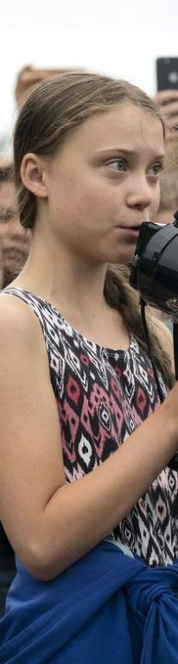
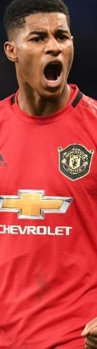
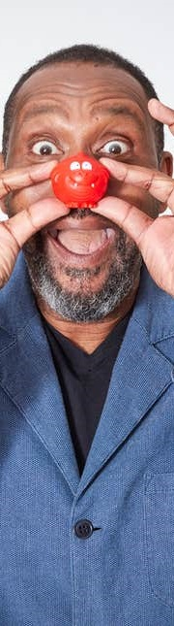
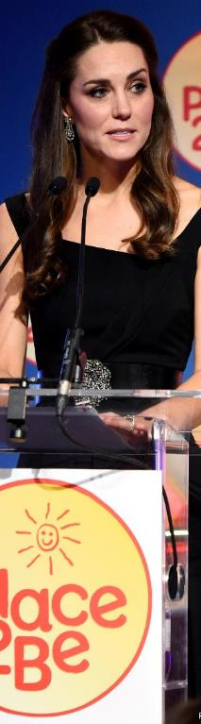
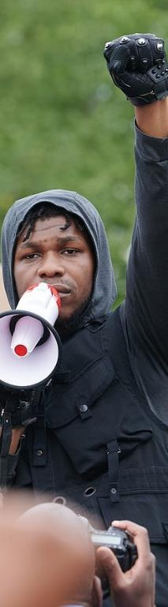
Do causes need celebrities’ help to be successful?
Notes:
Images:
iStock

Slide 7
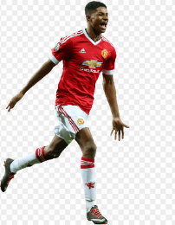




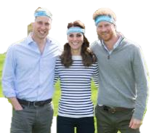

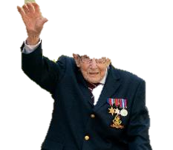


Our learning journey for this week!
Starter: Who are they?
Why are we talking about this?
What makes us support a cause?
Do we need their help?
Good idea or bad idea?
Vote!
Extension:
Happy birthday NHS
Notes:
Images:
iStock

Slide 8
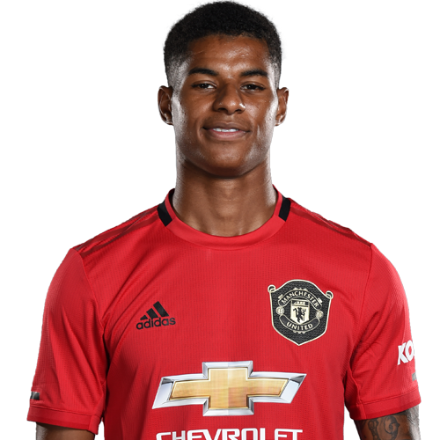
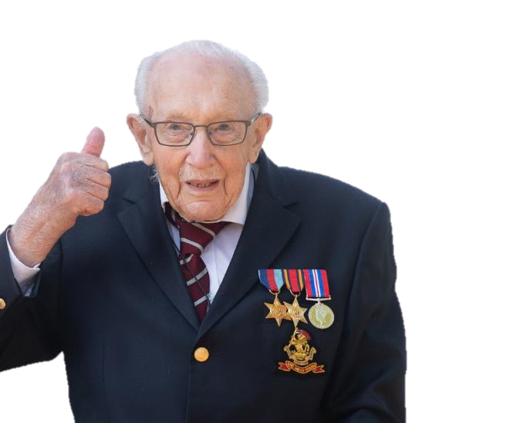
Why are we talking about this?
This month, footballer Marcus Rashford asked the Government to change their mind about giving food vouchers to children who need them over the summer. They agreed because of the letter he wrote to them!
Captain Tom Moore also raised almost £33 million for the NHS by walking laps of his garden during lockdown over the last few months!
Captain Tom may have started out on his own, but he got a lot of support from celebrities. So do we need celebrities to get people to support important causes?
Notes:
Parent/Carer Note: This week’s home learning pack contains additional resources about Mental Health Awareness.
Images:
iStock

Slide 9
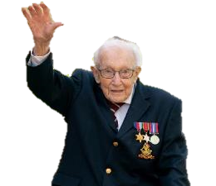
Our learning journey for this week!
Starter: Who are they?
Why are we talking about this?
What makes us support a cause?
Do we need their help?
Good idea or bad idea?
Vote!
Extension:
Happy birthday NHS
Notes:
Images:
iStock

Slide 10






What makes us support a cause?
While there are lots of important causes that need help, it’s not possible for you to help every one of them. Sometimes, we need to choose what cause is most important to us.
Your friends or family support it.
A celebrity you like supports it.
It affects you or someone you care about.
You recognize the name from an advert.
It’s something you believe is important.
Order (3-5 minutes)
Which do you think is the best reason to support a cause? Put them in order from 1 to 5.
Notes:
Images:
iStock
References:

Slide 11
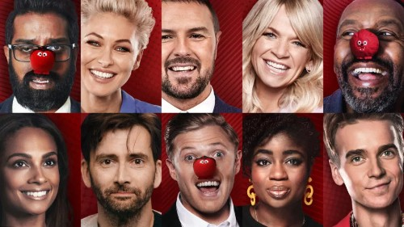



What makes us support a cause?
Some people have said that they are more likely to support a cause or a charity because a celebrity they like supports it. Is this true for you?
Vote (2-3 mins)
Are you more or less likely to support a cause because of the celebrities who support it? Vote with your thumbs!
More likely
Less likely
Makes no difference
Notes:
Images
https://www.aid-expo.com/blog/240-comic-relief-and-the-power-of-celebrity
Icon8
References
https://www.thirdsector.co.uk/people-say-celebrity-endorsement-does-not-affect-donation-decisions/fundraising/article/1459568

Slide 12
Our learning journey for this week!
Starter: Who are they?
Why are we talking about this?
What makes us support a cause?
Do we need their help?
Good idea or bad idea?
Vote!
Extension:
Happy birthday NHS
Notes:
Images:
iStock

Slide 13

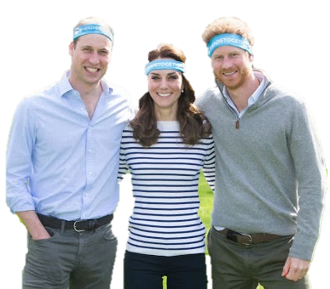

Do we need their help?
Discuss (5-10 mins)
On the next few slides, you’ll see how different people have tried to help cause change. For each example, discuss if you think we need celebrities to help these causes.
Notes:
Images:
iStock
References:

Slide 14

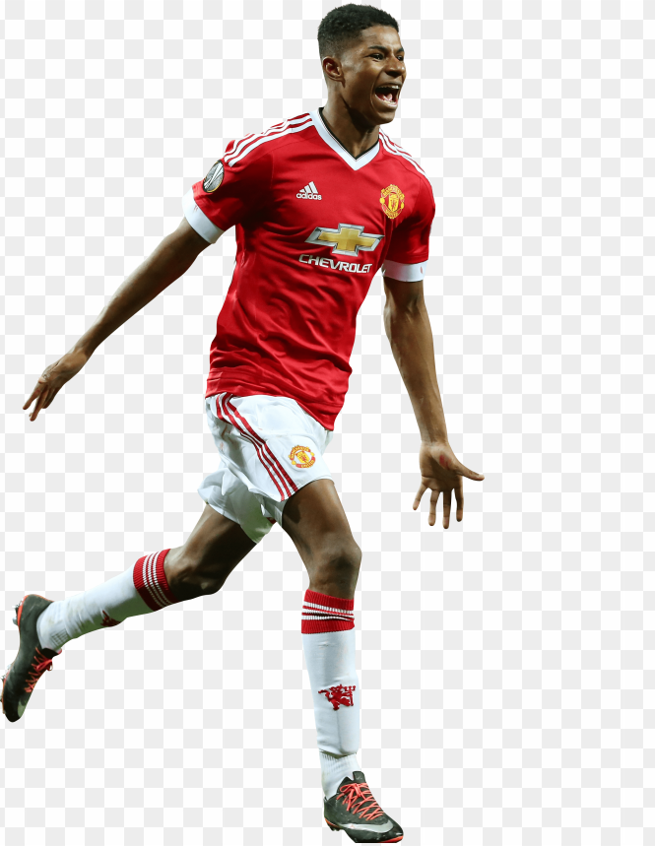
The celebrity impact
During school time, the government provides free school meals to children who need it.
A few weeks ago, footballer Marcus Rashford wrote a letter to the government and asked them to continue giving children free school meals over summer as some families might need more help because of Coronavirus.
Boris Johnson said he would! He told Marcus that he was able to understand the situation much better because of Marcus’ letter.
Do you think we needed Marcus Rashford to cause this change?
Notes:
References:
https://twitter.com/MarcusRashford/status/1272302819819823105
https://www.bbc.co.uk/news/uk-53073977
https://www.bbc.co.uk/news/explainers-53053337
https://www.nme.com/news/music/marcus-rashford-helped-by-jay-zs-roc-nation-in-successful-school-meals-fight-2693919
Images:
1) https://toppng.com/clipart-resolution-19033289-marcus-rashford-2016-PNG-free-PNG-Images_170346?search-result=seaweed-clipart

Slide 15


Do we need their help?
In the last few year, there have been many protests to raise awareness about the issue of climate change.
Greta Thunberg stopped going to school to protest climate change and her protests soon got lots of attention!
Lots of celebrities said they really admired her actions, but she told them that celebrities must act too.
Do you think we need celebrities to help fight climate change?
Notes:
Images
iStock
https://www.rte.ie/entertainment/2019/1111/1090073-6-celebrities-championing-climate-change/
https://en.wikipedia.org/wiki/Climate_Change_%E2%80%93_The_Facts
References
https://en.wikipedia.org/wiki/Climate_Change_%E2%80%93_The_Facts
https://www.walesonline.co.uk/news/uk-news/celebrities-who-leading-way-climate-17556887
https://www.plantbasednews.org/news/greta-thunberg-celebrities-face-climate-crisis

Slide 16


Do we need their help?
Captain Tom Moore set out to walk 100 laps of his garden before his 100th Birthday to raise £1000 for NHS Charities Together. He ended up getting lots of attention and raised almost £33 million!
Lots of celebrities shared their support for Captain Tom and presenter Piers Morgan promised to donate £10,000 of his own money to his cause!
Do you think we need celebrities to get us to support Captain Tom and the NHS?
Notes:
Images
iStock
https://www.justgiving.com/associationofnhscharities
https://www.dailymail.co.uk/tvshowbiz/article-8225797/David-Beckham-leads-celebrity-tributes-truly-inspiring-WWII-hero-Captain-Tom-Moore-99.html
https://escxtra.com/2020/04/24/michael-ball-tom-moore-number-1/
References
https://www.hellomagazine.com/celebrities/gallery/2020041788230/celebrities-gemma-atkinson-holly-willoughby-support-captain-tom-moore/1/
https://www.bbc.co.uk/news/uk-england-beds-bucks-herts-52735192
https://www.bbc.co.uk/news/av/entertainment-arts-52339204/captain-tom-moore-teams-up-with-singer-michael-ball-in-charity-release
https://en.wikipedia.org/wiki/Captain_Tom#Number_one_single

Slide 17

Do we need their help?
Right now, there are lots of campaigns, special days and lessons in school to make sure we’re looking after our mental health.
Will, Kate and Harry of the Royal family have also helped by starting their own mental health charity and doing assemblies for schools about mental health.
Do you think we need the Royal family to help us talk about mental health?
Notes:
Images
iStock
https://www.thesun.co.uk/fabulous/3222778/heads-together-charity-kate-middleton-prince-william-harry-world-mental-health-day-work-campaign/
References
https://www.thesun.co.uk/fabulous/3222778/heads-together-charity-kate-middleton-prince-william-harry-world-mental-health-day-work-campaign/

Slide 18
Our learning journey for this week!
Starter: Who are they?
Why are we talking about this?
What makes us support a cause?
Do we need their help?
Good idea or bad idea?
Vote!
Extension:
Happy birthday NHS
Notes:
Images:
iStock

Slide 19




Good idea or bad idea?
Mia, Andre, Sara and Jakub have started a new charity – but they can’t decide if getting a celebrity to help them is a good idea or a bad idea, so they need your help!
Vote with your feet (5-8 mins)
Read each of their arguments for or against getting a celebrity’s help. If you agree with what they say, point your feet to the left. If you disagree, point your feet to the right.
I agree
I’m not sure
I disagree
Notes:
Images:
iStock
References:

Slide 20

Good idea or bad idea?
A popular celebrity could help our cause get really famous!
I agree
I’m not sure
I disagree
Notes:
Images:
iStock
References:

Slide 21
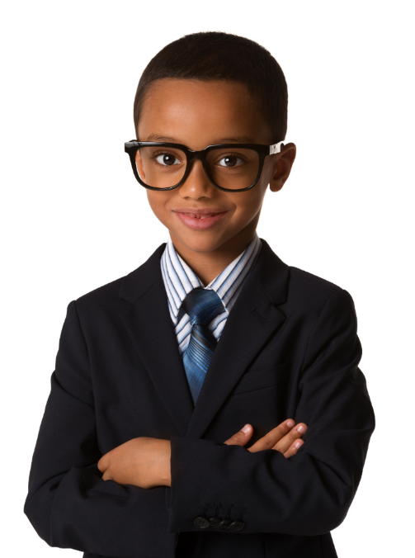
Good idea or bad idea?
It’s more important to find someone who believes in our cause than someone who’s famous.
I agree
I’m not sure
I disagree
Notes:
Images:
iStock
References:

Slide 22
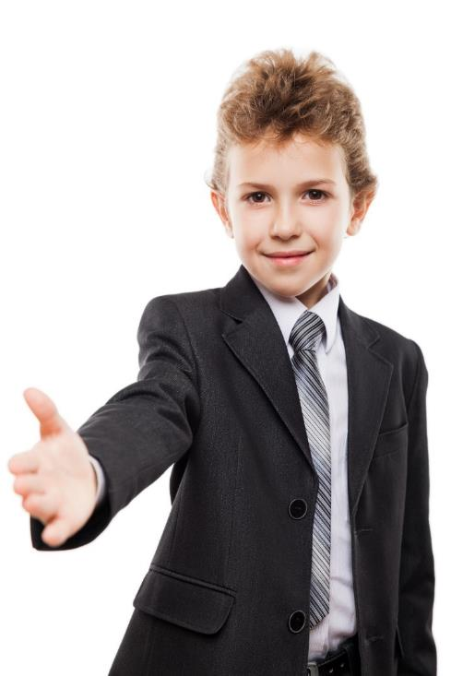
Good idea or bad idea?
We need a celebrity. People are more likely to listen to a celebrity they like than people they don’t know!
I agree
I’m not sure
I disagree
Notes:
Images:
iStock
References:

Slide 23
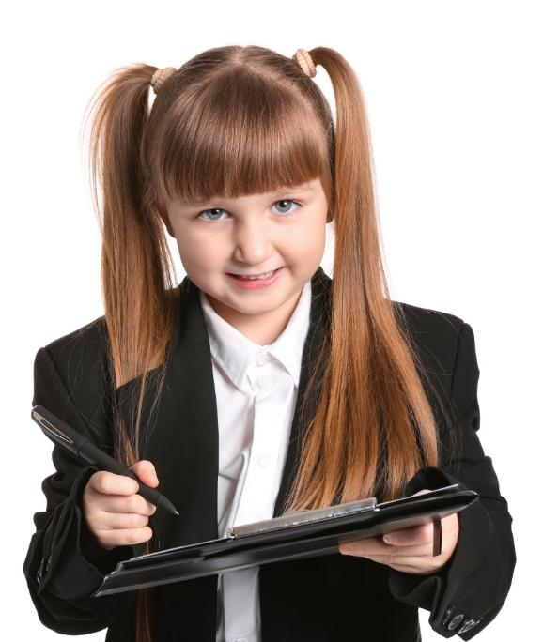
Good idea or bad idea?
Our cause is really important and celebrity would just take away their focus from what we’re fighting for!
I agree
I’m not sure
I disagree
Notes:
Images:
iStock
References:

Slide 24

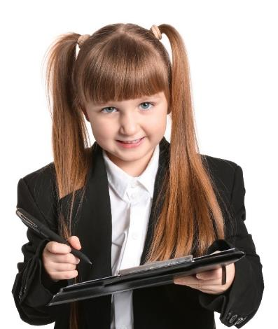


Good idea or bad idea?
Reflect (3-5 mins)
Based on what you’ve looked at, do you think they need a celebrity for their cause to be a success? Why/why not?
Notes:
Images:
iStock
References:

Slide 25
Our learning journey for this week!
Starter: Who are they?
Why are we talking about this?
What makes us support a cause?
Do we need their help?
Good idea or bad idea?
Vote!
Extension:
Happy birthday NHS
Notes:
Images:
iStock

Slide 26


Do causes need celebrities’ help to be successful?
Yes
No
Celebrities get lots of attention, which can help your cause.
Celebrities can donate lots of money to your cause.
Lots of people trust celebrities, which will get more people to support your cause.
Some causes have been successful without celebrities’ help.
Sometimes celebrities actually take attention away from the cause.
There are other reasons that get people to support a cause.
Calling all voters!
You can still vote at home! Just follow the link:
https://www.surveymonkey.co.uk/r/vfs-primary-causes

Slide 27



Ext: Happy Birthday NHS!
Sunday 5th July is the NHS’ 72nd birthday! This means that, for 72 years, the NHS has been providing free healthcare to everyone here in the UK.
This year, the NHS are asking us to celebrate their birthday in a slightly different way – by saying thank you to every key worker, including doctors, nurses, teachers, delivery drivers and everyone else!
Find out more
(10+ mins)
Check out all the activity ideas on the next slide for how you can get involved!

Slide 28
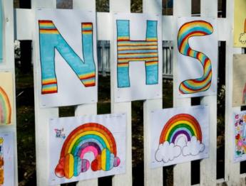
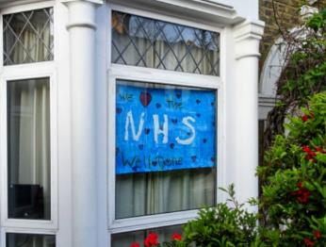
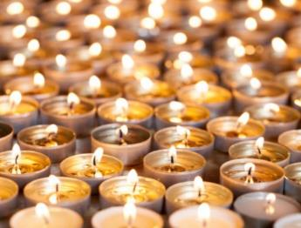
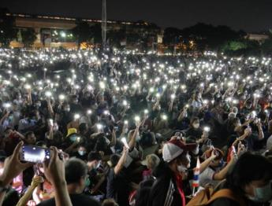

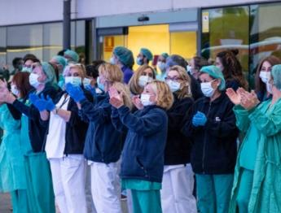
Now…
Ext: Happy Birthday NHS!
The first way you can get involved is by getting creative! Make posters and cards to put in your windows!
On Saturday…
At 8pm, light up a candle or torch in your window or on your doorstep to show your support.
On Sunday…
Get ready for the biggest clap yet! At 5pm, wherever you are, clap as loud as you can for the NHS!

Slide 29
You can vote from home at… https://www.surveymonkey.co.uk/r/vfs-primary-causes
To have your voice heard!
If you have any issues, feedback or comments, email amy@votesforschools.com
Notes:
Alternative video link: https://youtu.be/FoQ45XPO_WQ

