Slide 1


Article 15: “You have the right to choose your own friends and join or set up groups, as long as it isn’t harmful to others.”
–
Parents/Carers & Pupils:
This lesson works best in “Full Screen” mode – click the icon at the bottom right of your screen or use the “F5” key to start from the beginning. Use the space bar, mouse or arrow keys to click through!

Slide 2






How to use this lesson…
Use these buttons to get the most out of your lesson.
Find this button in the bottom right of you screen to start your lesson.
Use the arrow keys to go forwards and backwards through your lesson.
To go back to your normal screen, press the esc key on your keyboard.
–
Learning from home?
Here are some ideas of how to get the most out of this lesson at home.
Ask an adult to arrange a video call so you can do some
of the activities with a friend.
Explore the topic with a parent or caregiver: how is their opinion
different to yours?
Teach a younger sibling or relative
about how
VotesforSchools works!
In the classroom?
Look out for these boxes to see how to make the most of the activities!
Parents’ & Carers’ Note:
Please see the Notes section below each slide for any further guidance.
Don’t forget to vote…
You can find the link to do this on the final slide. Get your whole household involved!
Notes:
Images:
https://icons8.com/

Slide 3






Feedback: “Do we appreciate uniqueness?”
“I voted yes because when you understand how important uniqueness is, it will help end discrimination and to celebrate uniqueness around the world.”
Stanhope Primary School
“I voted no because there are so many people that look different or look unique, and quite a large amount of people in the world will say those people look weird or ugly or different which, if you think about it, [is] extremely rude to those who are being called that.”
Royal Alexandra & Albert School
“Nobody is mean or teases me and I have two dads.”
Childwall CofE School
82.9%
17.1%
“I put yes as my own answer, because I am a person who is against discrimination… However, if this question was directly asking about the whole world I would say no, especially with the Black Lives Matter protest, it seems that most people have no respect for others who are a different colour, religion, gender and even from a different country from them. Uniqueness is a special thing God has given to us and it should be appreciated more.”
Eastbury Primary School
Notes:
Parent/Carer Note: This slide shows the feedback to the question pupils answered two weeks ago. Check back in two weeks to see if the comment you make at the end of this lesson is featured!
To record your child’s vote, use the survey link on the last slide or use the hashtag #VotesatHome on social media to browse other children’s responses and share your own.

Slide 4

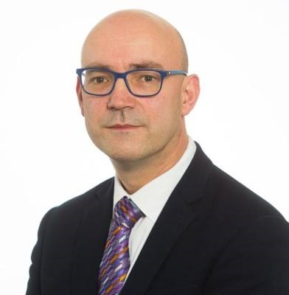
Feedback: “Do we appreciate uniqueness?”
We shared what you had to say with Jonathan Glazzard, a professor of Inclusive Education at Carnegie School of Education who is passionate about improving young people’s mental health. Here’s what he said:
17.1%
82.9%
“It is fantastic that children and young people have such positive attitudes toward diversity. However, what is clear from the survey is that they understand that discrimination still exists. Schools play a critical role in helping children to understand that all people deserve to be treated with respect. It is essential that children learn that prejudice and discrimination are wrong.”

Slide 5


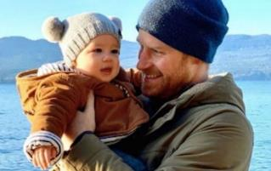
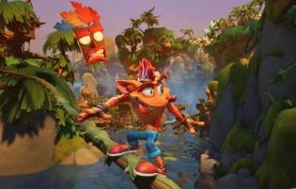
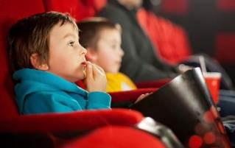



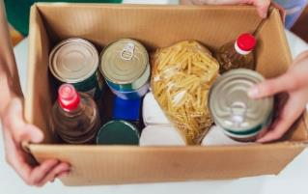
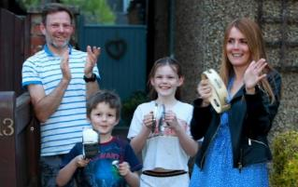
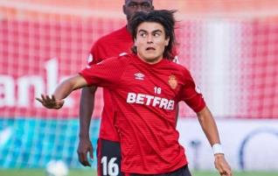
Be informed!
Here’s what’s been in the news this week...
More lockdown changes!
New Crash Bandicoot!
Prime Minister Boris Johnson said that more changes would be made to lockdown on 4th July. Click the picture to find out more!
After a 22-year wait, a new version of the famous game Crash Bandicoot is being released on 2nd October 2020!
Clap for carers will return every year on the NHS’ birthday – and you can find how to get involved later in this lesson!
15-year-old Luka Romero has become the youngest ever footballer to play in the Spanish top division.
Clap for carers returns!
Youngest top division footballer
Notes:
Parent/Carer Note: Use this slide to learn about headlines around the world. Using the presentation in Slide Show mode, you will be able to click on the highlighted pictures to follow links to websites and videos.
Alternative video link: https://www.bbc.co.uk/newsround/52228461
Images/Stories:
Lockdown: https://www.bbc.co.uk/newsround/53133813
Crash:
Clap: https://www.bbc.co.uk/newsround/53175383

Slide 6
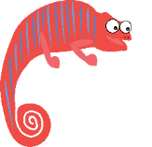


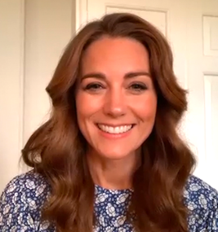
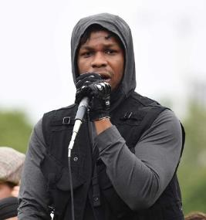





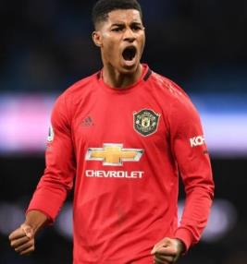

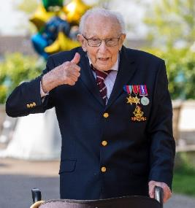

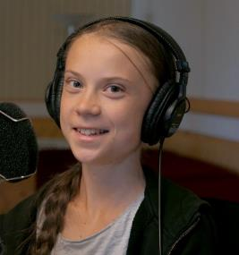


Starter: Being heard
Cause:
An issue that’s supported by people who want to see change, such as charities.
Guess (2-3 mins)
These well-known faces have all shown their support for different causes recently! Do you know who they are and what cause they’re trying to help?
Notes:
Images
https://www.scmp.com/news/world/europe/article/3089935/black-lives-matter-protests-show-world-has-reached-tipping-point
https://edition.cnn.com/2020/06/17/football/marcus-rashford-free-school-meals-u-turn-spt-intl/index.html
https://www.vanityfair.com/style/2020/06/kate-middleton-mental-health-student-assembly
https://www.thetimes.co.uk/article/captain-tom-moore-on-track-to-score-no-1-single-3ln8fsls3
https://www.highsnobiety.com/p/john-boyega-speech-black-lives-matter/
References

Slide 7
Starter: Being heard
Kate Middleton, Duchess of Cambridge
Captain Tom Moore, Former British Army officer
Children’s mental health
NHS charities
John Boyega,
Star Wars actor
Greta Thunberg,
Environmental activist
Black Lives Matter
Climate change awareness
Marcus Rashford,
Manchester United footballer
Challenge:
Why do you think these people decided to support these causes? Why might they be important to them?
Free School Meals vouchers
Notes:
Images
https://www.scmp.com/news/world/europe/article/3089935/black-lives-matter-protests-show-world-has-reached-tipping-point
https://edition.cnn.com/2020/06/17/football/marcus-rashford-free-school-meals-u-turn-spt-intl/index.html
https://www.vanityfair.com/style/2020/06/kate-middleton-mental-health-student-assembly
https://www.thetimes.co.uk/article/captain-tom-moore-on-track-to-score-no-1-single-3ln8fsls3
https://www.highsnobiety.com/p/john-boyega-speech-black-lives-matter/
References

Slide 8
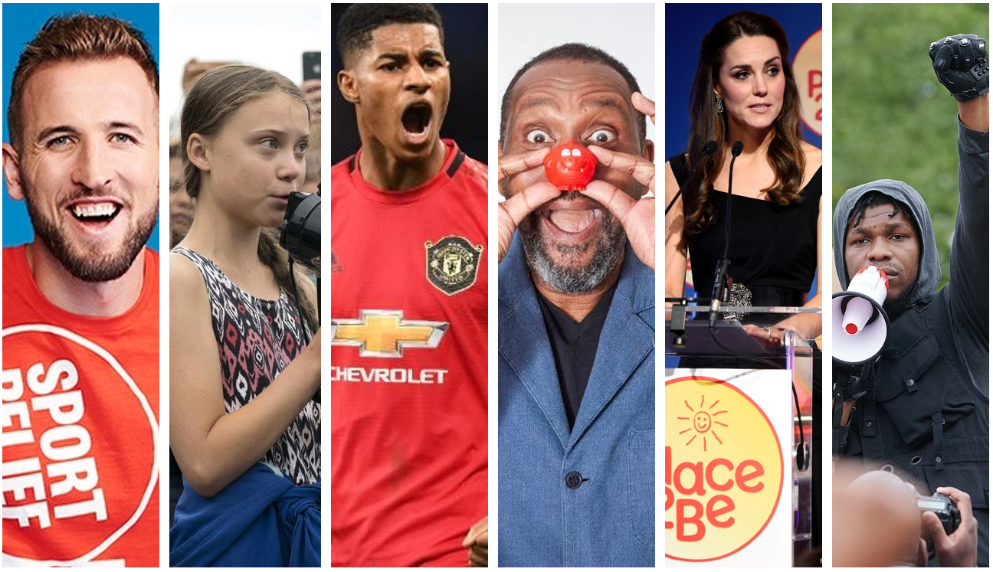
Do causes need celebrities' help to be successful?
Notes:
Parent/Carer Note: Each week, your child completes this lesson in school before recording their vote on an online platform. Temporarily, we have created a platform you can use at home. Please see the last slide for details.
Images:
iStock

Slide 9

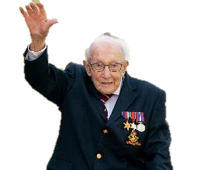
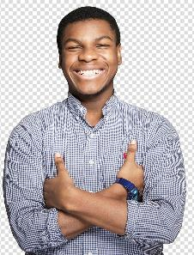
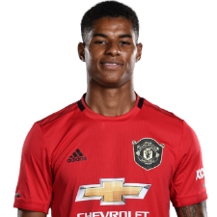
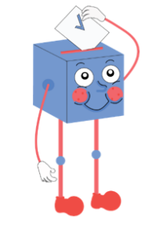

Starter: Being heard
Why are we talking about this?
The celebrity impact
For the right reasons?
Where do you stand?
Ext: NHS’ Birthday!
Vote!
Notes:
Images:
iStock

Slide 10
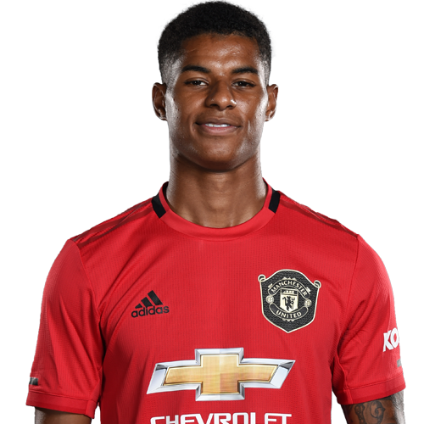
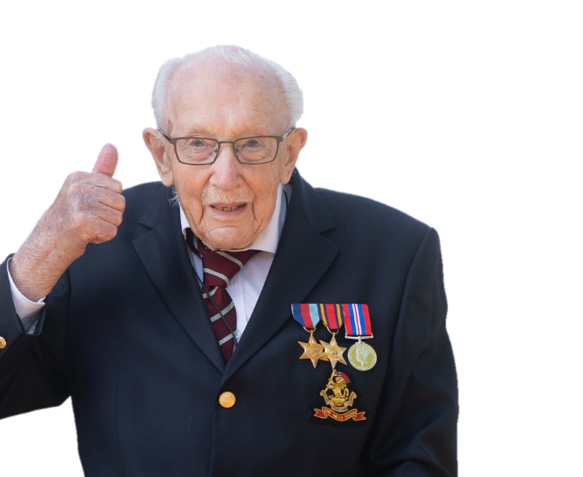
Why are we talking about this?
This month, footballer Marcus Rashford made headlines around the world after he asked the Government to provide free school meals over summer for children who need them.
His campaign raised more than £20 million before the Government changed their policies and agreed to help families that needed food over the summer holidays.
This is after Captain Tom Moore raised almost £33 million for the NHS by walking laps of his garden during lockdown.
Captain Tom may have started out on his own, but he quickly got the support of many famous faces… Would he have been so successful without celebrity help? Or do we need celebs to help show us what causes to support?
Notes:
Parent/Carer Note: This week’s home learning pack contains additional resources about Mental Health Awareness.
Images:
iStock

Slide 11
Starter: Being heard
Why are we talking about this?
The celebrity impact
For the right reasons?
Where do you stand?
Ext: NHS’ Birthday!
Vote!
Notes:
Images:
iStock

Slide 12
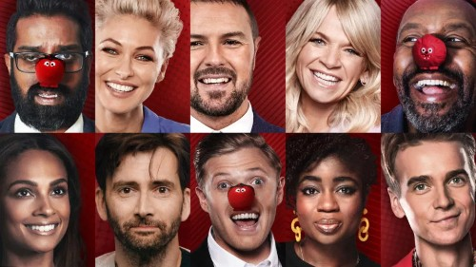



The celebrity impact
Quite often, when a charity or group want to make a change, they will ask celebrities to support their cause.
Some studies have shown that celebrity help makes us more likely to support a cause, but others have said the opposite!
Vote (2-3 mins)
Are you more or less likely to support a cause because of the celebrities who endorse it? Why?
More likely
Less likely
Makes no difference

Slide 13
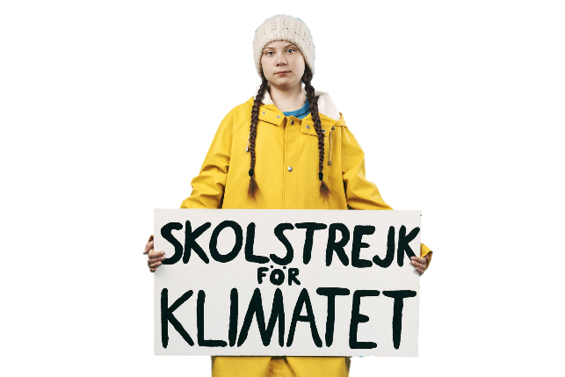
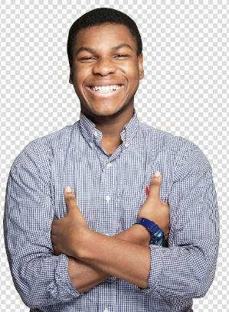

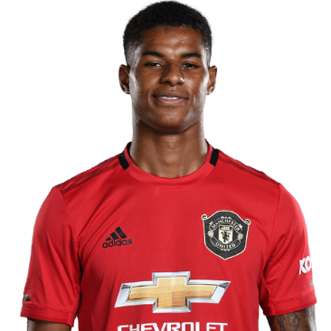
The celebrity impact
Discuss (10-20 mins)
On the next few slides, you are going to read about some different causes that celebrities have gotten involved in. For each one, think carefully about what impact the celebrity had on the cause, and whether they were needed.

Slide 14
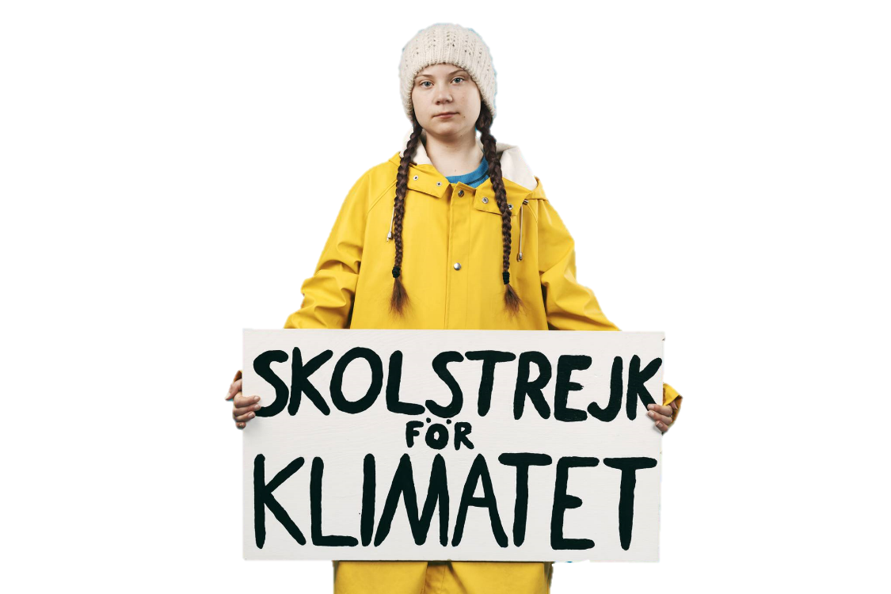
The celebrity impact
Greta Thunberg began protesting for change by sitting outside of the Swedish Parliament building asking for action to be taken on climate change. Very quickly, her protests went viral and millions of people joined in.
As more and more people heard about what she was doing, many celebrities also praised her. However, Greta told celebrities that they must act too, saying: “People see you celebrities as gods, you influence billions of people, we need you, you can use your voice to raise awareness about this global crisis.”
Do you think climate change protests needs celebrities to gain support? Why/why not?
Notes:
References:
https://www.vice.com/en_uk/article/59xag5/a-history-of-the-student-climate-protests
https://www.telegraph.co.uk/women/life/malala-leo-dicaprio-thunbergs-gretwork/
https://www.plantbasednews.org/news/greta-thunberg-celebrities-face-climate-crisis
Images:
1) https://www.wired.co.uk/article/greta-thunberg-climate-crisis

Slide 15
The celebrity impact
Earlier this year, Captain Tom Moore set out to walk 100 laps of his garden before his 100th birthday, and raise £1,000. His daughter thought it would make a nice news story, so wrote to a local paper about his mission.
Tom went on to raise £33 million, appear on TV many times and work with a singer to produce a Number 1* song in the charts! TV host Piers Morgan even promised to give £10,000 of his own money to the cause!
Do you think Captain Tom needed celebrities to gain support? Why/why not?
Notes:
*It sold 82,000 copies, with all proceeds going to NHS Charities Together: https://www.bbc.co.uk/news/entertainment-arts-52415966
References:
https://www.bbc.co.uk/news/av/uk-52312019/coronavirus-the-story-of-captain-tom-s-walk
https://www.theguardian.com/world/2020/may/01/hes-just-a-wonderful-man-how-captain-tom-became-a-superstar-fundraiser
https://www.bbc.co.uk/news/uk-england-beds-bucks-herts-52328241
Images:
1) https://www.thesun.co.uk/tvandshowbiz/11465310/captain-tom-moores-nhs-charity-beaten-no1-without-public-help-scott-mills/

Slide 16
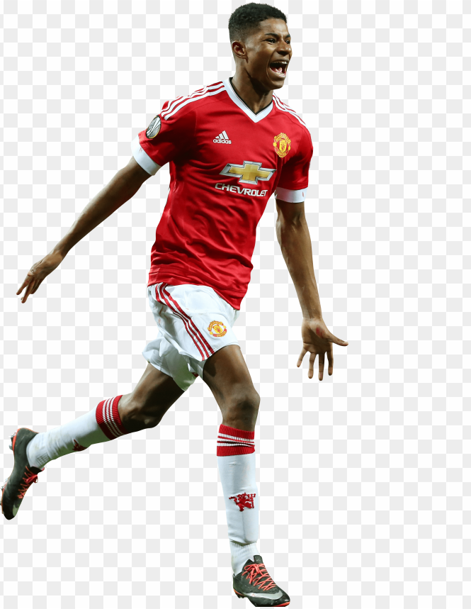
The celebrity impact
“As a family, we relied on breakfast clubs, free school meals, and the kind actions of neighbours and coaches.”
In June, Manchester United footballer Marcus Rashford wrote a letter to MPs telling them about his childhood and asking them not to stop free school meals vouchers for children over the summer holidays².
Since receiving the letter, the Government have set up a £120 million for a “Covid summer food fund” and Boris Johnson has praised him for speaking up about it!
Do you think this cause needed Rashford to gain support? Why/why not?
Notes:
References:
https://twitter.com/MarcusRashford/status/1272302819819823105
https://www.bbc.co.uk/news/uk-53073977
https://www.bbc.co.uk/news/explainers-53053337
https://www.nme.com/news/music/marcus-rashford-helped-by-jay-zs-roc-nation-in-successful-school-meals-fight-2693919
Images:
1) https://toppng.com/clipart-resolution-19033289-marcus-rashford-2016-PNG-free-PNG-Images_170346?search-result=seaweed-clipart

Slide 17
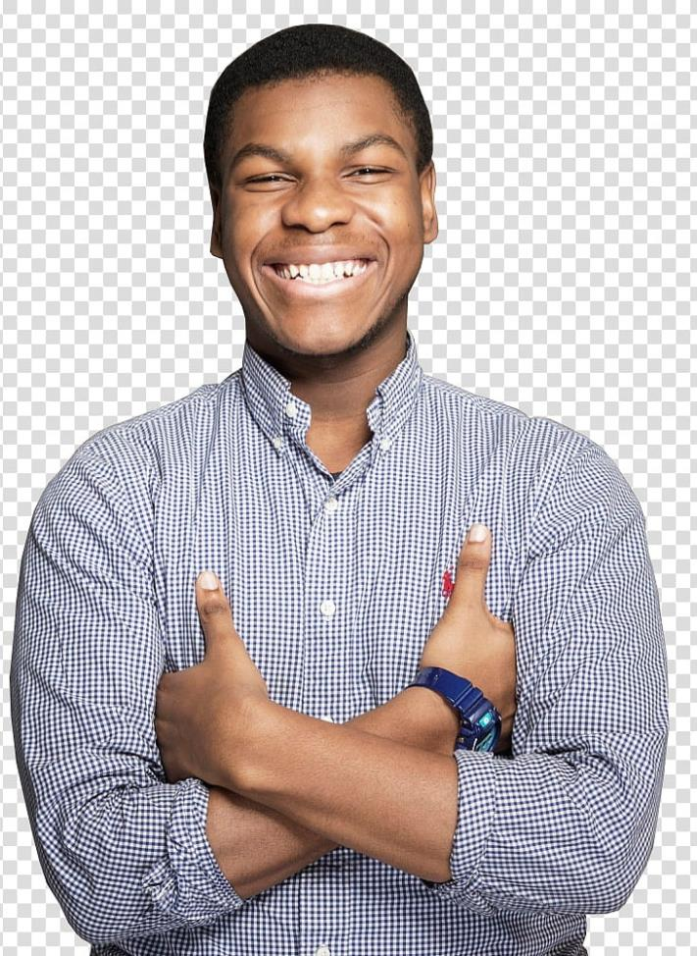
The celebrity impact
Celebrities like Star Wars’ John Boyega showed their support in the recent anti-racism protests in the UK and around the world through attending protests, posting their support online and speaking out about their own experiences of racism.
However, comedian Dave Chappelle said that celebrities don’t matter in these current protests. He said that the voice of “young people” is more important right now than that of a celebrity.
Do you think this cause needs celebrities to gain support? Why/why not?
Notes:
Images:
1) https://www.pngguru.com/free-transparent-background-png-clipart-ldrnq

Slide 18
Starter: Being heard
Why are we talking about this?
The celebrity impact
For the right reasons?
Where do you stand?
Ext: NHS’ Birthday!
Vote!
Notes:
Images:
iStock

Slide 19




For the right reasons
Now you’ve seen how celebs can help make change happen, you’re going to think about why they might help…
You decide (10-15 mins)
On the next few slides you are going to hear from some celebrities who are thinking of supporting a cause or charity. For each one, decide if you think that they should support the cause or not. Remember to explain your reasons.
They should not support the cause because…
They should support the cause because…
Notes:
Images:
iStock
https://emojipedia.org/apple/

Slide 20

For the right reasons
My manager said that I need to donate to a charity to keep my fans happy. I don’t know much about charities and I can’t really be bothered, but my manager knows best.
They should not support the cause because…
They should support the cause because…
Notes:
Images:
iStock

Slide 21
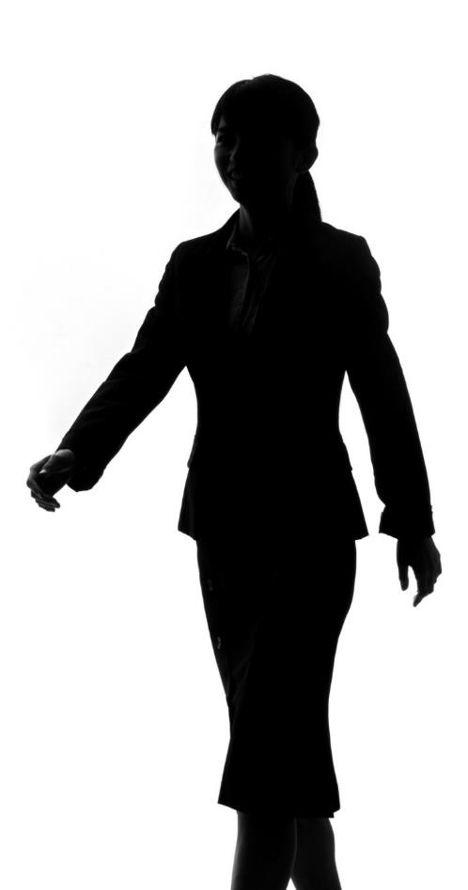
For the right reasons
After my Dad died of cancer, I’ve always wanted to help find a cure, so I know I want to donate money to Cancer Research. You can’t persuade me not to!
They should not support the cause because…
They should support the cause because…
Notes:
Images:
iStock

Slide 22

For the right reasons
A well known charity has offered to pay me to support their campaign about animal rights. I think that we should focus on human rights first, such as Black Lives Matter, but if I’m getting paid I suppose I might as well do it.
They should not support the cause because…
They should support the cause because…
Notes:
Images:
iStock

Slide 23

For the right reasons
A magazine accused me of being selfish because I’m rich and I don’t give any money to charity so now I guess I’ll have to do it.
They should not support the cause because…
They should support the cause because…
Notes:
Images:
iStock

Slide 24

For the right reasons
When I grew up we didn’t have enough money to go to theme parks on the weekend. I don’t want this to happen to other children, so I’m going to start a campaign to make entry free for all children.
They should not support the cause because…
They should support the cause because…
Notes:
Images:
iStock

Slide 25
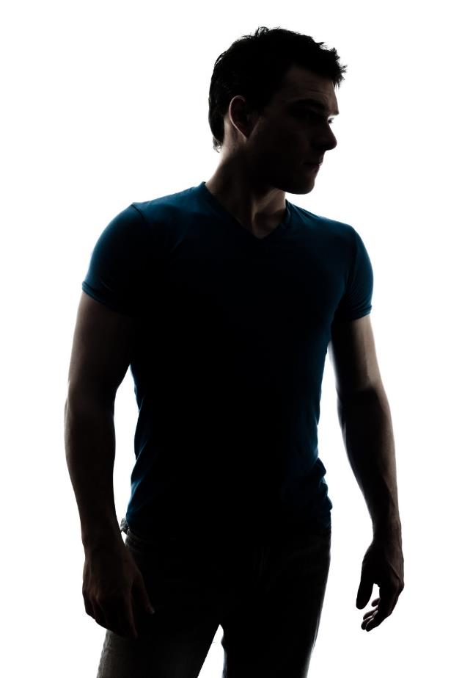
For the right reasons
To be honest, I’m feeling pretty bored of acting and I’d like to do something different. If I get involved in some charity work, I’ll meet new people and could even find a new job.
They should not support the cause because…
They should support the cause because…
Notes:
Images:
iStock

Slide 26
Starter: Being heard
Why are we talking about this?
The celebrity impact
For the right reasons?
Where do you stand?
Ext: NHS’ Birthday!
Vote!
Notes:
Images:
iStock

Slide 27






Where do you stand?
Where do you stand? (10-20 mins)
Take a look at the statements on the next slide. For each one, if you agree, go to the left. If you disagree with a statement go to the right. You must explain your reasons though!
I agree
I’m not sure
I disagree

Slide 28
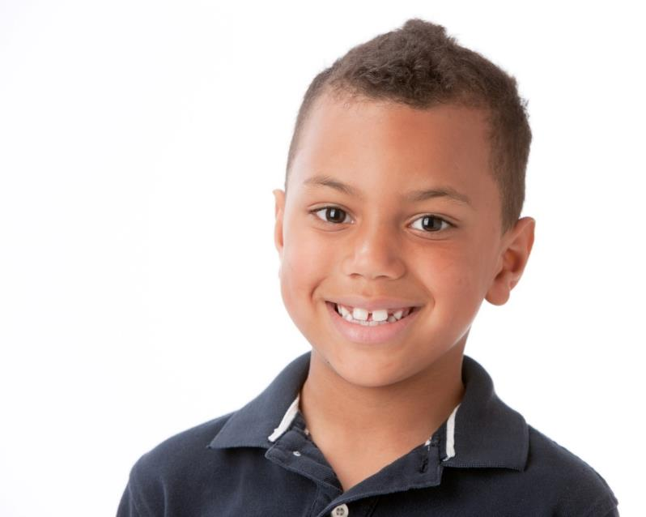
Where do you stand?
I’m more likely to do something if my favourite celebrity says that I should do it.
Do you agree or disagree? Why?
I agree
I’m not sure
I disagree
Notes:
Images:
iStock

Slide 29
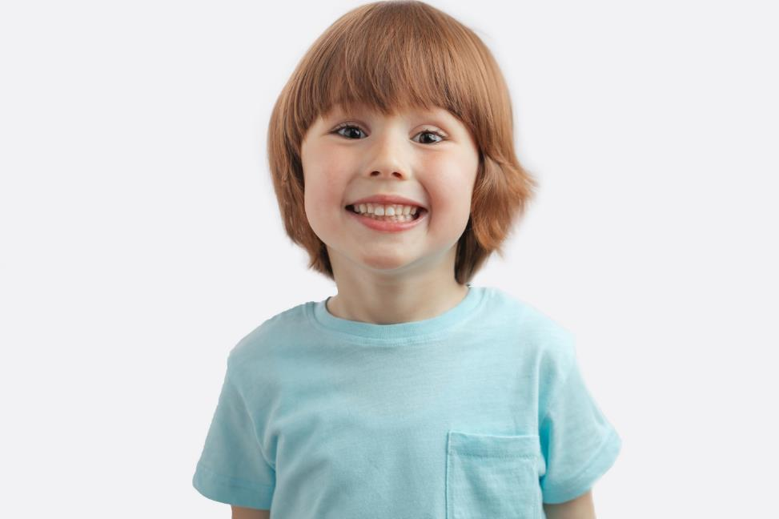
Where do you stand?
We don’t need celebrities to tell us what to support, but if they help then what’s the problem?
Do you agree or disagree? Why?
I agree
I’m not sure
I disagree
Notes:
Images:
iStock

Slide 30

Where do you stand?
We need to think about why we support causes and make sure that it is for the right reasons.
Do you agree or disagree? Why?
I agree
I’m not sure
I disagree
Notes:
Images:
iStock

Slide 31
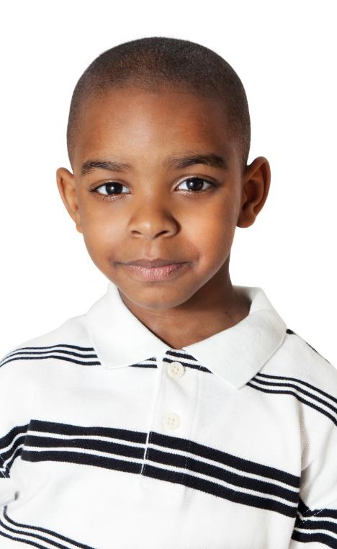
Where do you stand?
It doesn’t matter what your reasons are for supporting a good cause – it matters that you’re doing it!
Do you agree or disagree? Why?
I agree
I’m not sure
I disagree
Notes:
Images:
iStock

Slide 32
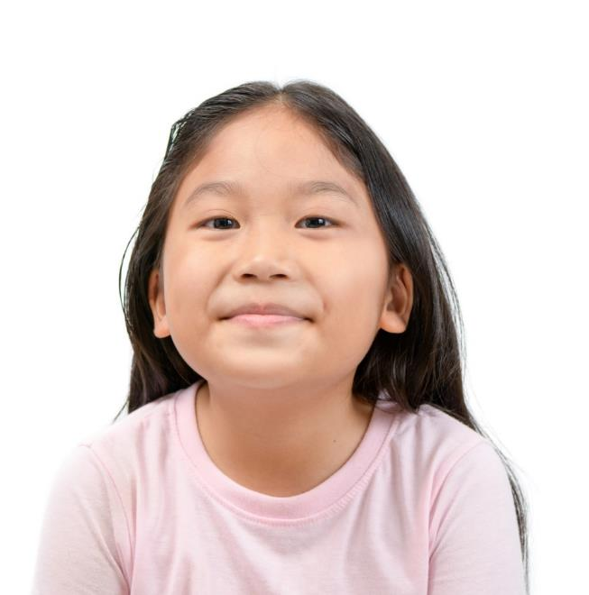
Where do you stand?
If we start telling people off for why they support a cause then they’ll stop supporting, and that will be worse.
Do you agree or disagree? Why?
I agree
I’m not sure
I disagree
Notes:
Images:
iStock

Slide 33
Starter: Being heard
Why are we talking about this?
The celebrity impact
For the right reasons?
Where do you stand?
Ext: NHS’ Birthday!
Vote!
Notes:
Images:
iStock

Slide 34
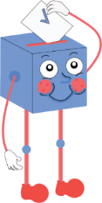
Do causes need celebrities' help to be successful?
Lots of people want to know what celebrities are doing, so their support is a great way to let lots of people know about the cause.
Raising awareness for causes like Comic Relief and Children in Need are based around celebrities, and it clearly works!
If celebrities help bring more awareness, even if they aren’t genuine, it can only ever be a good thing!
…
Many causes started by normal people still go on to be very successful – just look at Greta Thunberg or Captain Tom Moore!
Celebrity support isn’t always genuine, and can take attention away from the thing that really matters because people will be doing it for the wrong reasons.
Celebrity support might help spread the word, but it isn’t necessary – it just helps speed things up.
…
Notes:
Parent/Carer Note: Use this slide to review the arguments before voting.

Slide 35
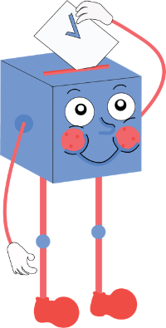
You can vote from home at…
https://www.surveymonkey.co.uk/r/vfs-primary-causes
To have your voice heard!
If you have any issues, feedback or comments, email amy@votesforschools.com!
Notes:
Teacher’s Note: Please log your class’ vote the usual way!
Parent/Carer Note: The link provided allows your child to record their vote online. Find it here: https://www.surveymonkey.co.uk/r/vfs-primary-child-actors

Slide 36
Starter: Being heard
Why are we talking about this?
The celebrity impact
For the right reasons?
Where do you stand?
Ext: NHS’ Birthday!
Vote!
Notes:
Images:
iStock

Slide 37


Ext: Happy Birthday NHS!
Sunday 5th July is the NHS’ 72nd birthday! This means that, for 72 years, the NHS has been providing free healthcare to everyone here in the UK.
This year, the NHS are asking us to celebrate their birthday in a slightly different way – by saying thank you to every key worker, including doctors, nurses, teachers, delivery drivers and everyone else!
Find out more
(10+ mins)
Check out all the activity ideas on the next slide for how you can get involved!

Slide 38
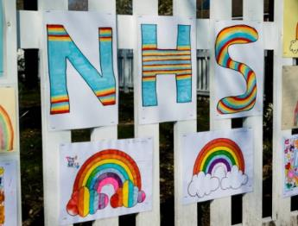
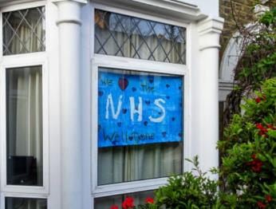
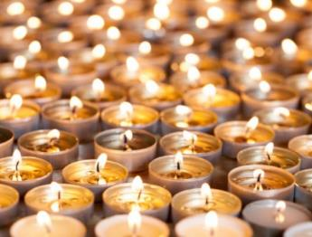
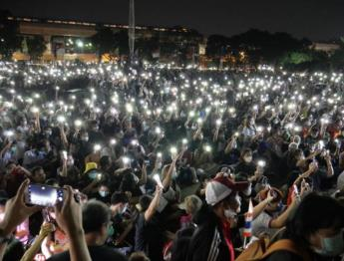
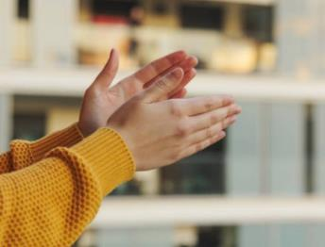
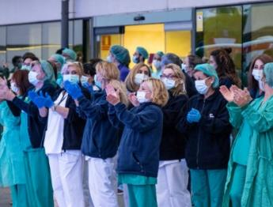
Now…
Ext: Happy Birthday NHS!
The first way you can get involved is by getting creative! Make posters, cards and display them so that everybody can see them!
On Saturday…
At 8pm, light up a candle or torch in your window or on your doorstep to remember the people that have lost their lives during the pandemic.
On Sunday…
Get ready for the biggest clap yet! At 5pm, wherever you are, clap as loud as you can for the NHS. You could even cheer!

Slide 39



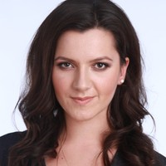
Career Launchpad!
Lean more… NHS Birthday Celebrations!
Sunday 5th July marks the 72nd birthday of the NHS, and /Together have a range of ideas of how you can get involved! As well as taking part in the activities you learned about earlier, click the image to read up on how they want to make sure that we all continue to be kind to each other in the months & years ahead.
0:00-1:44
Career Spotlight:
This is Alice. She is the current Director of /Together, an organisation striving to create a kinder, closer and more connected society.
Click the image to find out more about her job and some of the events they have coming up (including The Big Thank You!).
https://safeshare.tv/x/sdodO0KJKJw
Notes:
Alternative Video Link: https://youtu.be/sdodO0KJKJw
Images:
explore.org
BBC Earth

