Slide 1
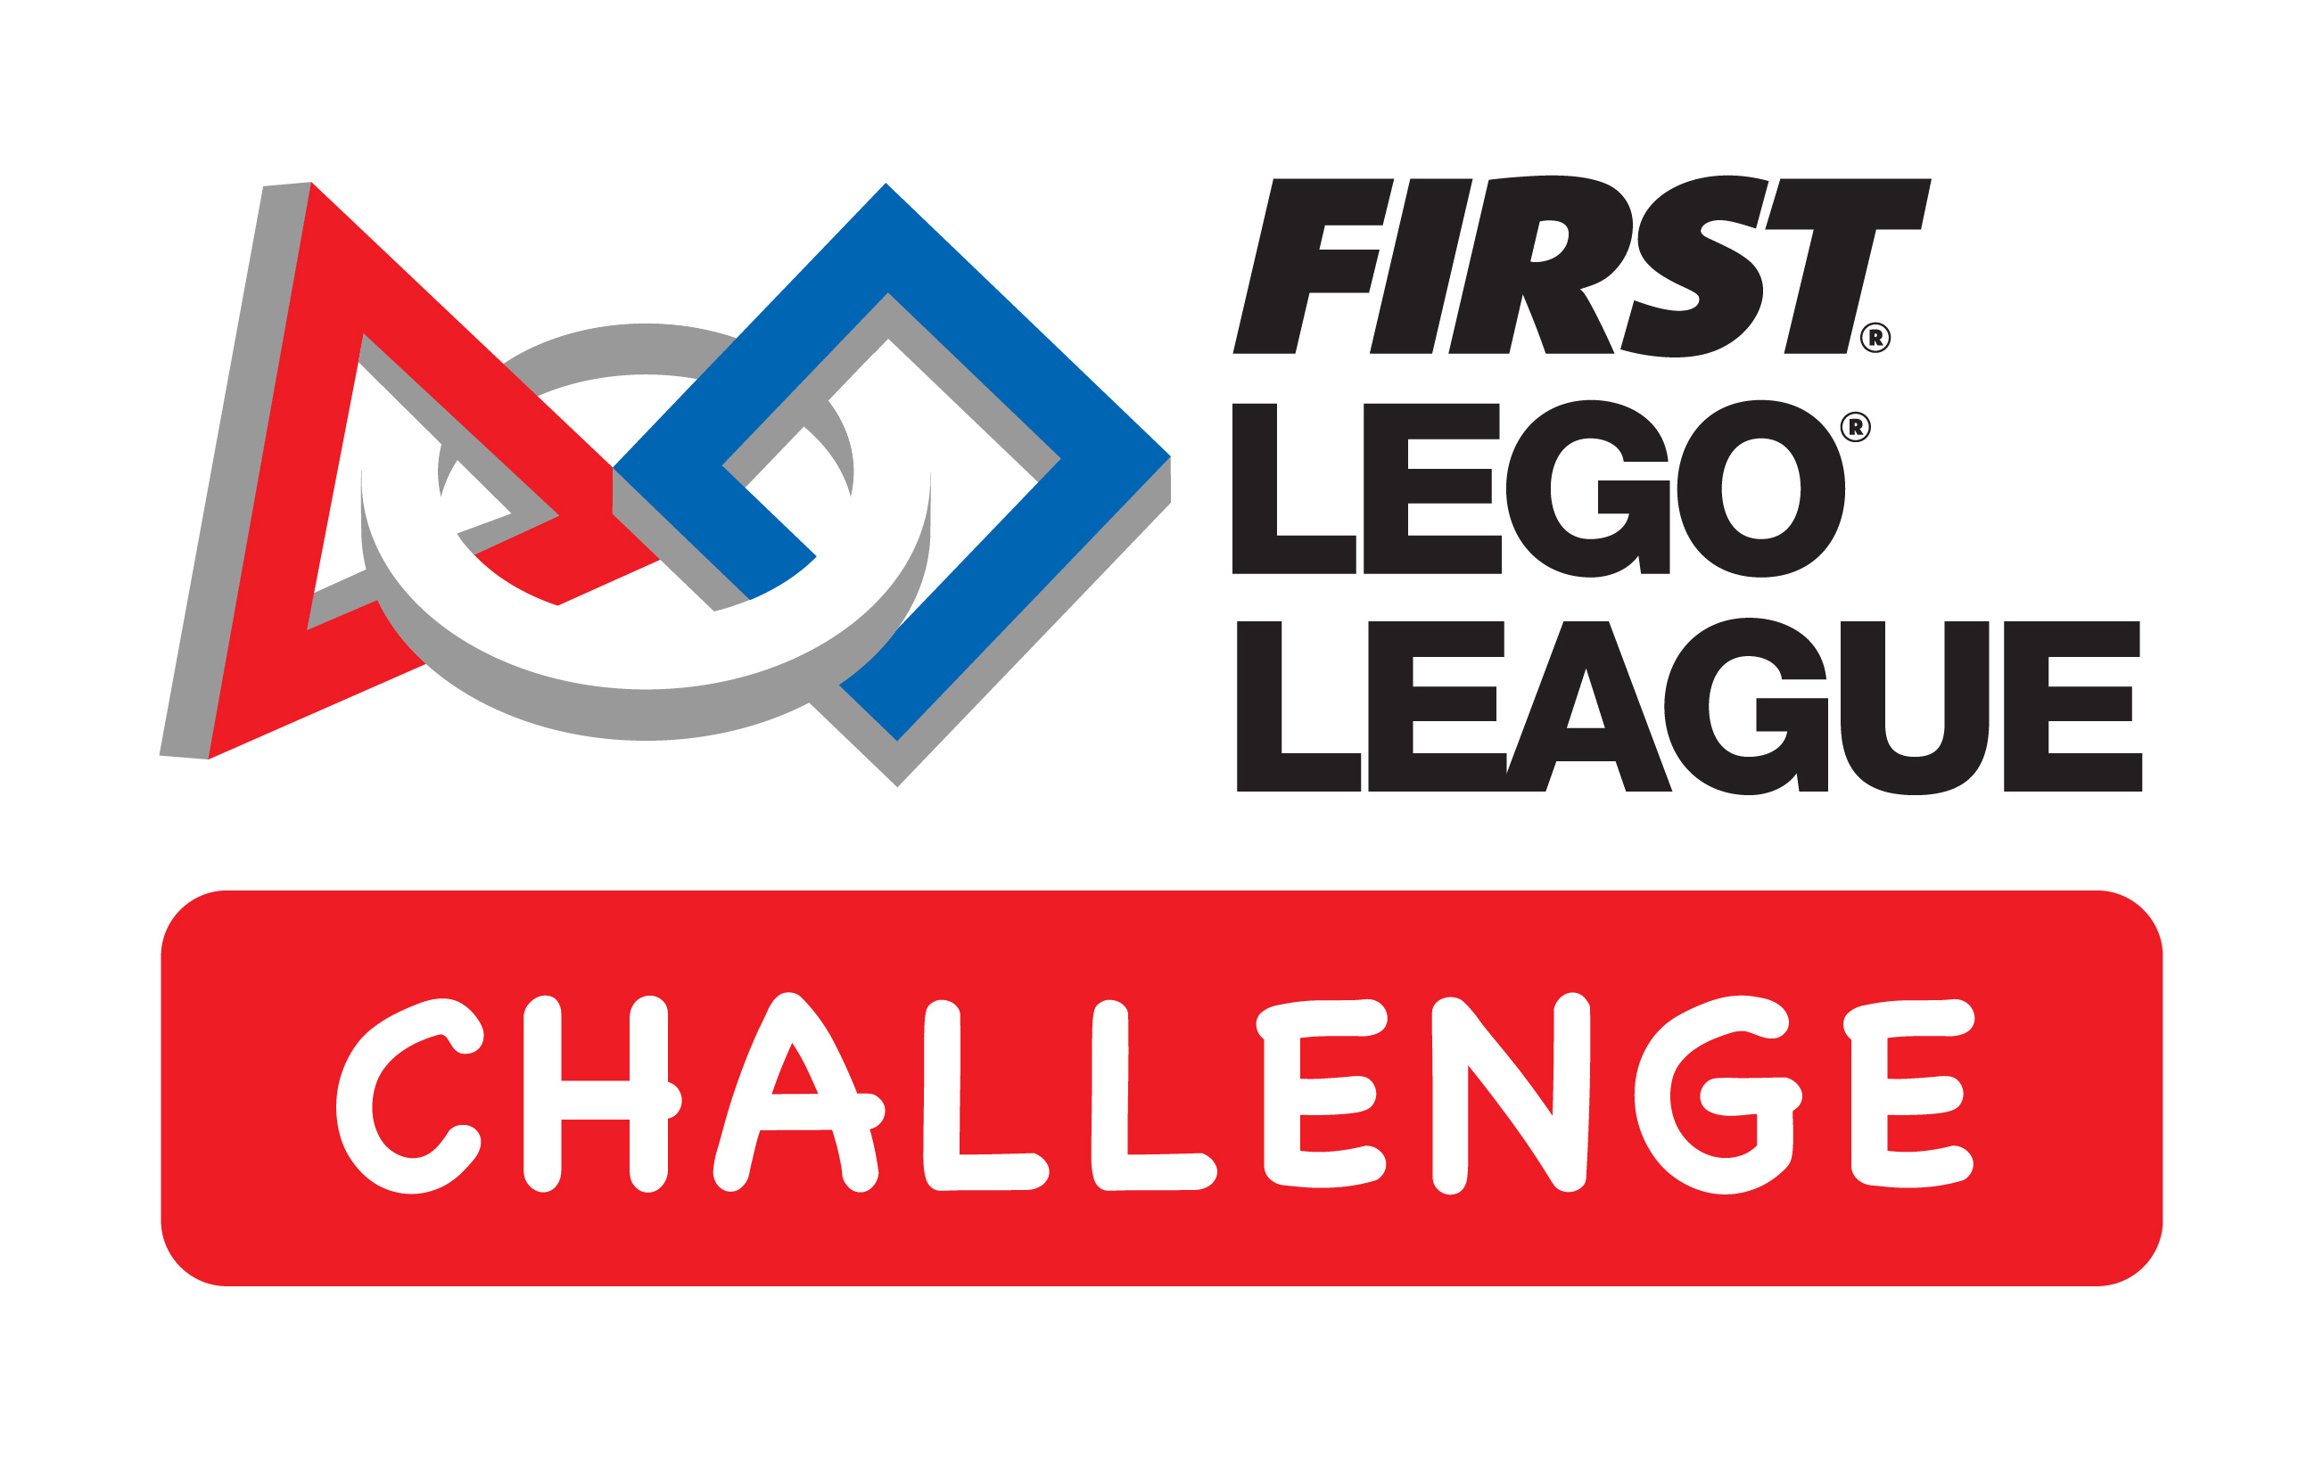
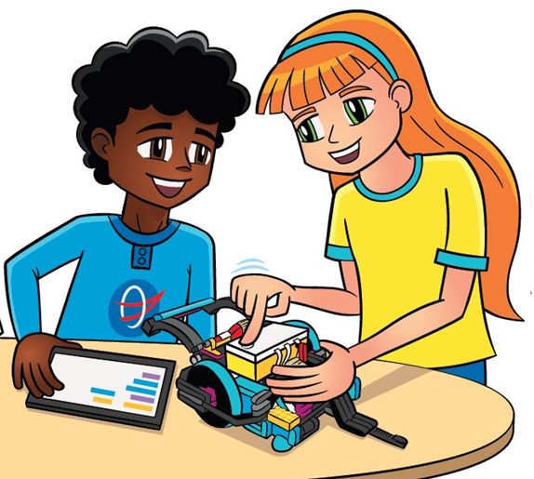
Introduction

Slide 2

What is FIRST® LEGO ® League?
Visit the
FIRST® LEGO ® League
YouTube Channel
to watch the
What is FIRST LEGO League video

Slide 3
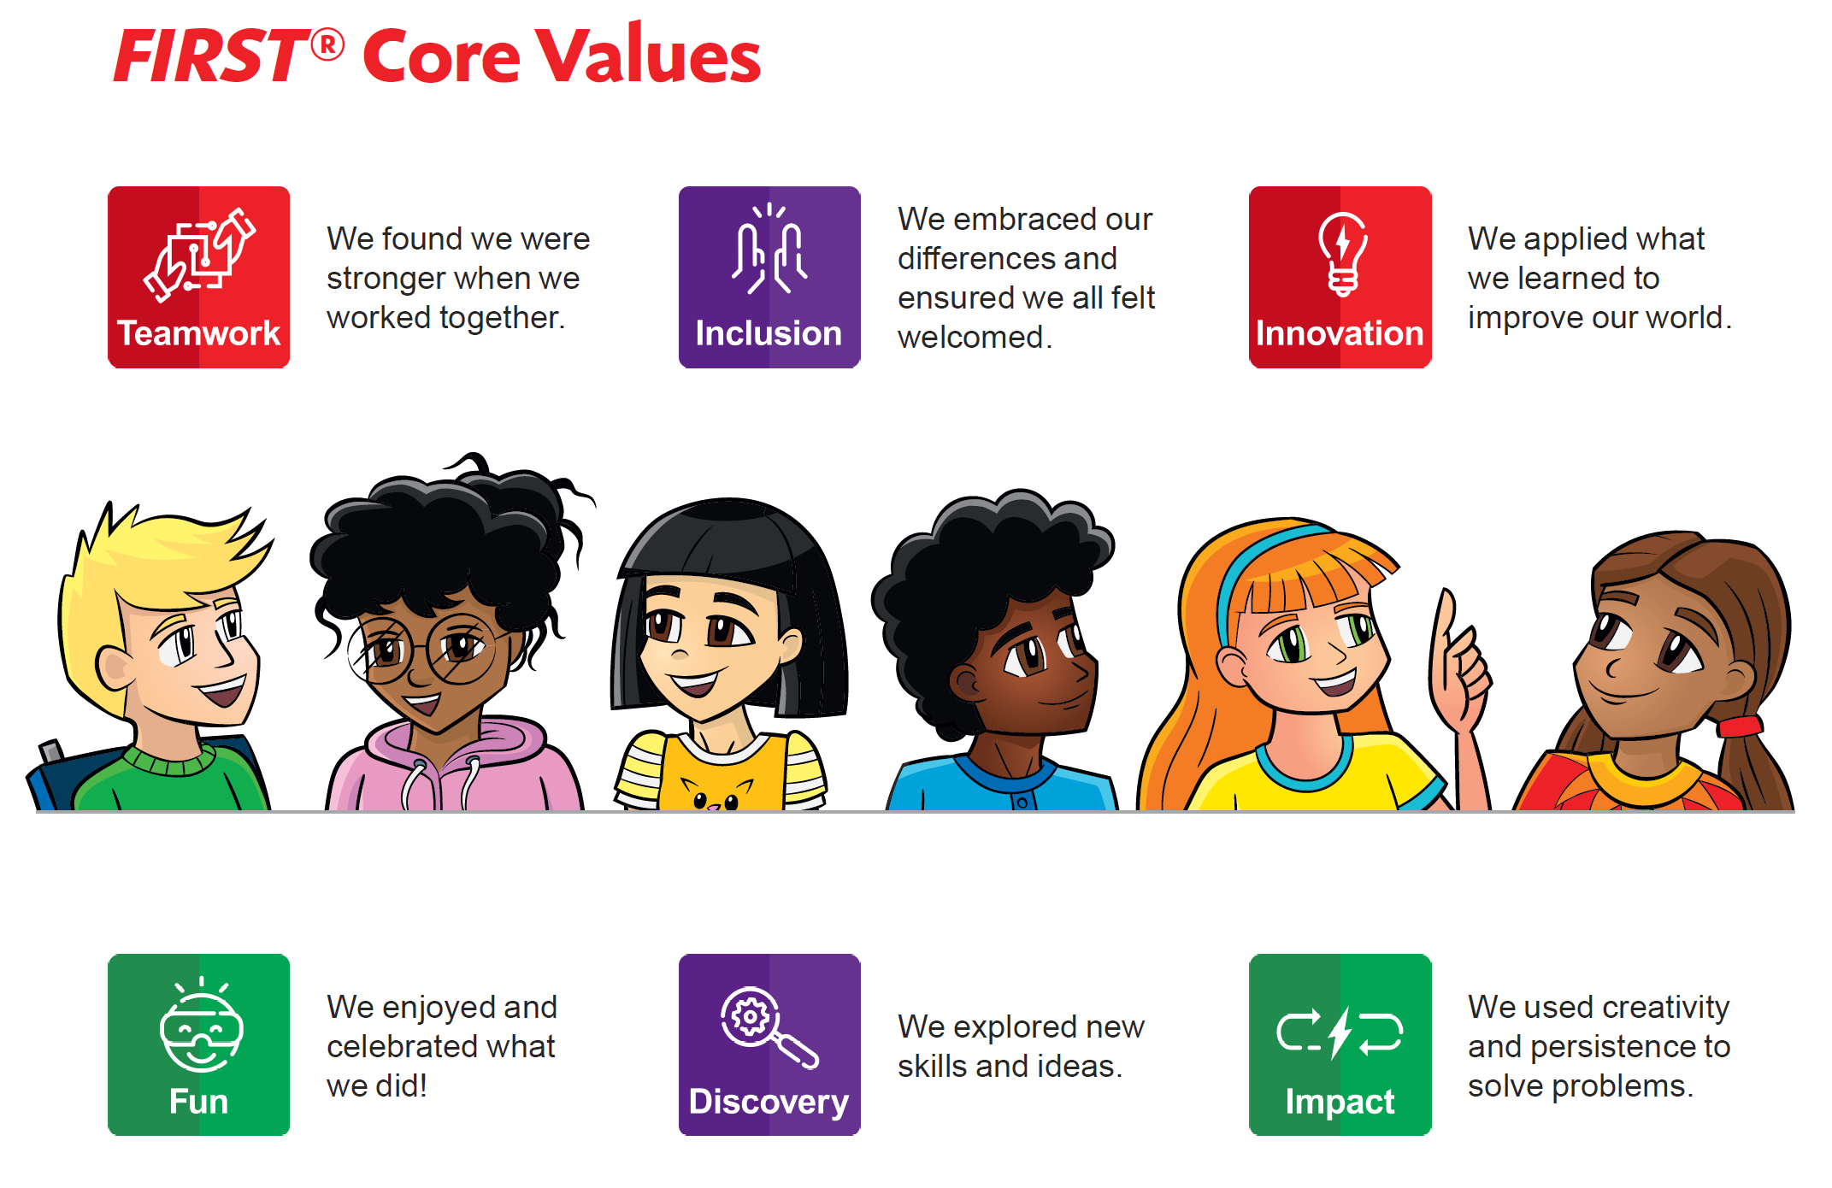
Welcome
Notes:
FIRST® Core Values
The FIRST® Core Values are the cornerstones of the program. They are among the fundamental elements of FIRST LEGO League. By embracing the Core Values, children use discovery and exploration of the theme in each session and learn that helping one another is the foundation of teamwork. It is important that the children have fun. The more playful the sessions are, the more motivated the children will be.
Gracious Professionalism® is a way of doing things that encourages high-quality work, emphasizes the value of others, and respects individuals and the community. The team’s Core Values and Gracious Professionalism will be evaluated during Robot Game matches and during the judging session at the tournament. The team demonstrates Coopertition® by showing that learning is more important than winning and they can help others even as they compete.

Slide 4
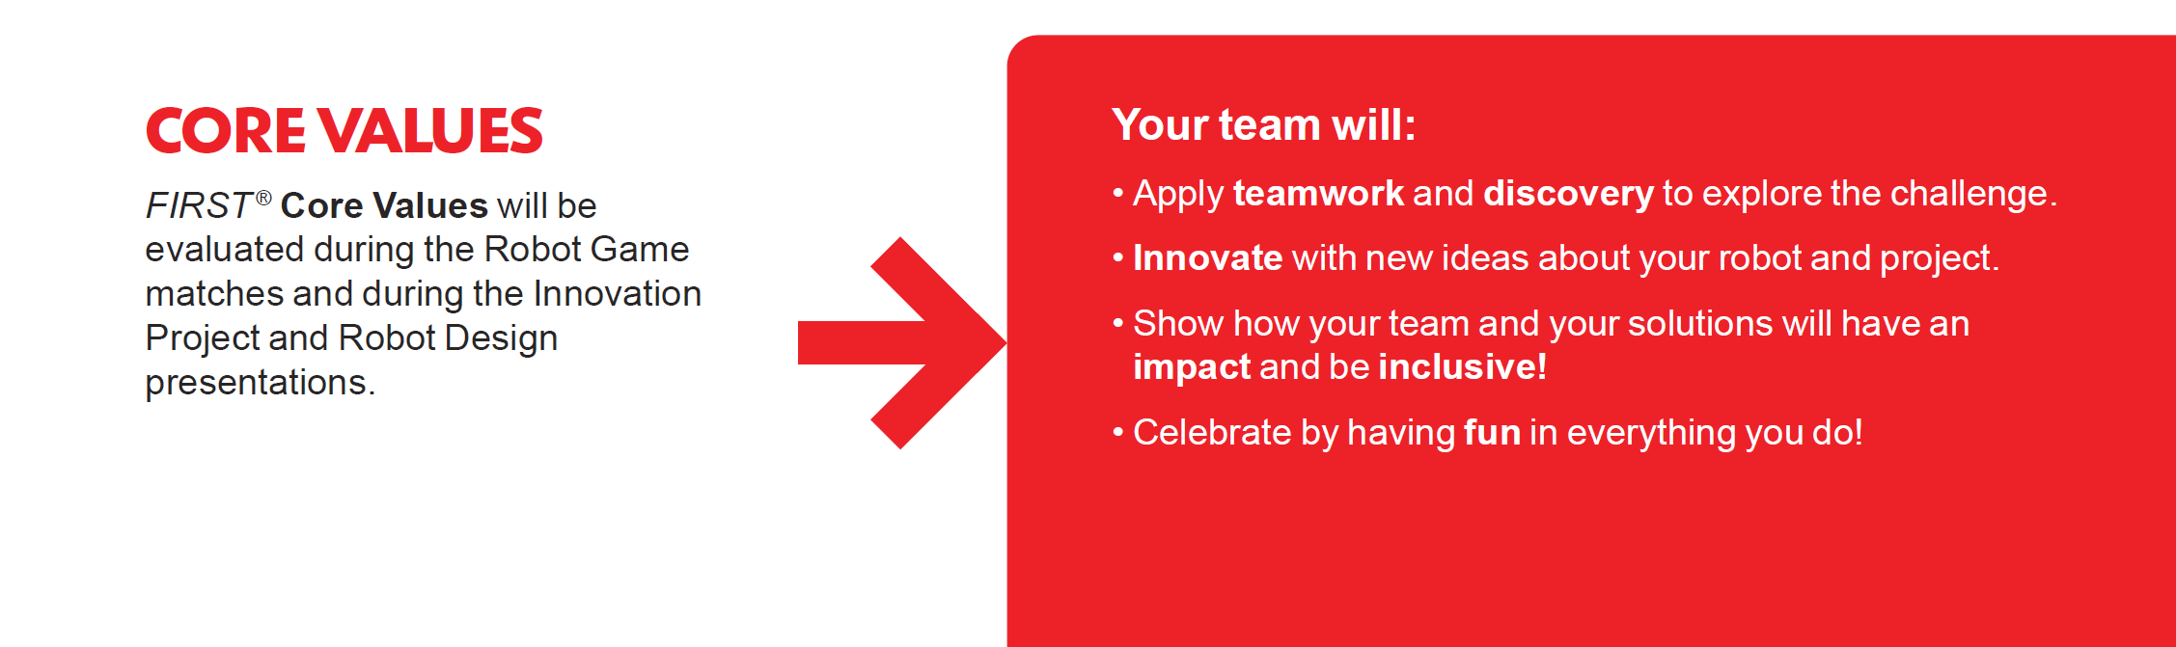
FIRST ® LEGO ® League Challenge Overview

Slide 5
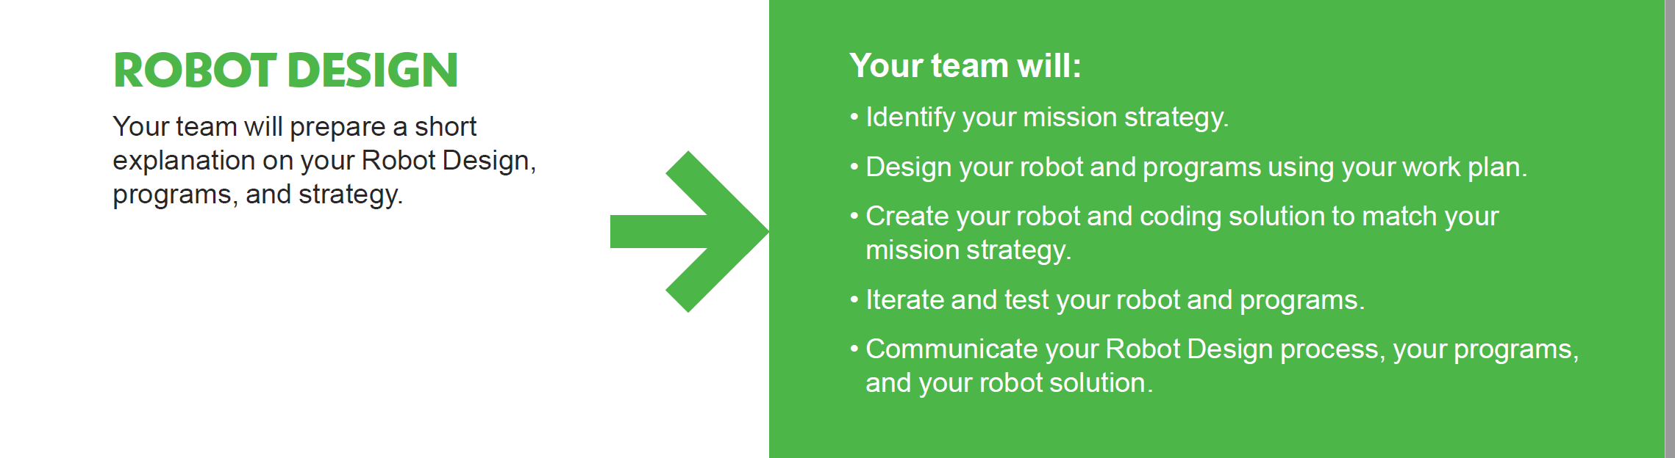
FIRST ® LEGO ® League Challenge Overview

Slide 6
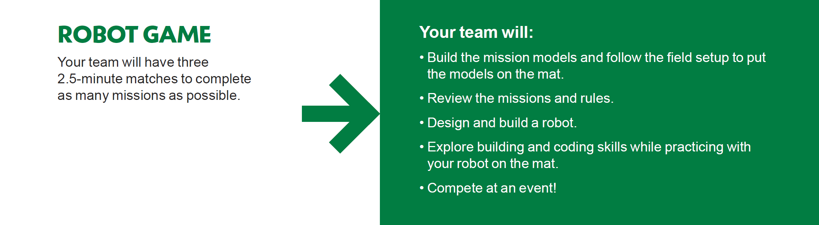
FIRST ® LEGO ® League Challenge Overview

Slide 7
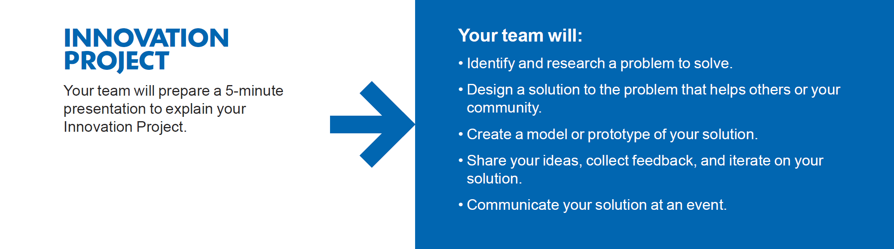
FIRST ® LEGO ® League Challenge Overview

Slide 8
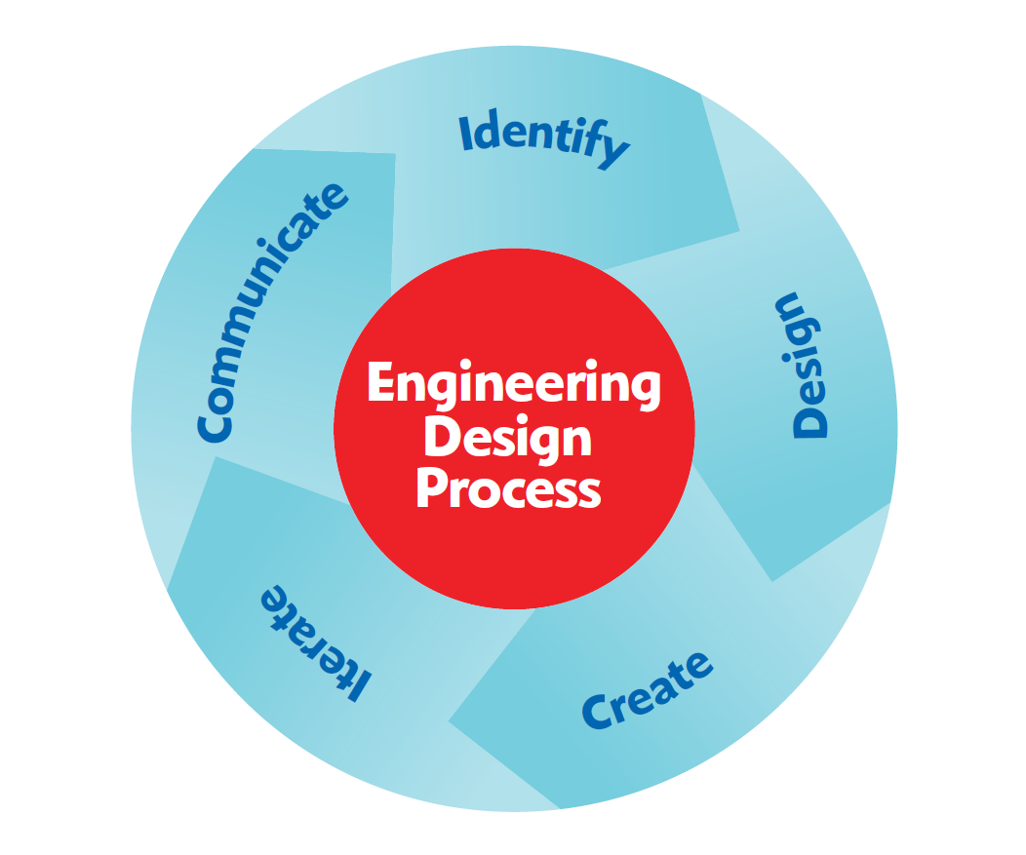
Notes:
During the sessions, the team will use the engineering design process. The team will identify, design, and create solutions and test, iterate, and improve them. The team will then share and communicate what they learned with others. The rubrics used in judging capture the engineering design process used to create both the robot and Innovation Project solutions.

Slide 9
CARGO CONNECTSM
Visit the
FIRST® LEGO ® League
YouTube Channel
to watch the
CARGO CONNECT season launch video

Slide 10
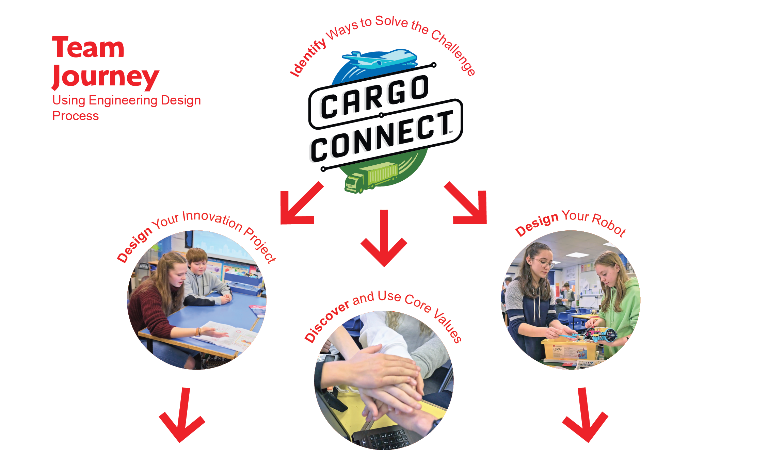


Slide 11
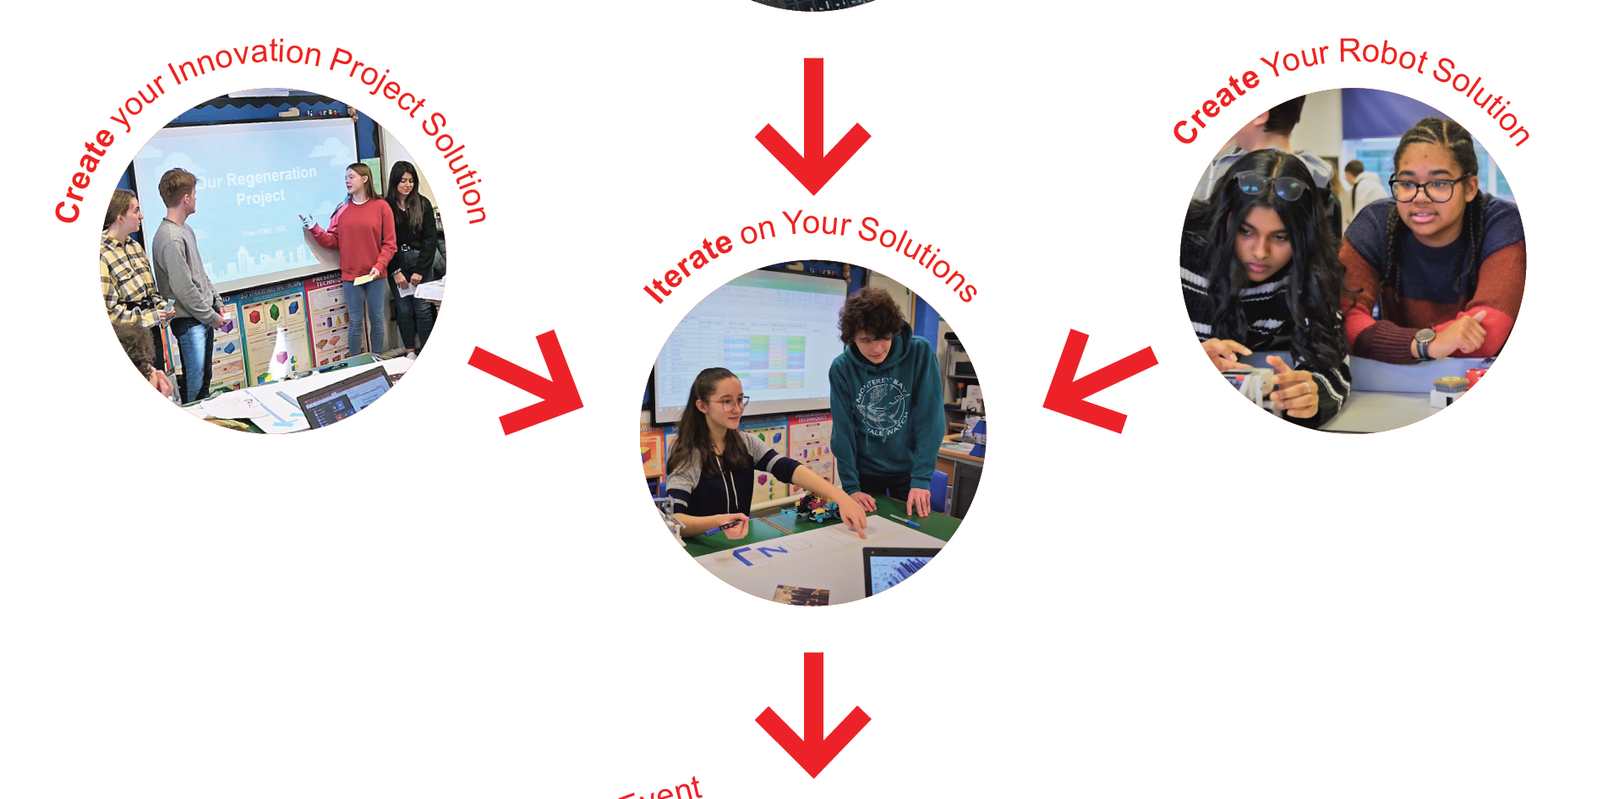

Slide 12
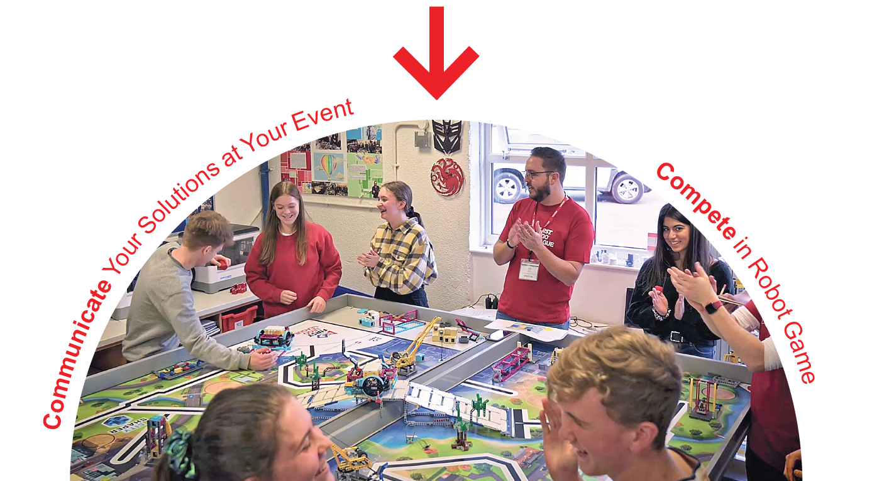

Slide 13
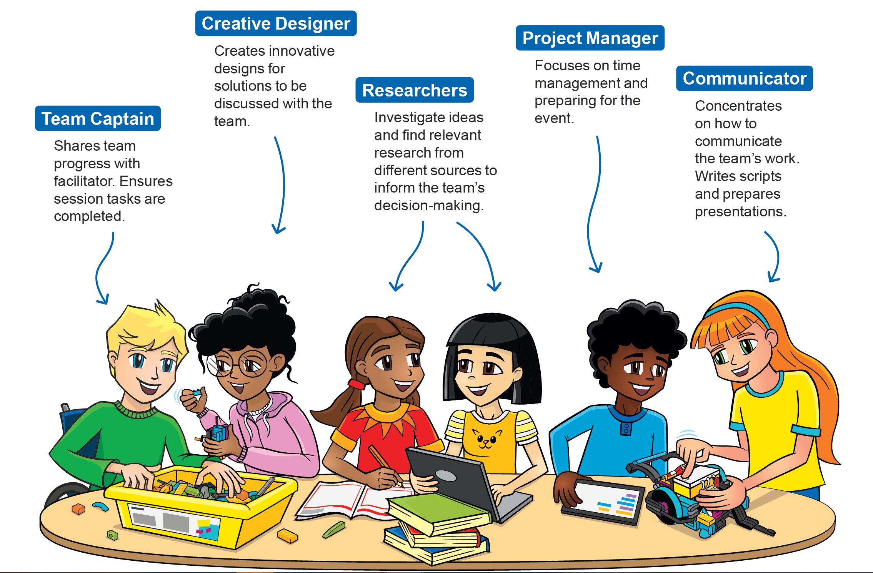
Team Roles
What roles will you use on your team?

Slide 14
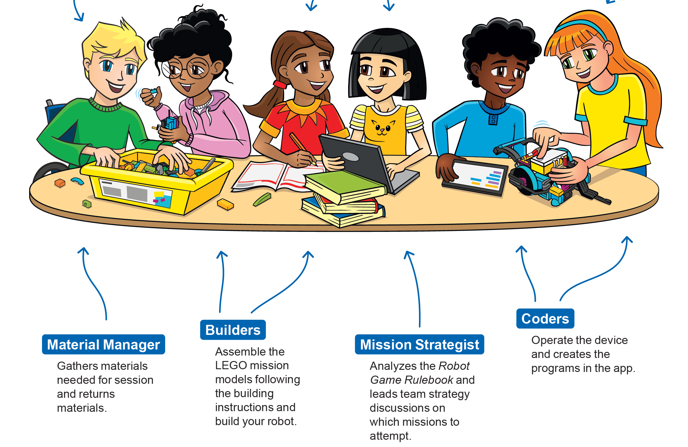
Team Roles

Slide 15
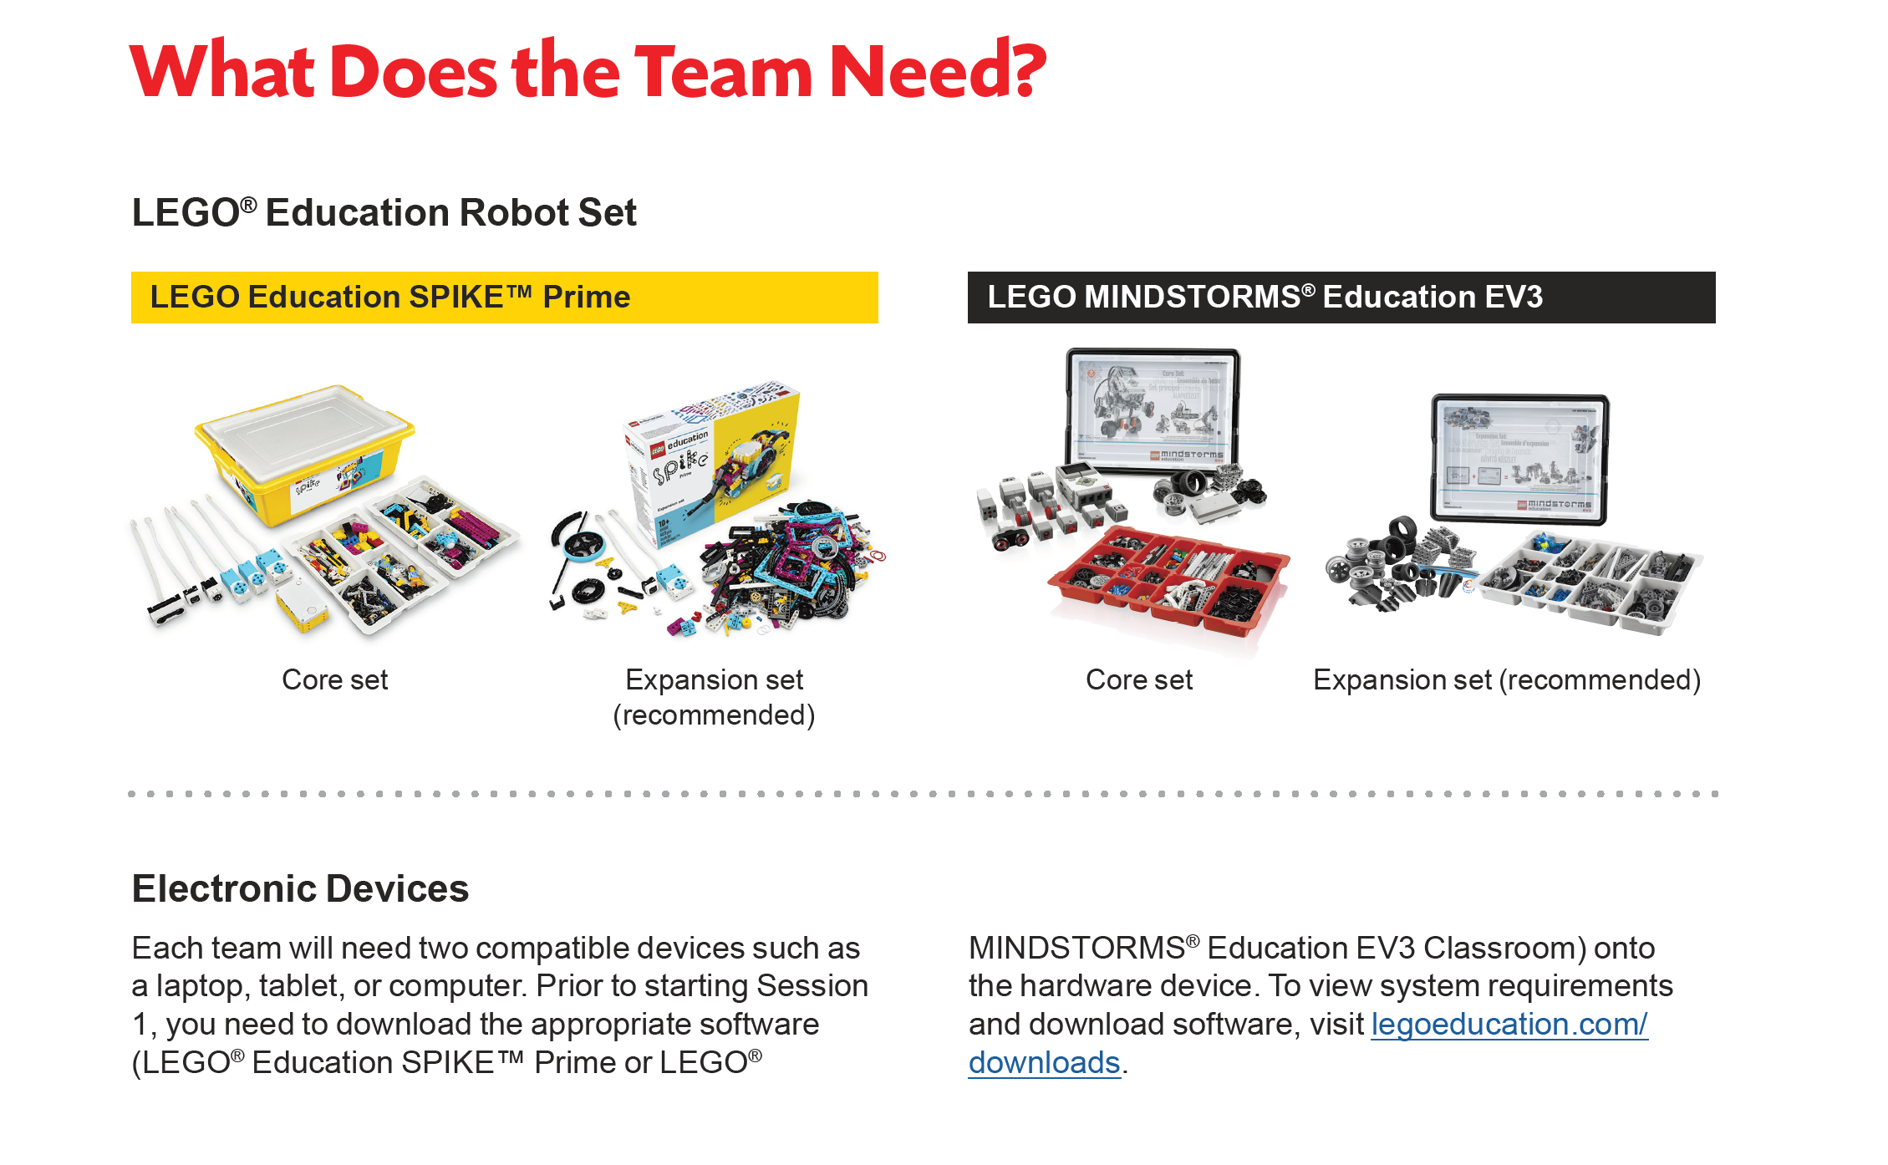

Slide 16
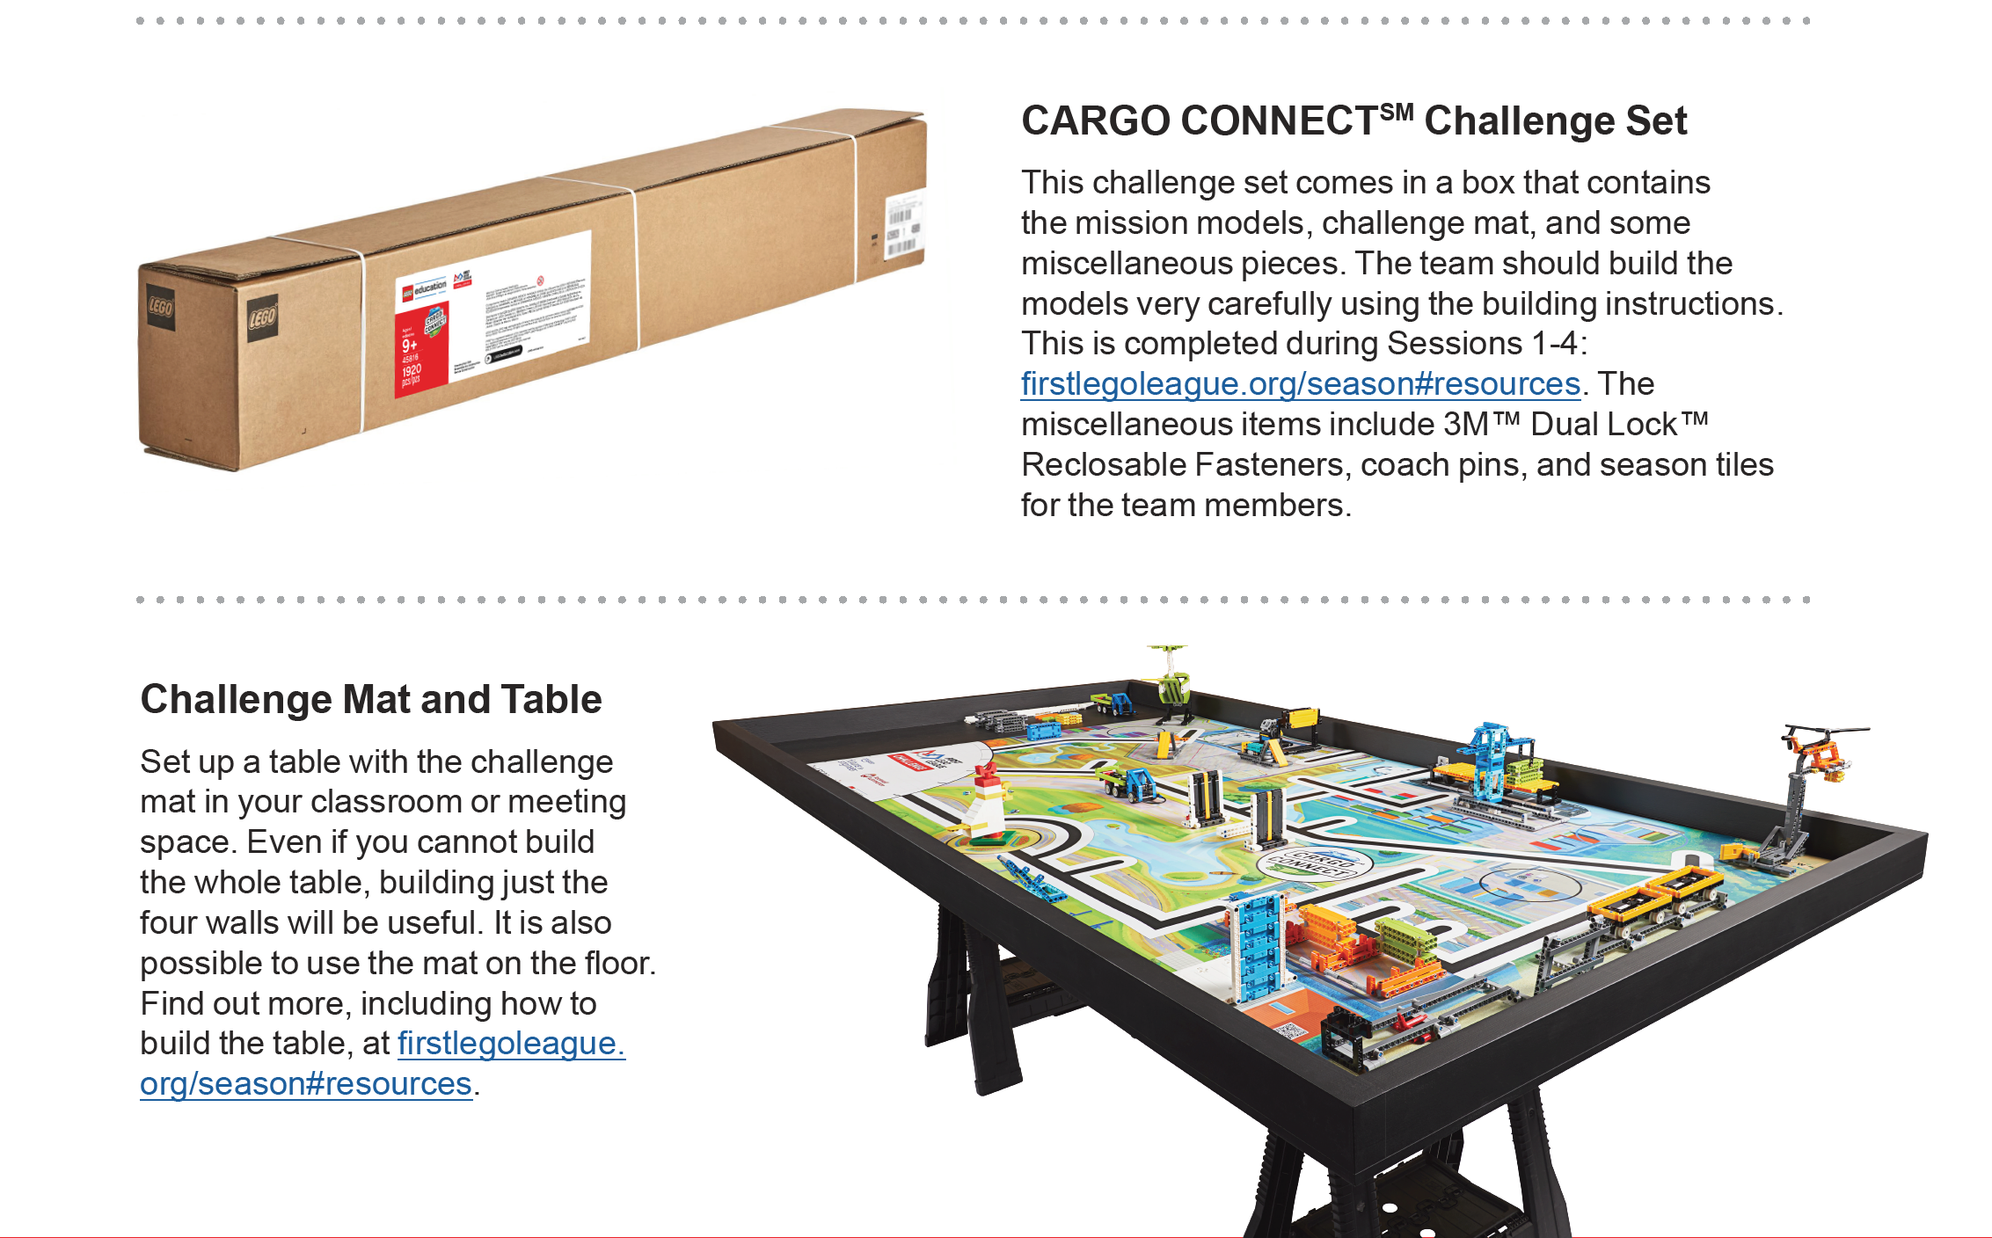
Notes:
Pre-Session Checkpoint
Please read the student Engineering Notebook, Robot Game Rulebook, and this Team Meeting Guide before starting the sessions. They are full of very useful information to guide you through this experience. Use this checkpoint to help you get started and guide you toward success.
You need at least two devices with Internet access and appropriate LEGO® Education app installed per team.
Unpack the robot set and sort the LEGO elements into the trays.
Make sure the controller is charged or has batteries in it.
Explore the FIRST® Core Values. These are the essential foundation for your team.
Watch the season videos on the FIRST LEGO League YouTube channel.
If the team is new to using their LEGO Education robot set, it would be beneficial to take some time for them to get acquainted building and coding with the set. The team could complete the Getting Started activities in the relevant LEGO Education app.
Have a location to place the mat and models after each session if they have to be stored.

Slide 17
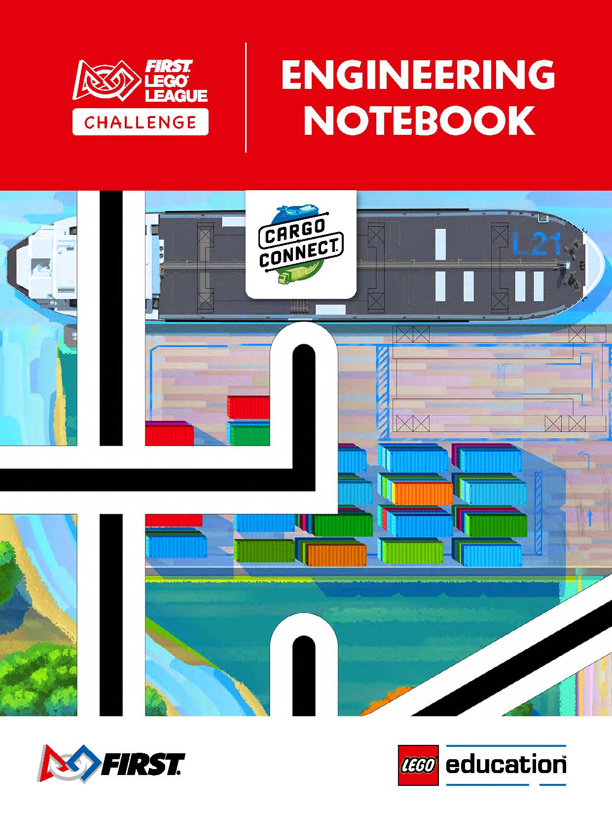
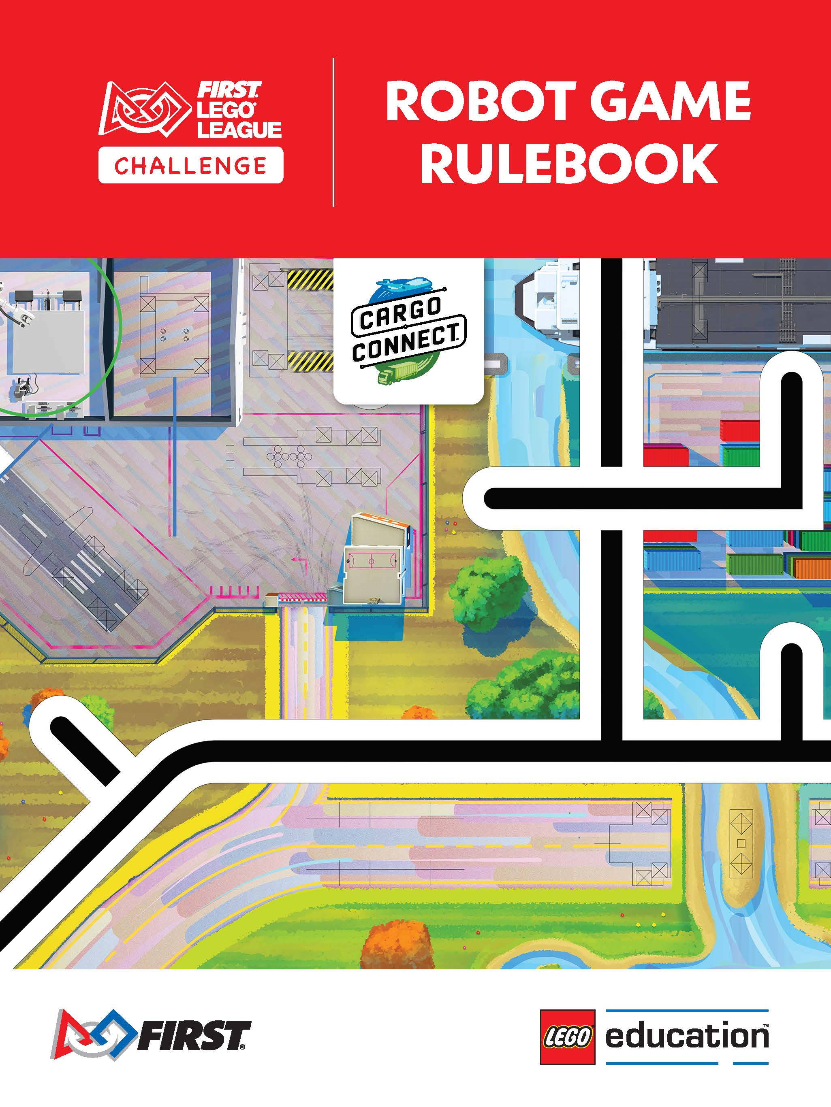
Notes:
ENGINEERING NOTEBOOK TIPS
Read the Engineering Notebook carefully. The team will share the notebooks and work on them collaboratively.
The notebook contains relevant information and guides the team through the sessions.
The tips in this Team Meeting Guide will direct you how to support each session.
As facilitator, help guide the team members in the performance of their roles during each session.
Using the team roles outlined in the notebook can help your team function more efficiently and ensures that everyone on the team is involved.

Slide 18

Clean Up
Notes:
Every session includes time to clean up and properly store the team’s LEGO pieces, devices, and other supplies.

Slide 19
FIRST® and the FIRST® logo are registered trademarks of For Inspiration and Recognition of Science and Technology (FIRST). LEGO® and MINDSTORMS® are registered trademarks of the LEGO Group. FIRST® LEGO® League and CARGO CONNECTSM are jointly held trademarks of FIRST and the LEGO Group. SPIKE™ Prime is a trademark of LEGO® Education. All other trademarks are the property of their respective owners. ©2021 FIRST and the LEGO Group. All rights reserved.

