Slide 1

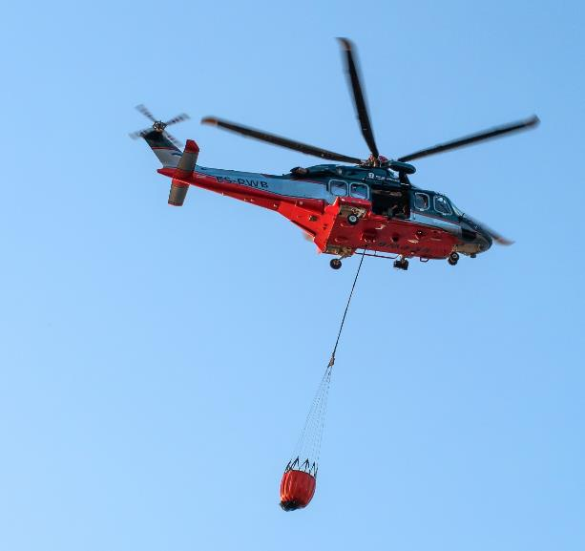
Session 3

Slide 2
Session Overview
Outcomes
The team will code their robot to avoid obstacles using a sensor and to power an attachment.
The team will make connections from the mission models to the Access Project Spark ideas.
Notes:
Facilitator Tips
As the team completes the sessions, ask them to collect evidence of their use of the Core Values. What does it look like, what does it sound like when people are using the Core Values appropriately?

Slide 3
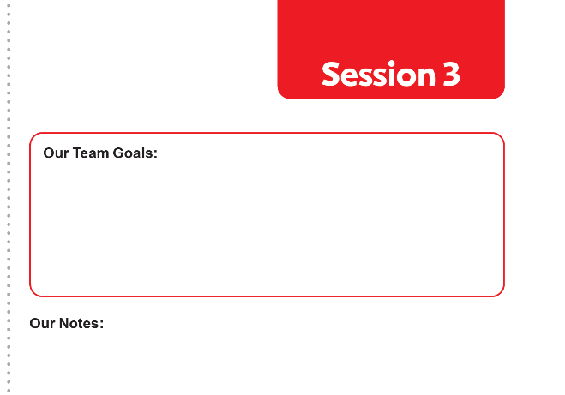
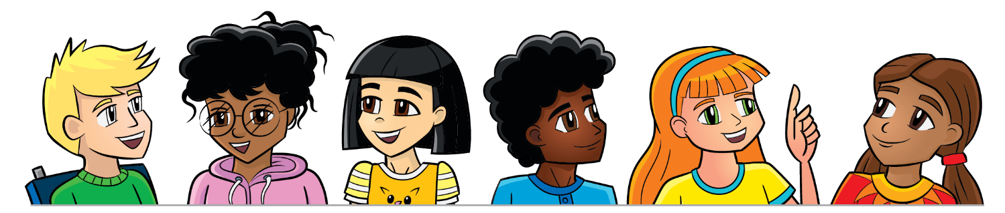
Introduction
Now that you’re familiar with FIRST® LEGO® League Challenge, discuss the goals you want to achieve for the season.
Talk about what processes your team will follow and determine responsibilities.
Notes:
Facilitator Tips
Goals should be tangible and something the team can achieve. The team can read over the judging rubrics for ideas.
Team planning and project management is important to achieve goals and be ready for the tournament.

Slide 4
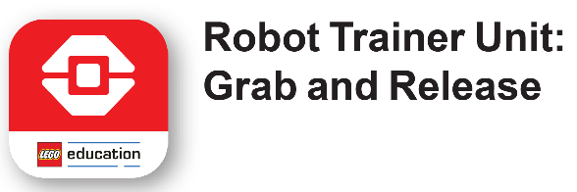

Robot Lesson 3
Open the SPIKE™ Prime or EV3 Classroom app. Find your lesson.
Recognize the skills you learned that will be beneficial in completing missions.
Notes:
Facilitator Tips
Have the team check that the wires are plugged into the right ports and that the ports used match their program.
To make missions easier to complete, the team can build LEGO® attachments and fit them onto the robot.
Robot Game Connection: Have the team think about how to use the attachment from the robot lesson to complete missions.

Slide 5
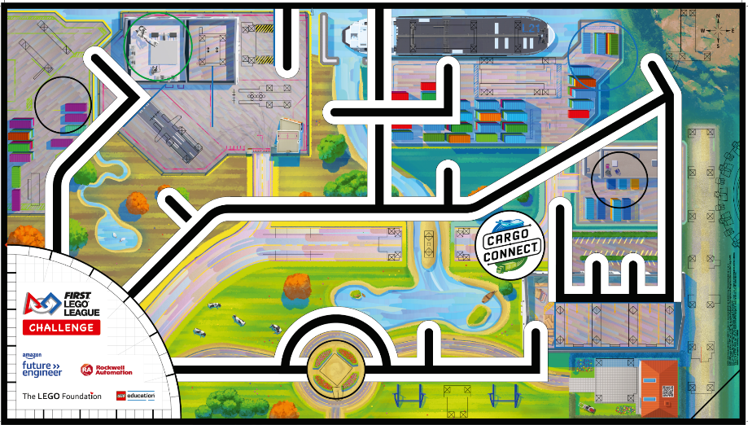
Robot Lesson 3
Reflection Questions
Can you code your robot to navigate to a model on the mat?
What objects does your robot need to avoid?

Slide 6

Access Project Spark
How can you ensure cargo is transported to where it needs to go, especially when the location is difficult to access? Well-maintained infrastructure and innovative ways to reach isolated areas should be considered.
Think about…
Maintenance of roads, tracks, and transportation systems.
Repair of infrastructure.
Creation of new transportation networks to improve access.
Innovative new forms of transportation.
The models you built this session relate to missions in the Robot Game that represent improving access to delivery destinations.

Slide 7
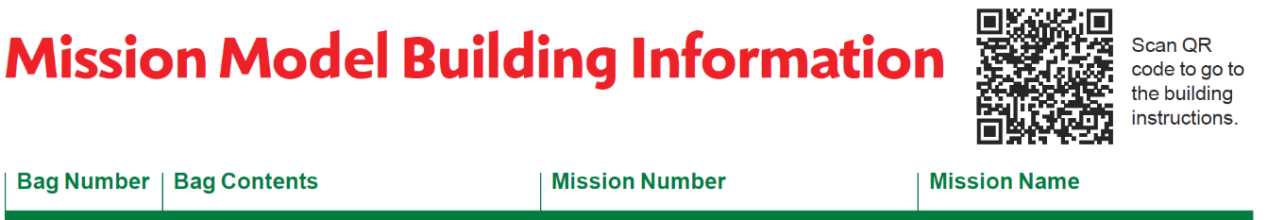
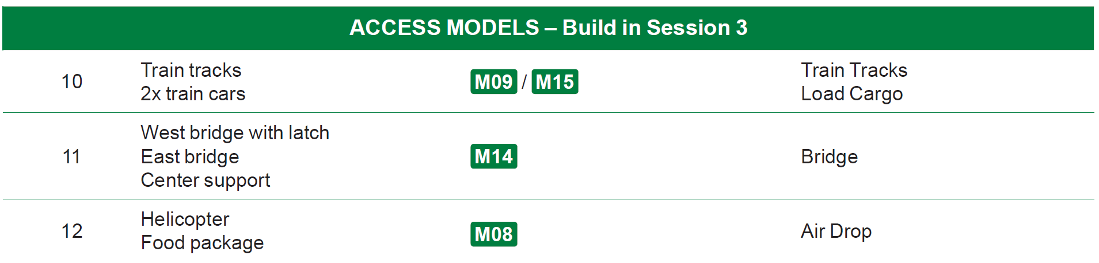
Access Project Spark
Build the Access models in Bags 10-12 using Building Instruction Books 10-12.
Notes:
Facilitator Tips
Provide the digital building instructions Books 10-12 to the team.
The team will need Bags 10-12 from the Challenge set.

Slide 8
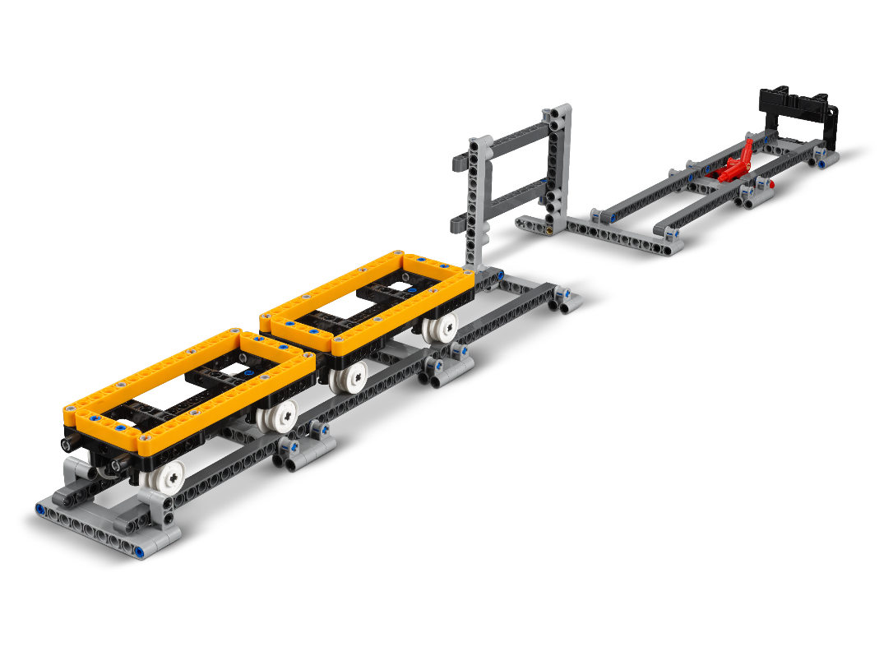
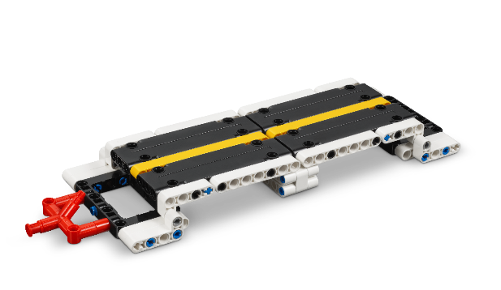
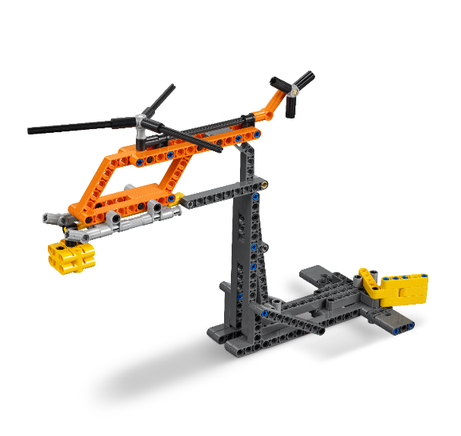
Access Project Spark
Connect the missions to the models you built.
Discuss how the models are linked to the problem presented
Notes:
Facilitator Tips
Consider inviting an expert or someone who works in this area to talk about the Project Sparks.

Slide 9
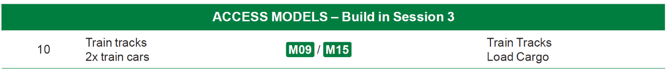

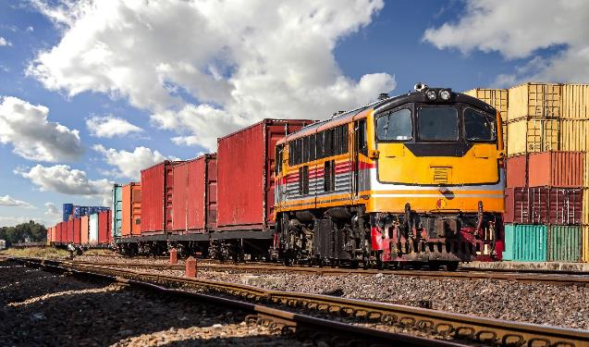
Train Tracks

Slide 10
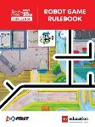
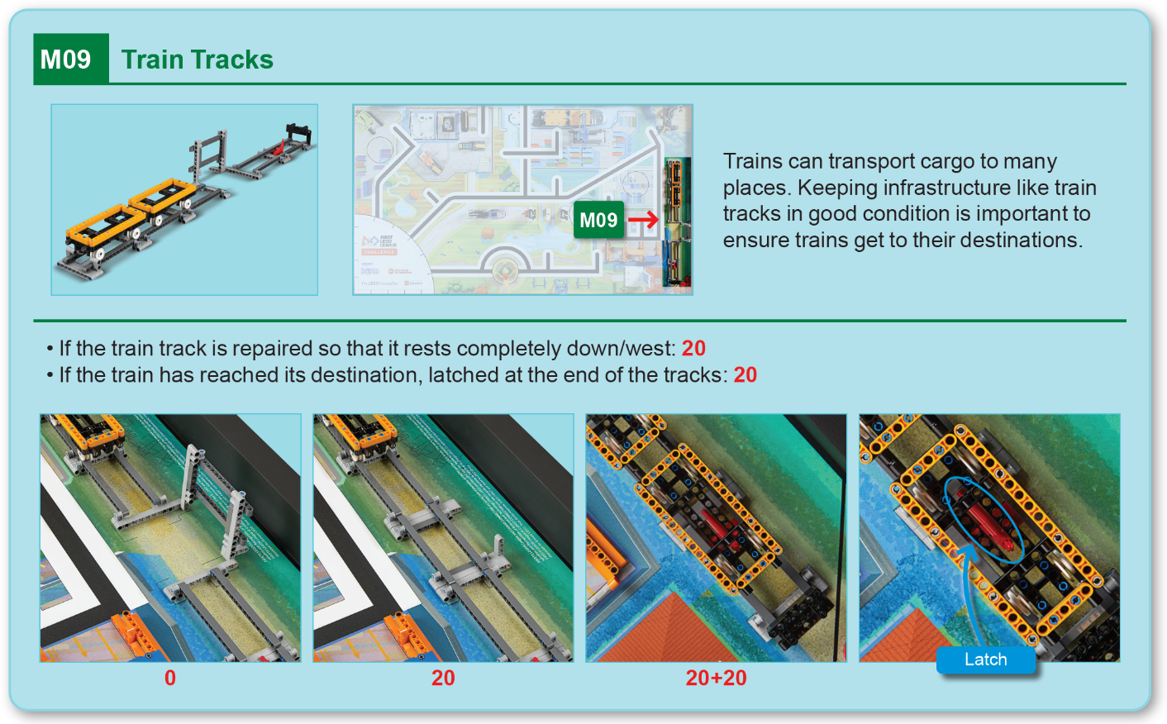
Robot
Game
Rulebook
page 16

Slide 11
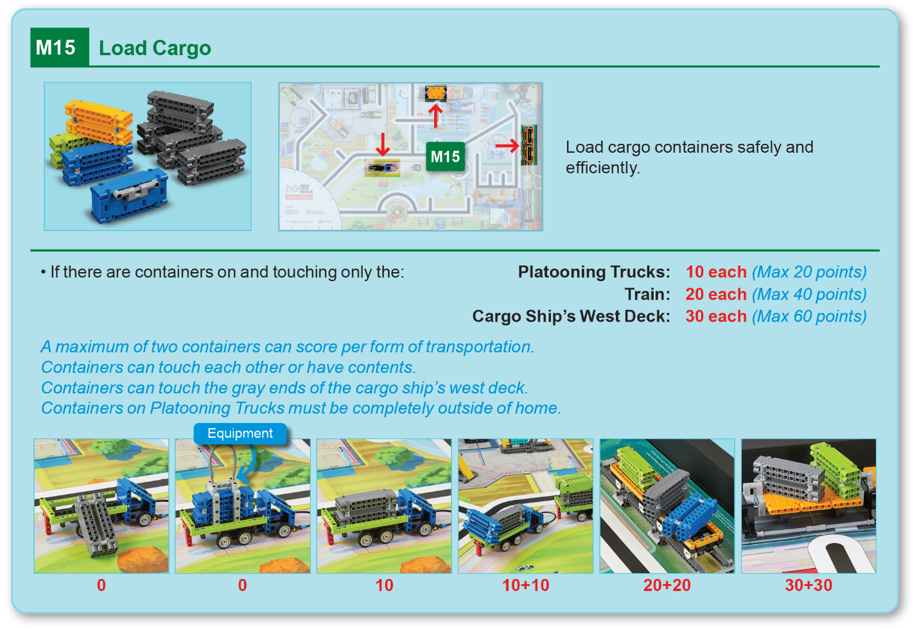
Robot
Game
Rulebook
page 19

Slide 12

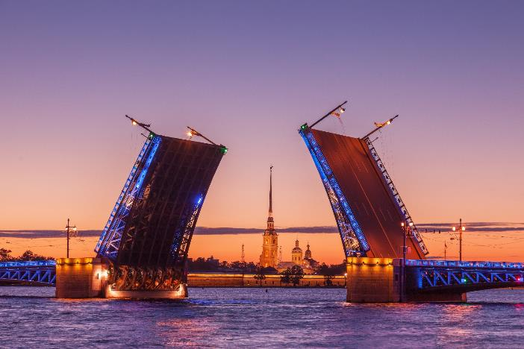
Bridge

Slide 13
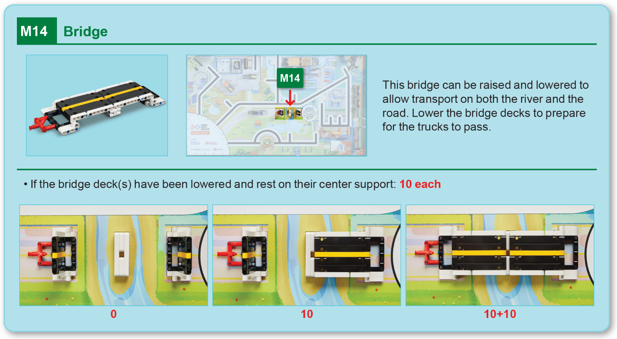
Robot
Game
Rulebook
page 19

Slide 14

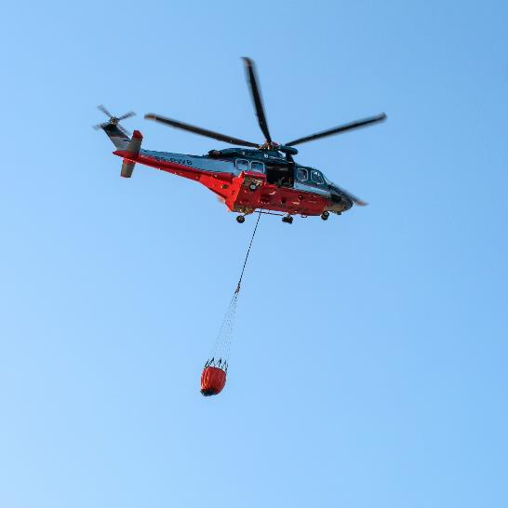
Air Drop

Slide 15
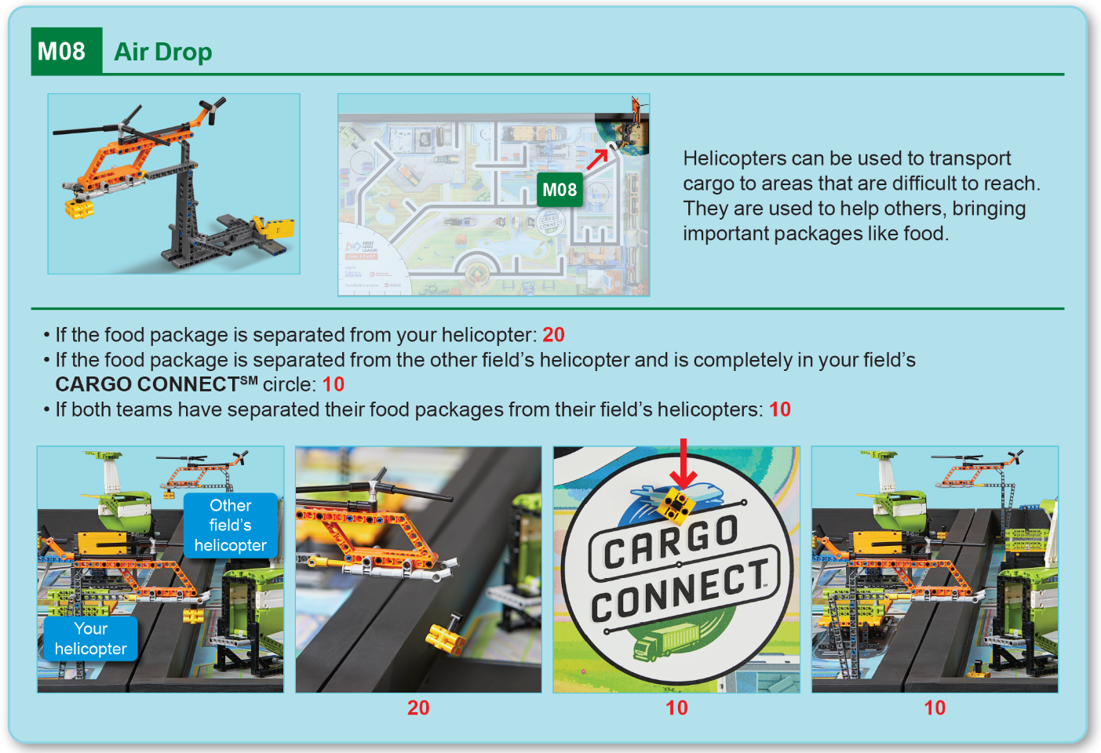
Robot
Game
Rulebook
page 16

Slide 16
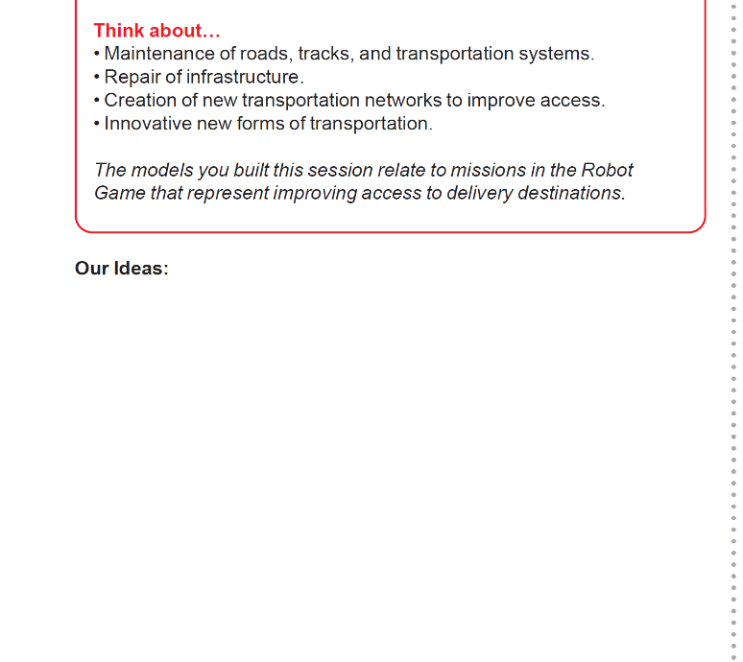
Access Project Spark
Brainstorm and record your ideas that relate to this Project Spark.
Create a list of your innovative ideas.
Notes:
Facilitator Tips
The team will learn about four different Project Sparks to inspire their Innovation Project. Have them keep notes of their ideas.
The team can think of ways to improve existing solutions to the Project Sparks. Their ideas don’t have to be brand new.

Slide 17
Share
Get together at the mat.
Place each model where it belongs.
Share how the models work and the robot skills you learned.
Demonstrate the models’ functions and how they connect to the Project Spark.
Talk about the reflection questions.
Clean up your space.

Slide 18
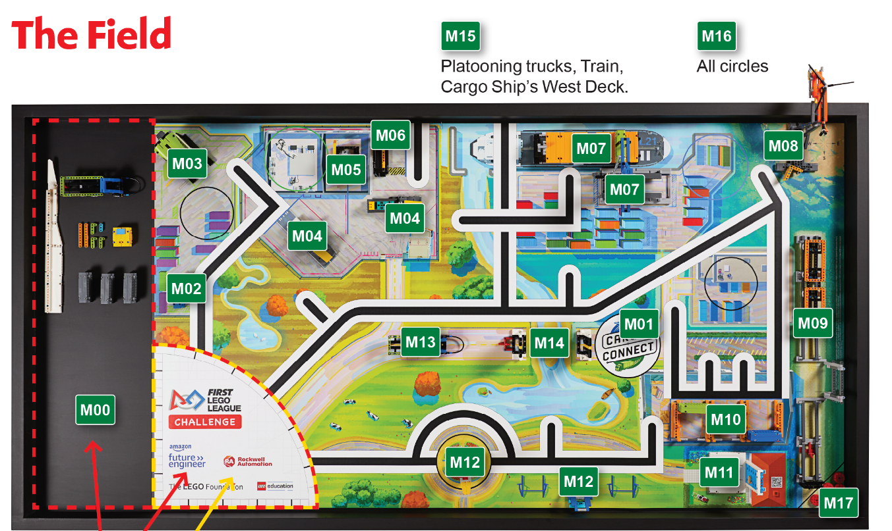
Models built this session are for the circled missions.
Notes:
Place the completed models on the mat with Dual Lock™ according to the field setup in the Robot Game Rulebook.

Slide 19

Reflection Questions
Are there any places in your community that would be hard to access to make a delivery?
Can you think of ways to improve access to remote areas?
How does a courier deliver packages to isolated areas?

Slide 20
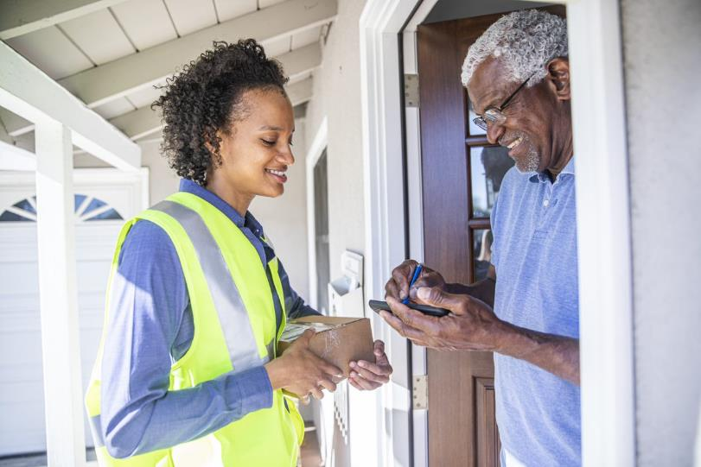
Career Connections
Courier
Role:
Transports and delivers packages to customers.

Slide 21

Multimedia Resources
You may wish to embed a relevant, age-appropriate video for your students here. See the Notes for an example.
Notes:
Choose a relevant, age-appropriate video for your students.
Here is one example:
This "Flying Drawbridge" Lifts And Lowers In A Unique Way from Tech Insider – Length 3:11
https://youtu.be/Bxh3S5Ov5nE

Slide 22
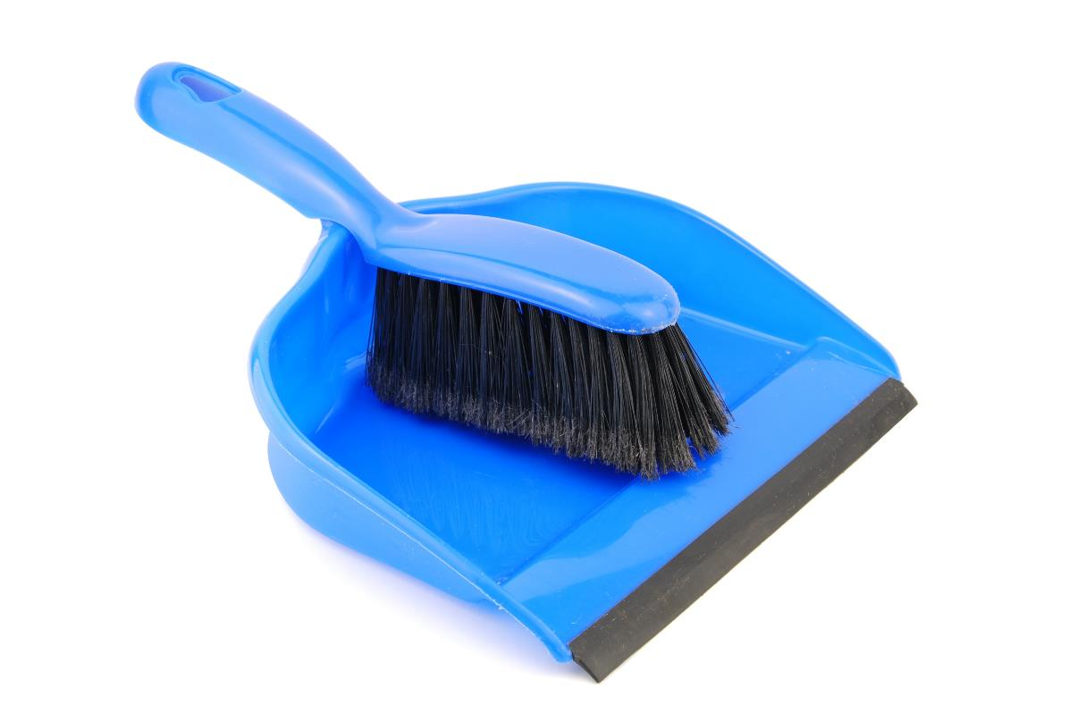
Clean Up

Slide 23

FIRST® and the FIRST® logo are registered trademarks of For Inspiration and Recognition of Science and Technology (FIRST). LEGO® and MINDSTORMS® are registered trademarks of the LEGO Group. FIRST® LEGO® League and CARGO CONNECTSM are jointly held trademarks of FIRST and the LEGO Group. SPIKE™ Prime is a trademark of LEGO® Education. All other trademarks are the property of their respective owners. ©2021 FIRST and the LEGO Group. All rights reserved.

