Slide 1

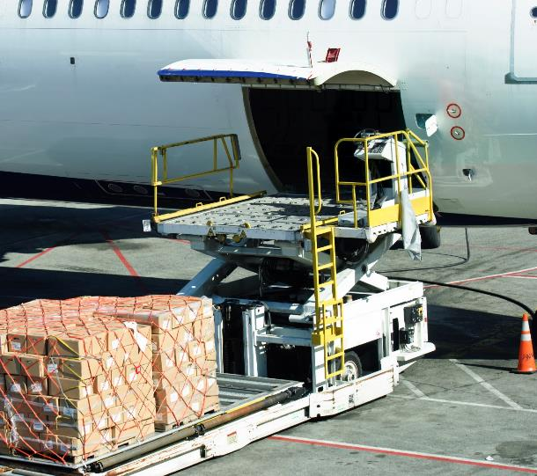
Session 4

Slide 2
Session Overview
Outcomes
The team will build a driving base and code it to move and use the color sensor to follow a line.
The team will make connections from the mission models to the Connections Project Spark ideas.
Notes:
Facilitator Tips
Have the team pick a few mission models to highlight and tell stories about. Provide resources to the team to learn more about the real-world examples and problems the mission models represent and solve.

Slide 3

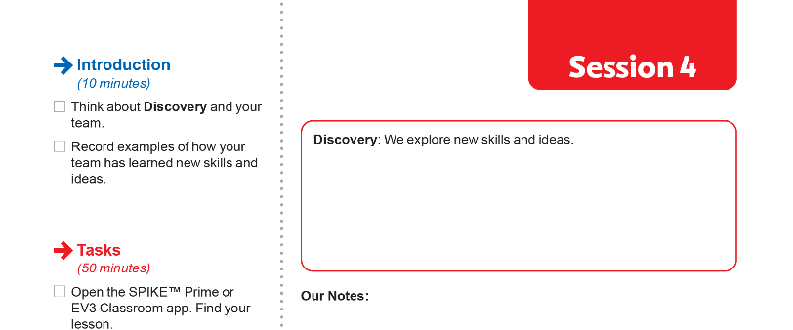
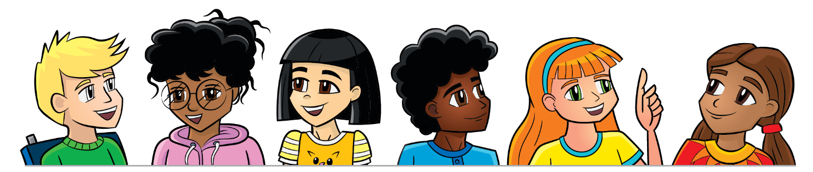
Introduction
Think about Discovery and your team.
Record examples of how your team has learned new skills and ideas.

Slide 4
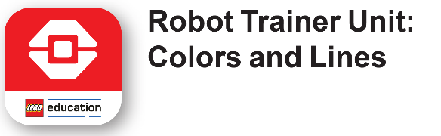

Robot Lesson 4
Open the SPIKE™ Prime or EV3 Classroom app. Find your lesson.
Determine what building and coding skills will help you in the Robot Game.
Notes:
Facilitator Tips
Plug in the controller and open the app periodically to check for software and firmware updates.
Have the team pick out lines on the mat that will help them navigate the robot to different mat areas.
Have the team follow the code on the screen to see how it matches the robot’s actions. This will help them debug their programs.
Try to start the robot in the same or a very similar place each time in the Launch area.
Robot Game Connection: Have the team adapt and test out their line-following program on the mat.

Slide 5

Robot Lesson 4
How does a warehouse worker ensure cargo is sorted correctly in the sorting center?
Reflection Questions
What attachment could you create for your robot?
How would you code an attachment?

Slide 6

Connections Project Spark
Transporting cargo across different forms of transportation can have a great impact on the overall journey. How can we improve the connections between different forms of transportation?
Think about…
Mechanisms for sorting goods.
Devices for unloading or loading cargo.
Tracking cargo on its journey.
Communication with the consumer.
The models you built this session relate to missions in the Robot Game that represent improving connections between different forms of transportation.
Notes:
Facilitator Tips
The four Project Sparks presented in Sessions 1-4 provided different ideas for the team for their final Innovation Project.

Slide 7
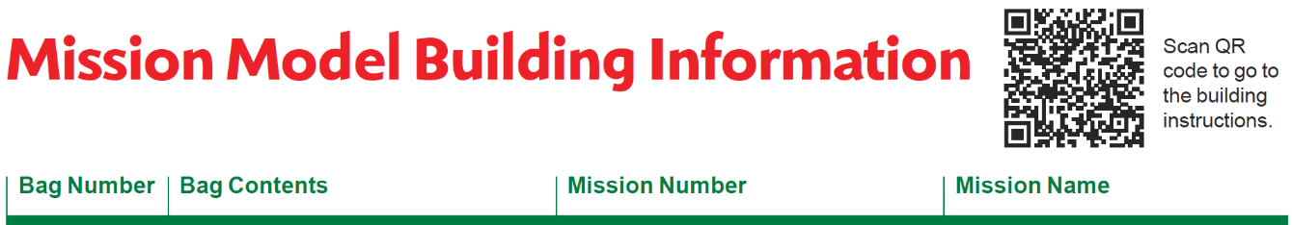
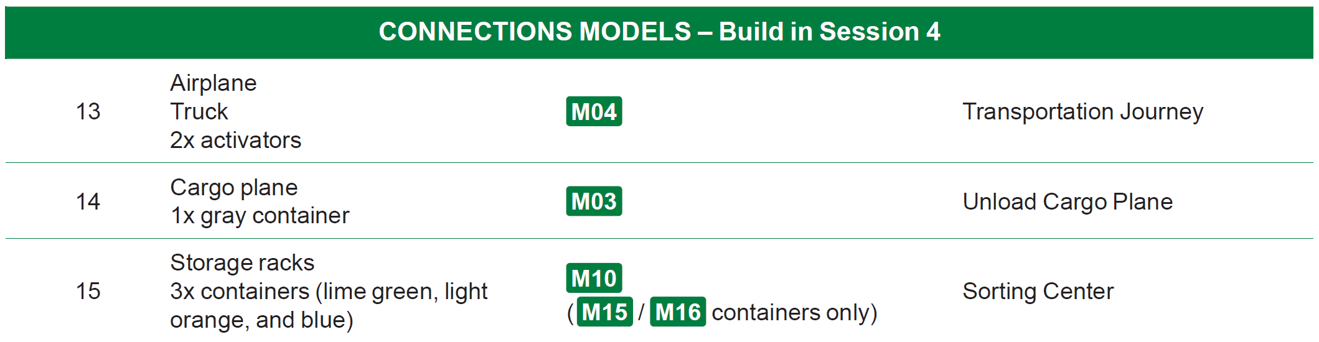
Connections Project Spark
Build the Connection models in Bags 13-15 using Building Instruction Books 13-15.
Notes:
Facilitator Tips
Provide the digital building instructions Books 13-15 to the team.
The team will need Bags 13-15 from the Challenge set.
This is the last session for building models. Finish building all the models and placing them on the mat before the next session.

Slide 8
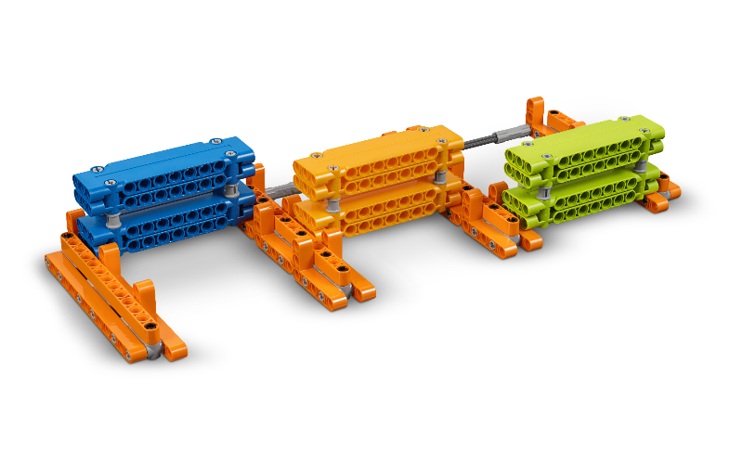
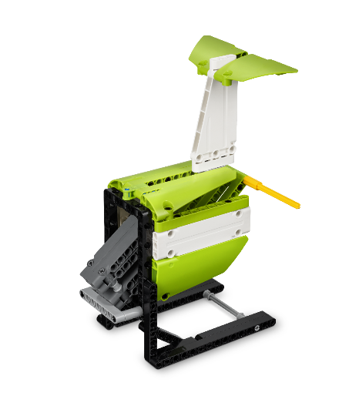
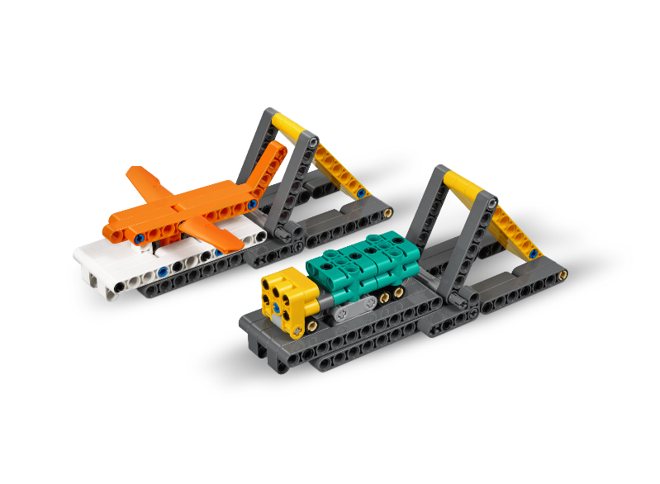
Connections Project Spark
Identify the missions that relate to the models you built.
Discuss how the Project Spark and models are linked.

Slide 9
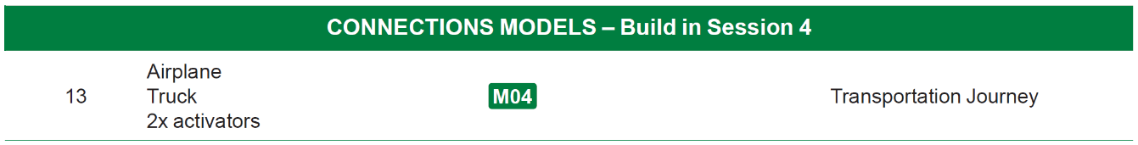

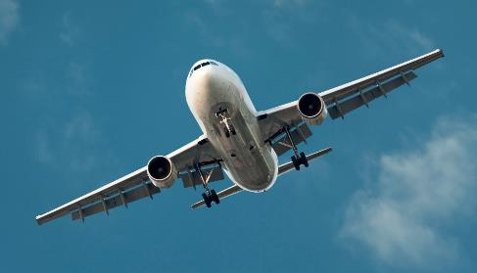
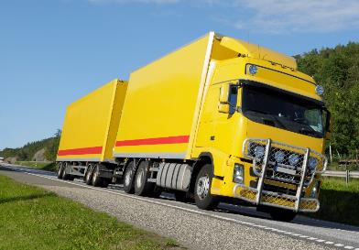
Transportation Journey

Slide 10
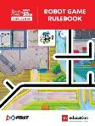
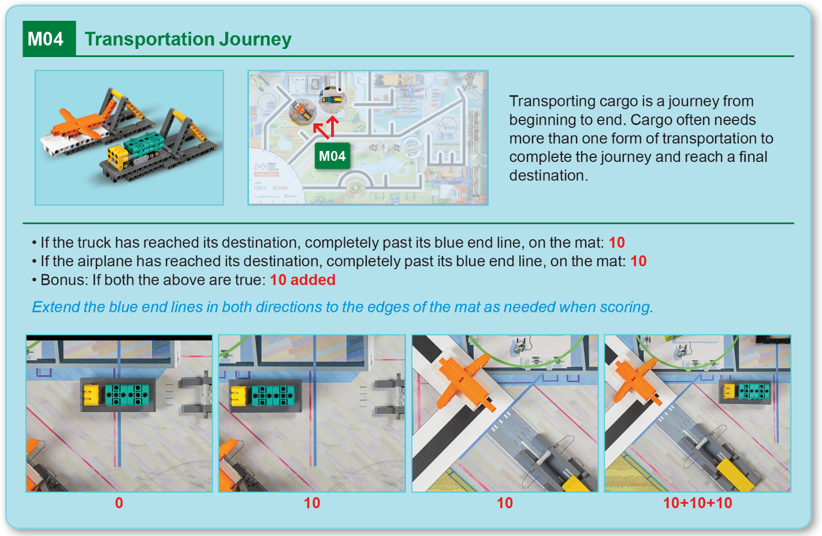
Robot
Game
Rulebook
page 14

Slide 11

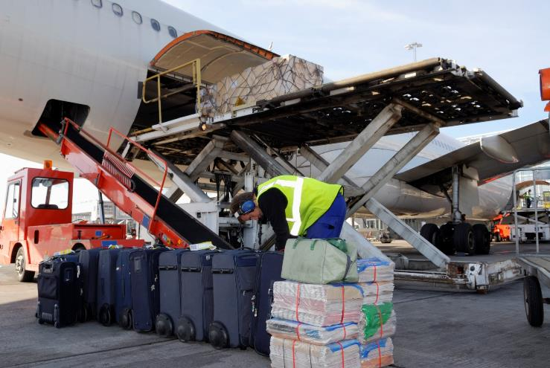
Cargo Plane

Slide 12
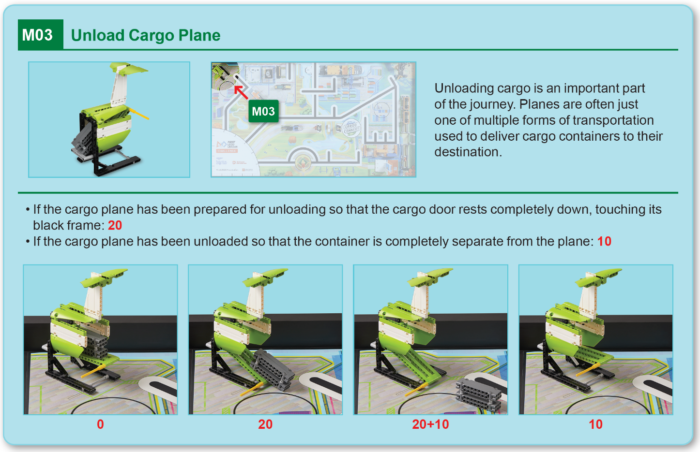
Robot
Game
Rulebook
page 13

Slide 13

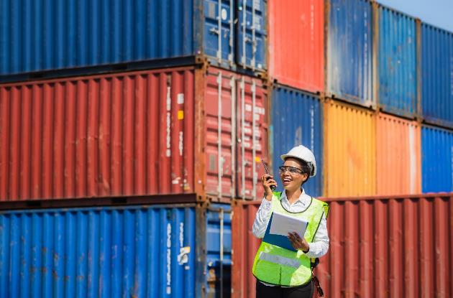
Storage Racks

Slide 14
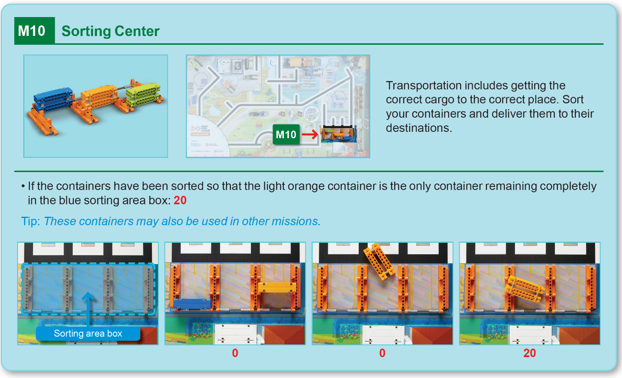
Robot
Game
Rulebook
page 17

Slide 15
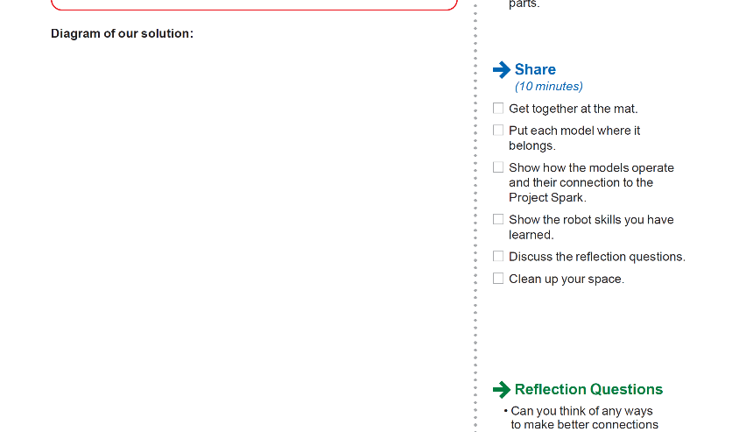
Connections Project Spark
Draw your solution for a piece of equipment or technology that could improve how different vehicles make connections.
In your drawing, include how your solution works and label its parts.
Notes:
Facilitator Tips
Make sure the team label their diagram with lots of details that explains how their solution works.

Slide 16
Share
Get together at the mat.
Put each model where it belongs.
Show how the models operate and their connection to the Project Spark.
Show the robot skills you have learned.
Discuss the reflection questions.
Clean up your space.

Slide 17
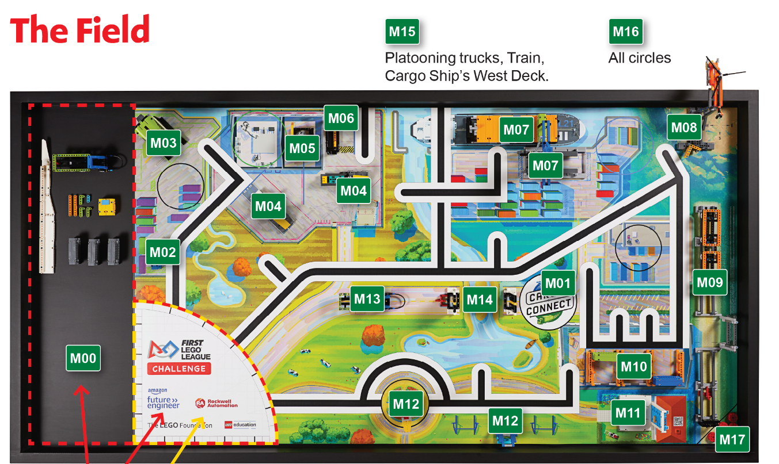
Models built this session are for the circled missions.
Notes:
Place the completed models on the mat with Dual Lock™ according to the field setup in the Robot Game Rulebook.

Slide 18
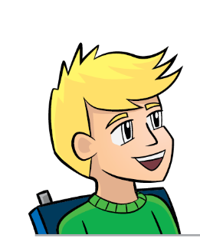
Reflection Questions
Can you think of any ways to make better connections between different forms of transportation?
What different connection points are used for transportation in your community?
How does a freight driver know what routes to use when transporting cargo?

Slide 19
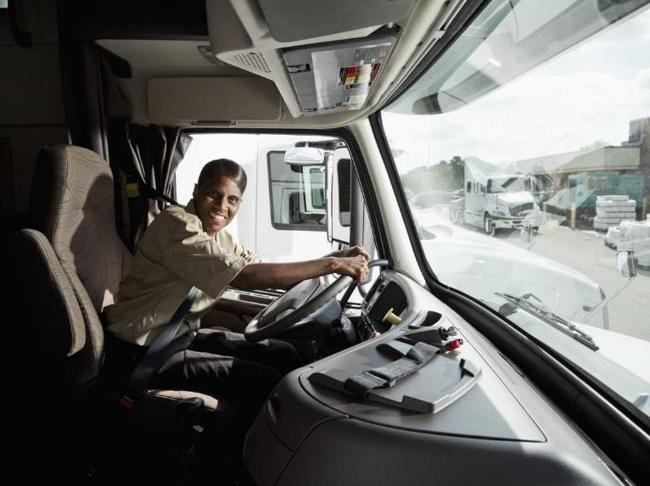
Career Connections
Freight Driver
Role:
Moves cargo from one location to another.

Slide 20

Multimedia Resources
You may wish to embed a relevant, age-appropriate video for your students here. See the Notes for an example.
Notes:
Choose a relevant, age-appropriate video for your students.
Here is one example:
Inside Australia Post’s High Tech Parcel Sorting Facility from 7News Australia – Length 1:30
https://youtu.be/XW_ka8Yu68U

Slide 21
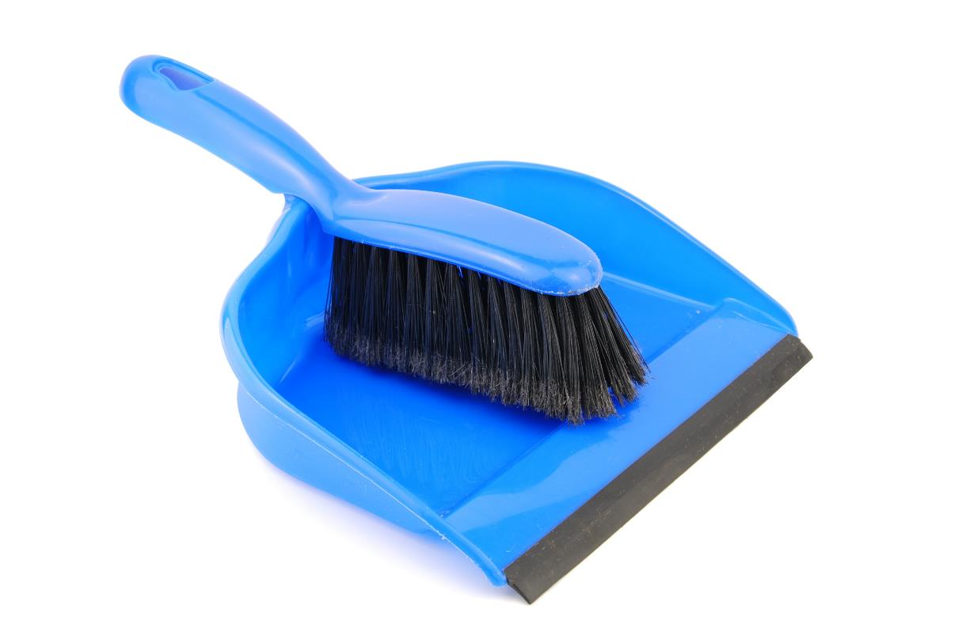
Clean Up

Slide 22

FIRST® and the FIRST® logo are registered trademarks of For Inspiration and Recognition of Science and Technology (FIRST). LEGO® and MINDSTORMS® are registered trademarks of the LEGO Group. FIRST® LEGO® League and CARGO CONNECTSM are jointly held trademarks of FIRST and the LEGO Group. SPIKE™ Prime is a trademark of LEGO® Education. All other trademarks are the property of their respective owners. ©2021 FIRST and the LEGO Group. All rights reserved.

