Slide 1

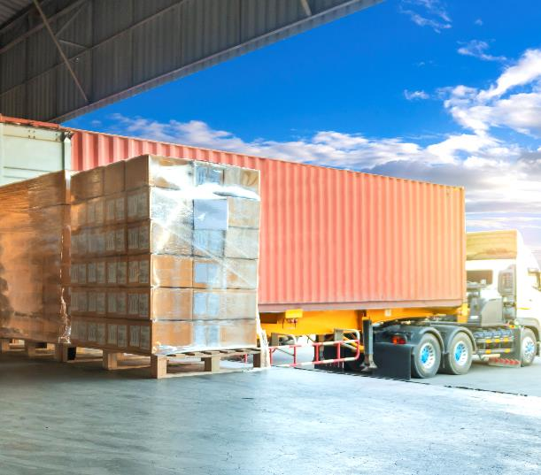
Session 8

Slide 2
Session Overview
Outcomes
The team will evaluate and improve on their Innovation Project solution.
The team will design robot attachments and create programs to solve missions.
Notes:
Facilitator Tips
Use the Core Values where appropriate to encourage the team. To celebrate the team learning these important values, highlight examples of these principles being demonstrated by the team.

Slide 3
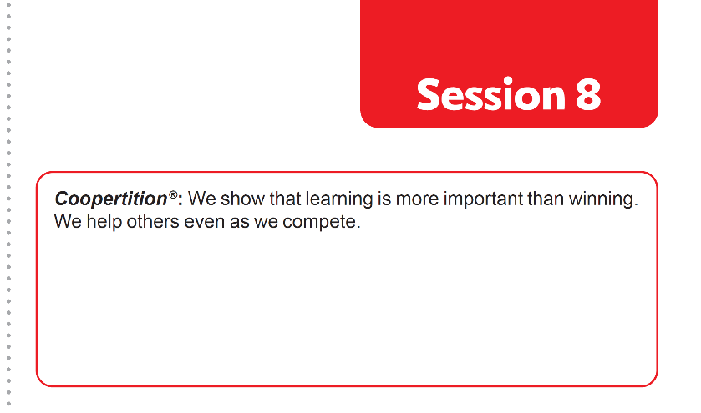

Introduction
Reflect on Coopertition®.
Note ways your team will demonstrate this at an event.
Notes:
Facilitator Tips
Have the team discuss how the Guided Mission is an example of Coopertition®.

Slide 4
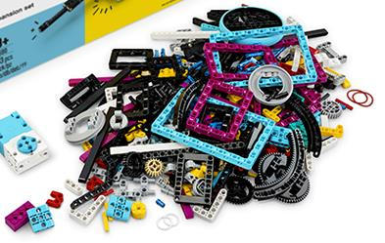
Solve Missions
Decide which mission to attempt next.
Think about your mission strategy and work plan.
Build any attachments you need to complete missions.
Iterate and refine your program so your robot completes the mission reliably.
Be sure to document your design process and testing for each mission!
Notes:
Facilitator Tips
The team should think about strategy when choosing missions to solve. Multiple missions can be completed on the same run to save time.
Encourage the team to discuss how their program works. Break the program into blocks that control one movement.
Treat the Robot Game like a sport. The team needs to practice, practice, practice to perform well in the Robot Game.
Where the robot starts strongly influences where it ends. Have team keep good notes about where the robot is placed.

Slide 5
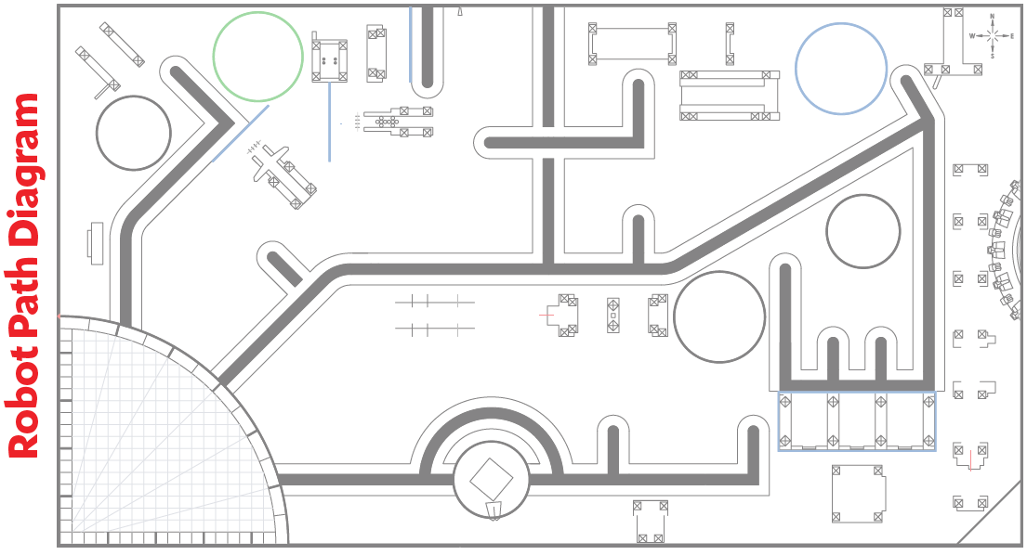
Solve Missions

Slide 6

Solve Missions
Reflection Questions
Is the program for each mission saved on your electronic device?
In what order will you run the missions in the Robot Game?
How would a robotic engineer design robots to make transporting cargo more efficient?

Slide 7
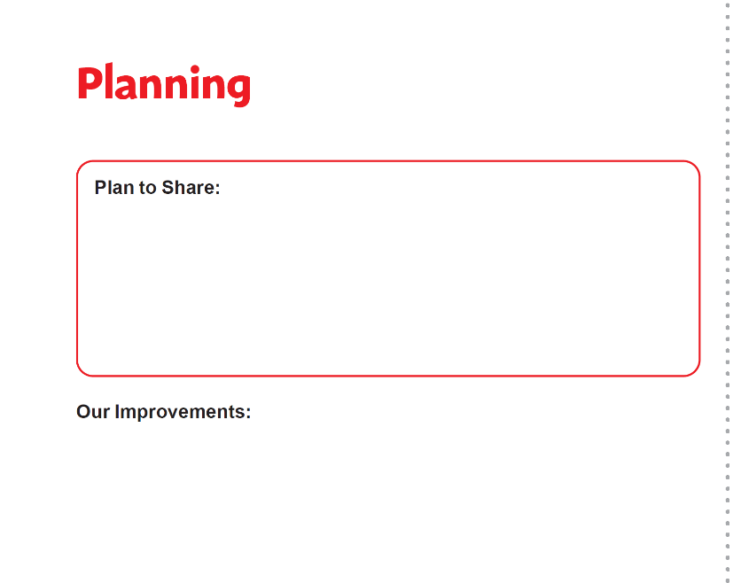
Evaluate & Test Project Solution
Make a plan to share about your solution with others!
Evaluate your present solution.
Iterate and improve to make it better based on feedback.
Determine if you can do any testing of your solution.
Notes:
Facilitator Tips
Keep the white brick model made by the team representing their Innovation Project solution.
Collect the remaining white bricks from Bag 16 in a sealed plastic bag. They do NOT have to use all the white bricks.
The team should iterate and improve their project solution following feedback from others.
The team can create a survey to evaluate their solution or ask for feedback from someone who is an expert on their chosen problem.
The team could go through multiple cycles of the Engineering Design Process as they test and improve their project solution.

Slide 8
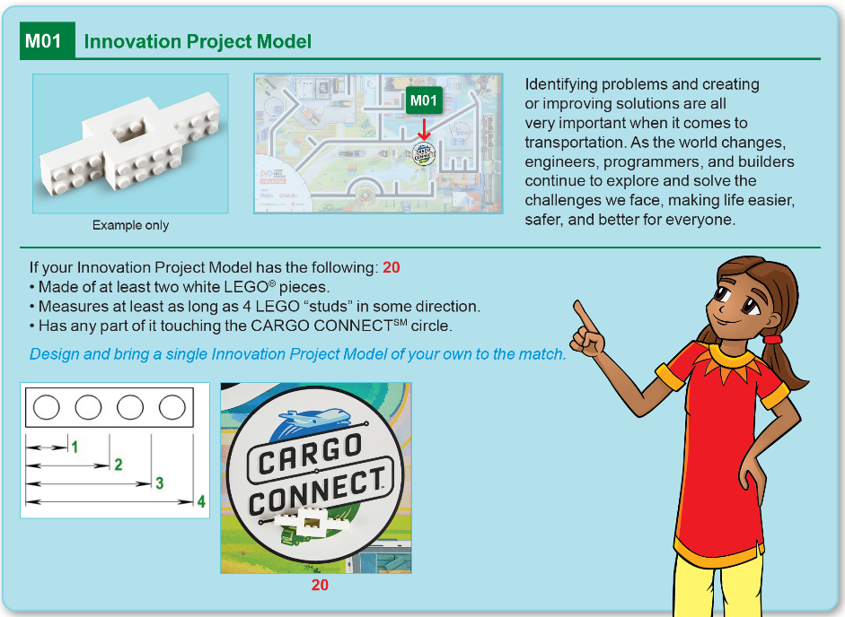
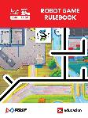
Evaluate & Test Project Solution
Use the elements from Bag 16 to build a model that represents your Innovation Project solution.
Robot
Game
Rulebook
page 12
Notes:
Facilitator Tips
Keep the white brick model made by the team representing their Innovation Project solution.
Collect the remaining white bricks from Bag 16 in a sealed plastic bag. They do NOT have to use all the white bricks.
The team should iterate and improve their project solution following feedback from others.
The team can create a survey to evaluate their solution or ask for feedback from someone who is an expert on their chosen problem.
The team could go through multiple cycles of the Engineering Design Process as they test and improve their project solution.

Slide 9
Share
Get together at the mat.
Show any new missions you have been working on.
Discuss how you will share about your solution with others.
Discuss the reflection questions.
Clean up your space.

Slide 10

Reflection Questions
How can you realistically implement your Innovation Project solution?
Could your project solution be manufactured and what would it cost?

Slide 11

Multimedia Resources
You may wish to embed a relevant, age-appropriate video for your students here. See the Notes for an example.
Notes:
Choose a relevant, age-appropriate video for your students.
Here is one example:
How UPS Is Using Big Data to Transform Package Deliveries from CNBC Length 3:48
https://youtu.be/PSNIr1EMu_I

Slide 12

Clean Up

Slide 13
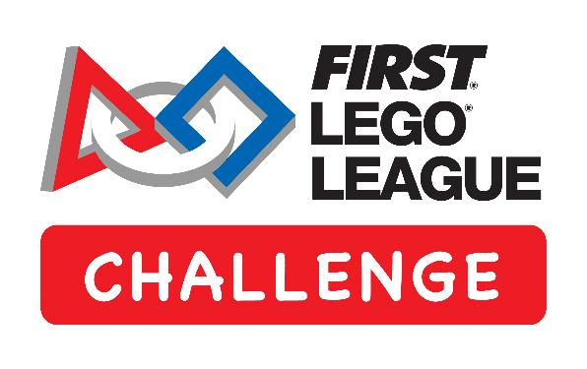
FIRST® and the FIRST® logo are registered trademarks of For Inspiration and Recognition of Science and Technology (FIRST). LEGO® and MINDSTORMS® are registered trademarks of the LEGO Group. FIRST® LEGO® League and CARGO CONNECTSM are jointly held trademarks of FIRST and the LEGO Group. SPIKE™ Prime is a trademark of LEGO® Education. All other trademarks are the property of their respective owners. ©2021 FIRST and the LEGO Group. All rights reserved.

