Slide 1

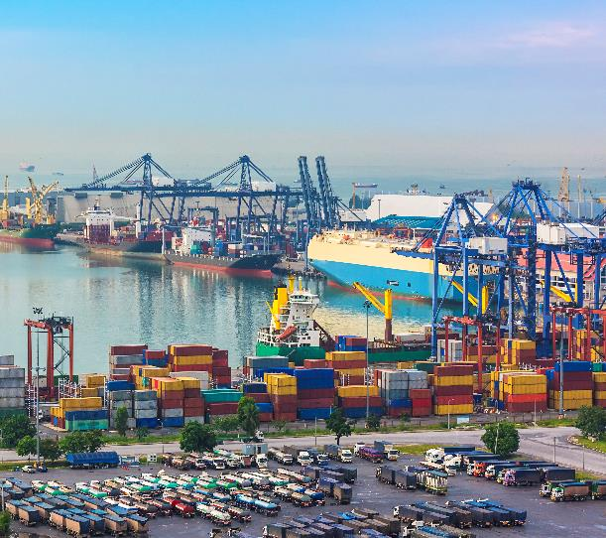
Session 10

Slide 2
Session Overview
Outcomes
The team will plan and create their Innovation Project presentation.
The team will continue to solve missions for the Robot Game.
Notes:
Facilitator Tips

Slide 3

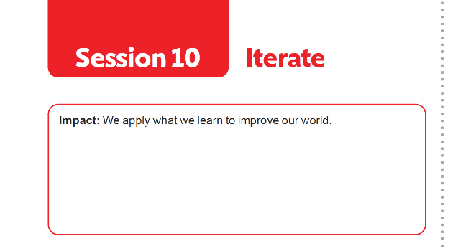
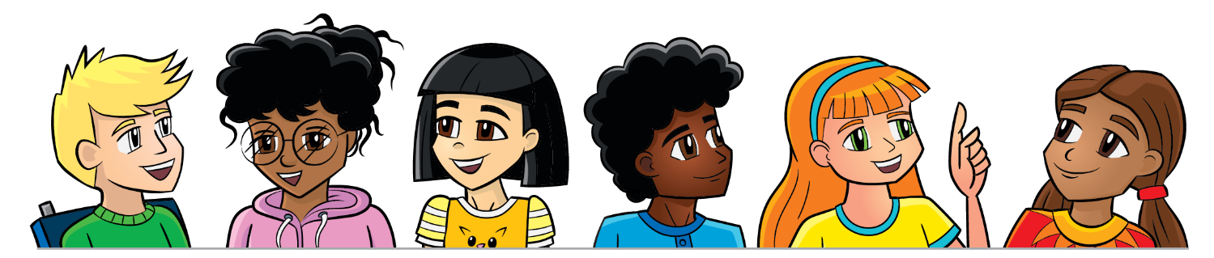
Introduction
Think about Impact and your team.
Record examples of how your team has had a positive influence on you and others.
Notes:
Facilitator Tips

Slide 4
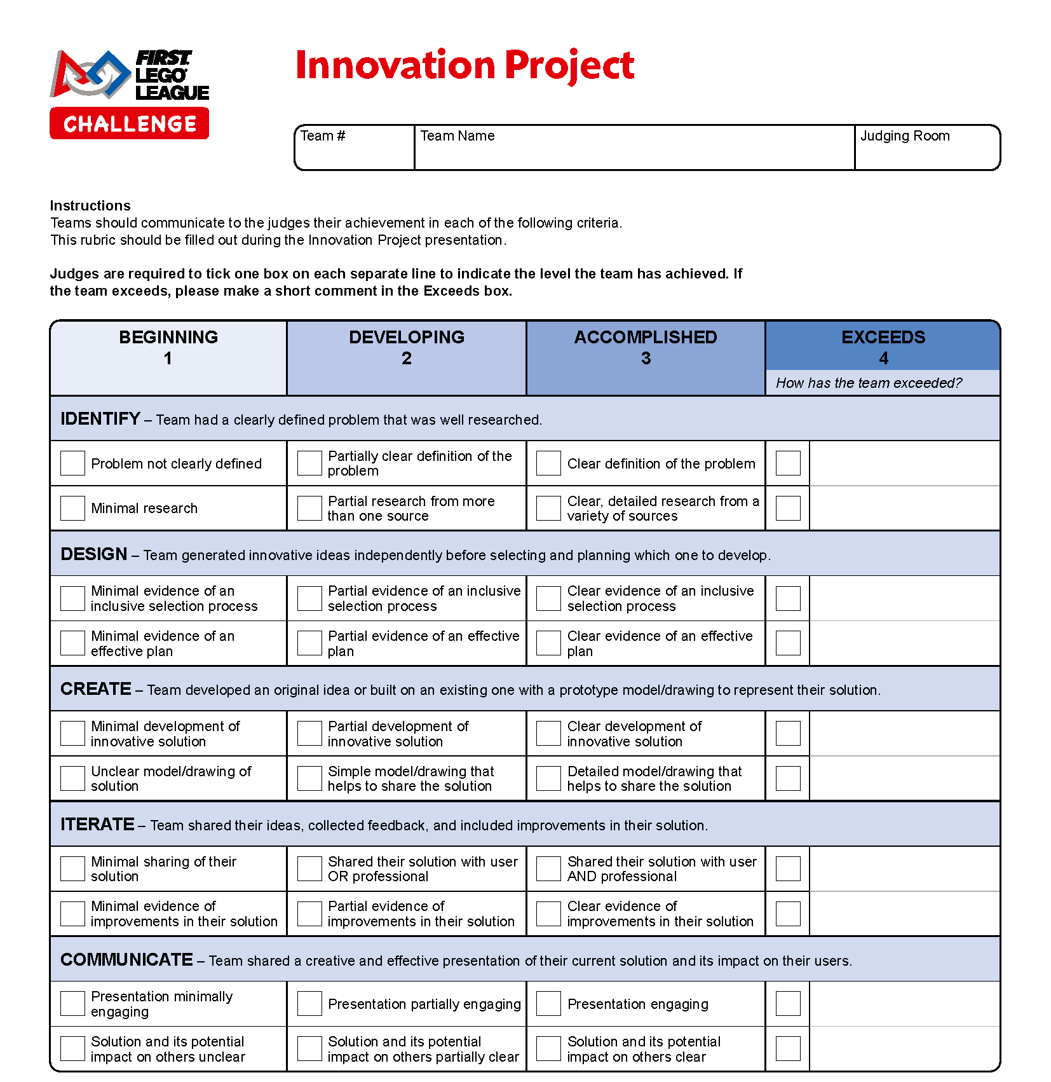
Plan Project Presentation
Plan out your project presentation. Refer to the Innovation Project rubric for what to cover.
Write out your Innovation Project presentation script.
Make any props or displays that you need. Be engaging and creative!
Notes:
Facilitator Tips
Their presentation can be a slideshow, poster, play, or even a skit. Props can be used, such as costumes, shirts, or hats.
Scripts can be made for both the Innovation Project presentations and for explaining the robot. Provide copies for each team member.
The team may need more space to store all the materials they have created for their presentation.
Find the rubrics in the FIRST LEGO League season resources (https://www.firstlegoleague.org/season#resources)

Slide 5
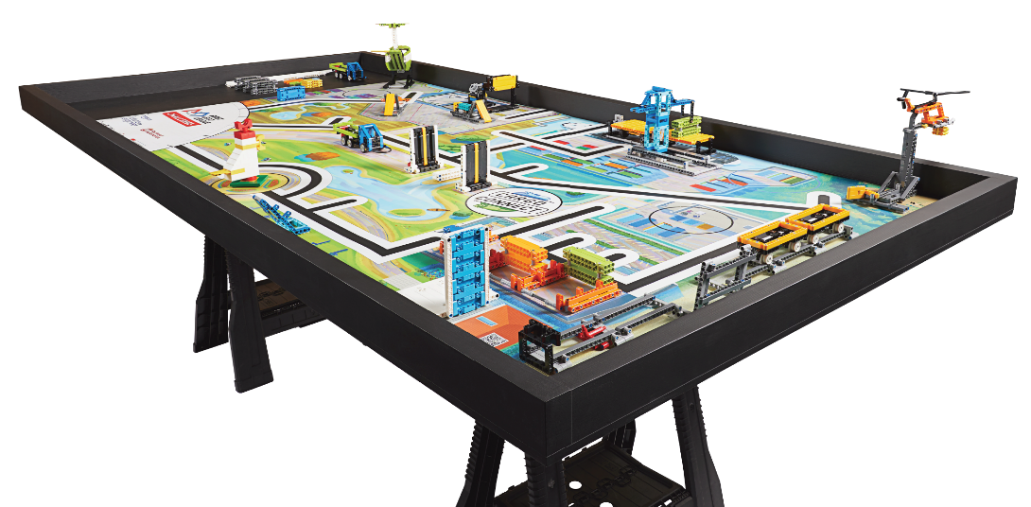
Iterate and Improve
Continue to create, test, and iterate on your robot solution.
Practice a 2.5-minute Robot Game with all your completed missions.
Notes:
Facilitator Tips
Encourage the team to run their robot in practice 2.5-minute robot matches so that they get used to the time limit.

Slide 6
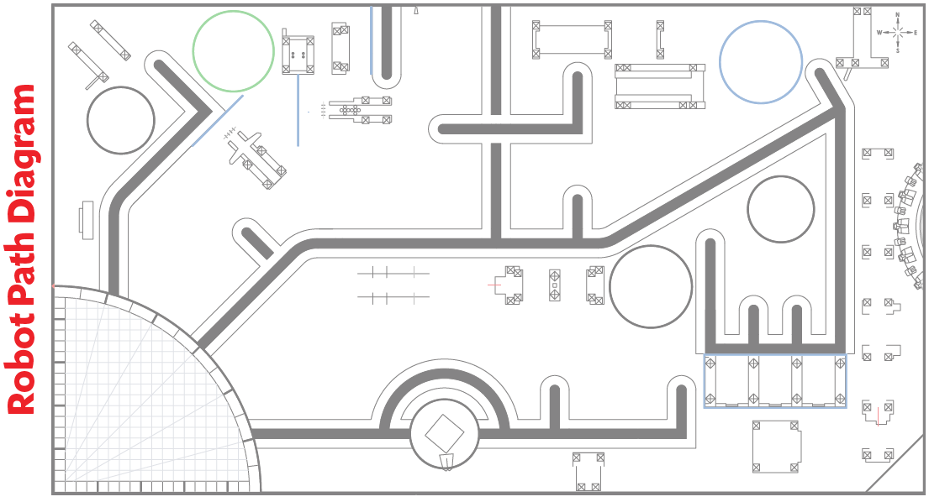
Iterate and Improve

Slide 7
Share
Get together at the mat.
Share the project presentation work completed.
Share what missions you have completed.
Discuss how everyone will be involved in the presentation.
Discuss the reflection questions and clean up your space.
Notes:
Facilitator Tips
Provide the team with the Innovation Project rubric here: firstlegoleague.org/ season#resources.

Slide 8

Reflection Questions
How did you decide which missions to attempt?
How can your Innovation Project solution help your community?
How will your Innovation Project solution have an impact on others?

Slide 9

Multimedia Resources
You may wish to embed a relevant, age-appropriate video for your students here. See the Notes for an example.
Notes:
Choose a relevant, age-appropriate video for your students.
Here is one example:
In this session, you could show a video with some tips on giving presentations.
Here are two examples made by middle school students:
Schooled by Kids: Presentation Skills, Part 1: https://youtu.be/8IbheB2-ixM
Schooled by Kids: Presentation Skills, Part 2: https://youtu.be/PX_DAFXQxpc

Slide 10
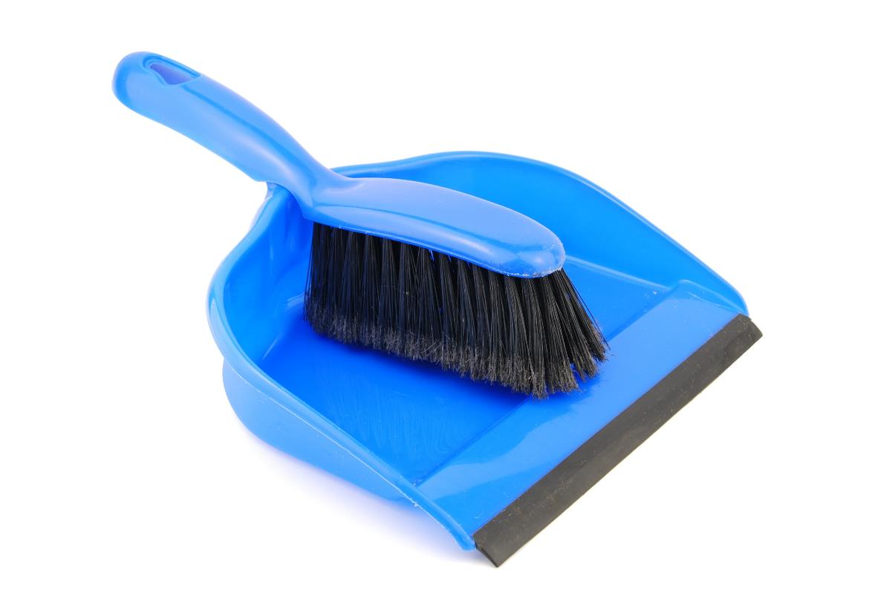
Clean Up

Slide 11

FIRST® and the FIRST® logo are registered trademarks of For Inspiration and Recognition of Science and Technology (FIRST). LEGO® and MINDSTORMS® are registered trademarks of the LEGO Group. FIRST® LEGO® League and CARGO CONNECTSM are jointly held trademarks of FIRST and the LEGO Group. SPIKE™ Prime is a trademark of LEGO® Education. All other trademarks are the property of their respective owners. ©2021 FIRST and the LEGO Group. All rights reserved.

