Slide 1

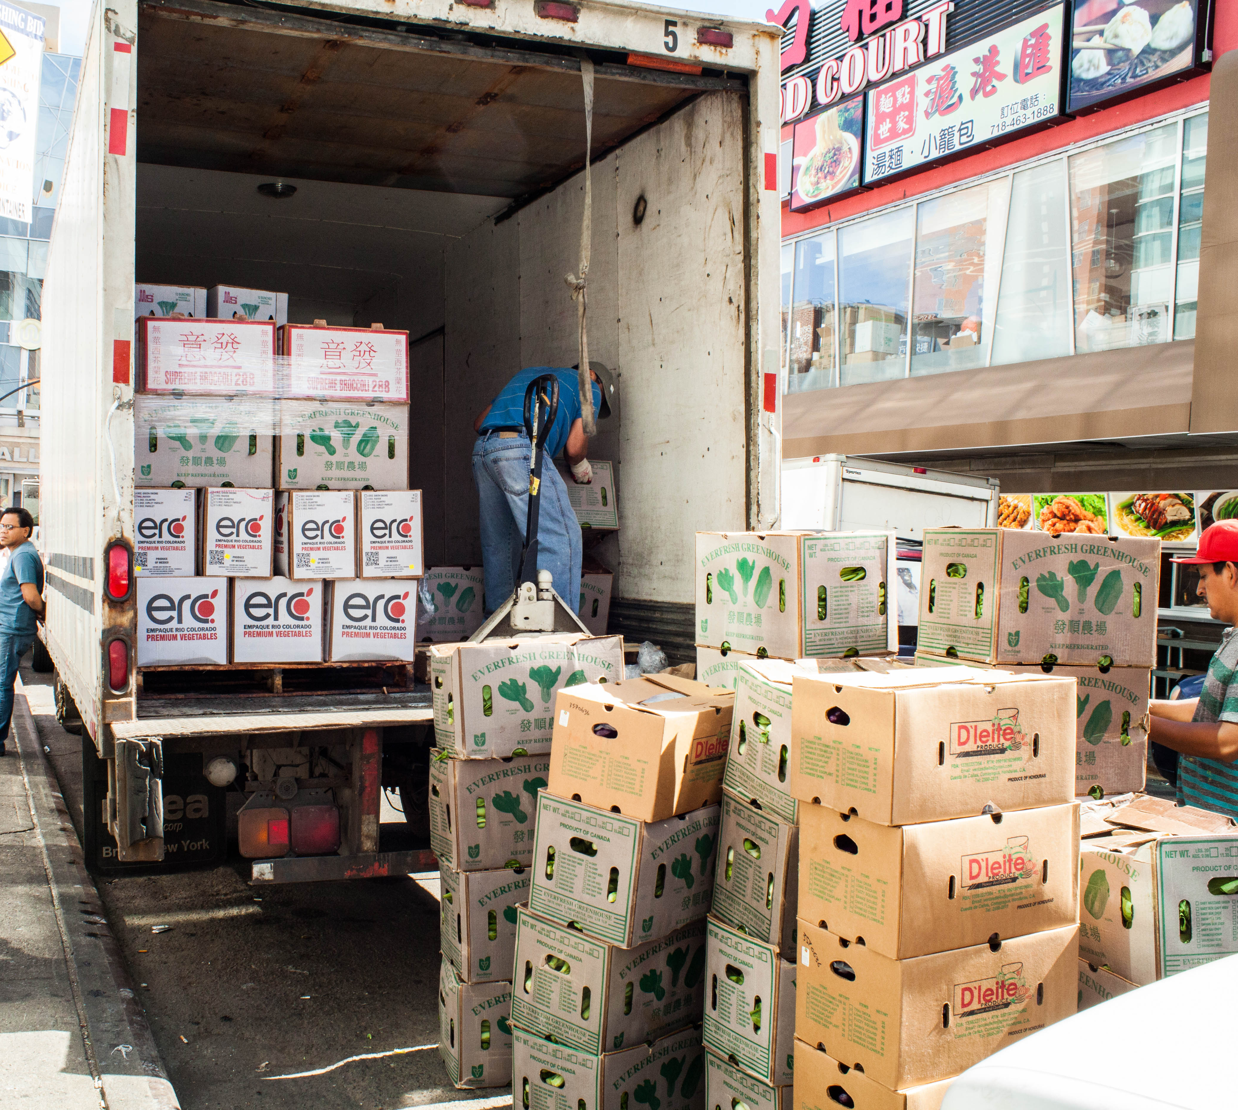
Session 11

Slide 2

Session Overview
Outcomes
The team will finalize their Innovation Project presentation.
The team will finalize their robot for the Robot Game and create their Robot Design explanation.
Notes:
Facilitator Tips

Slide 3
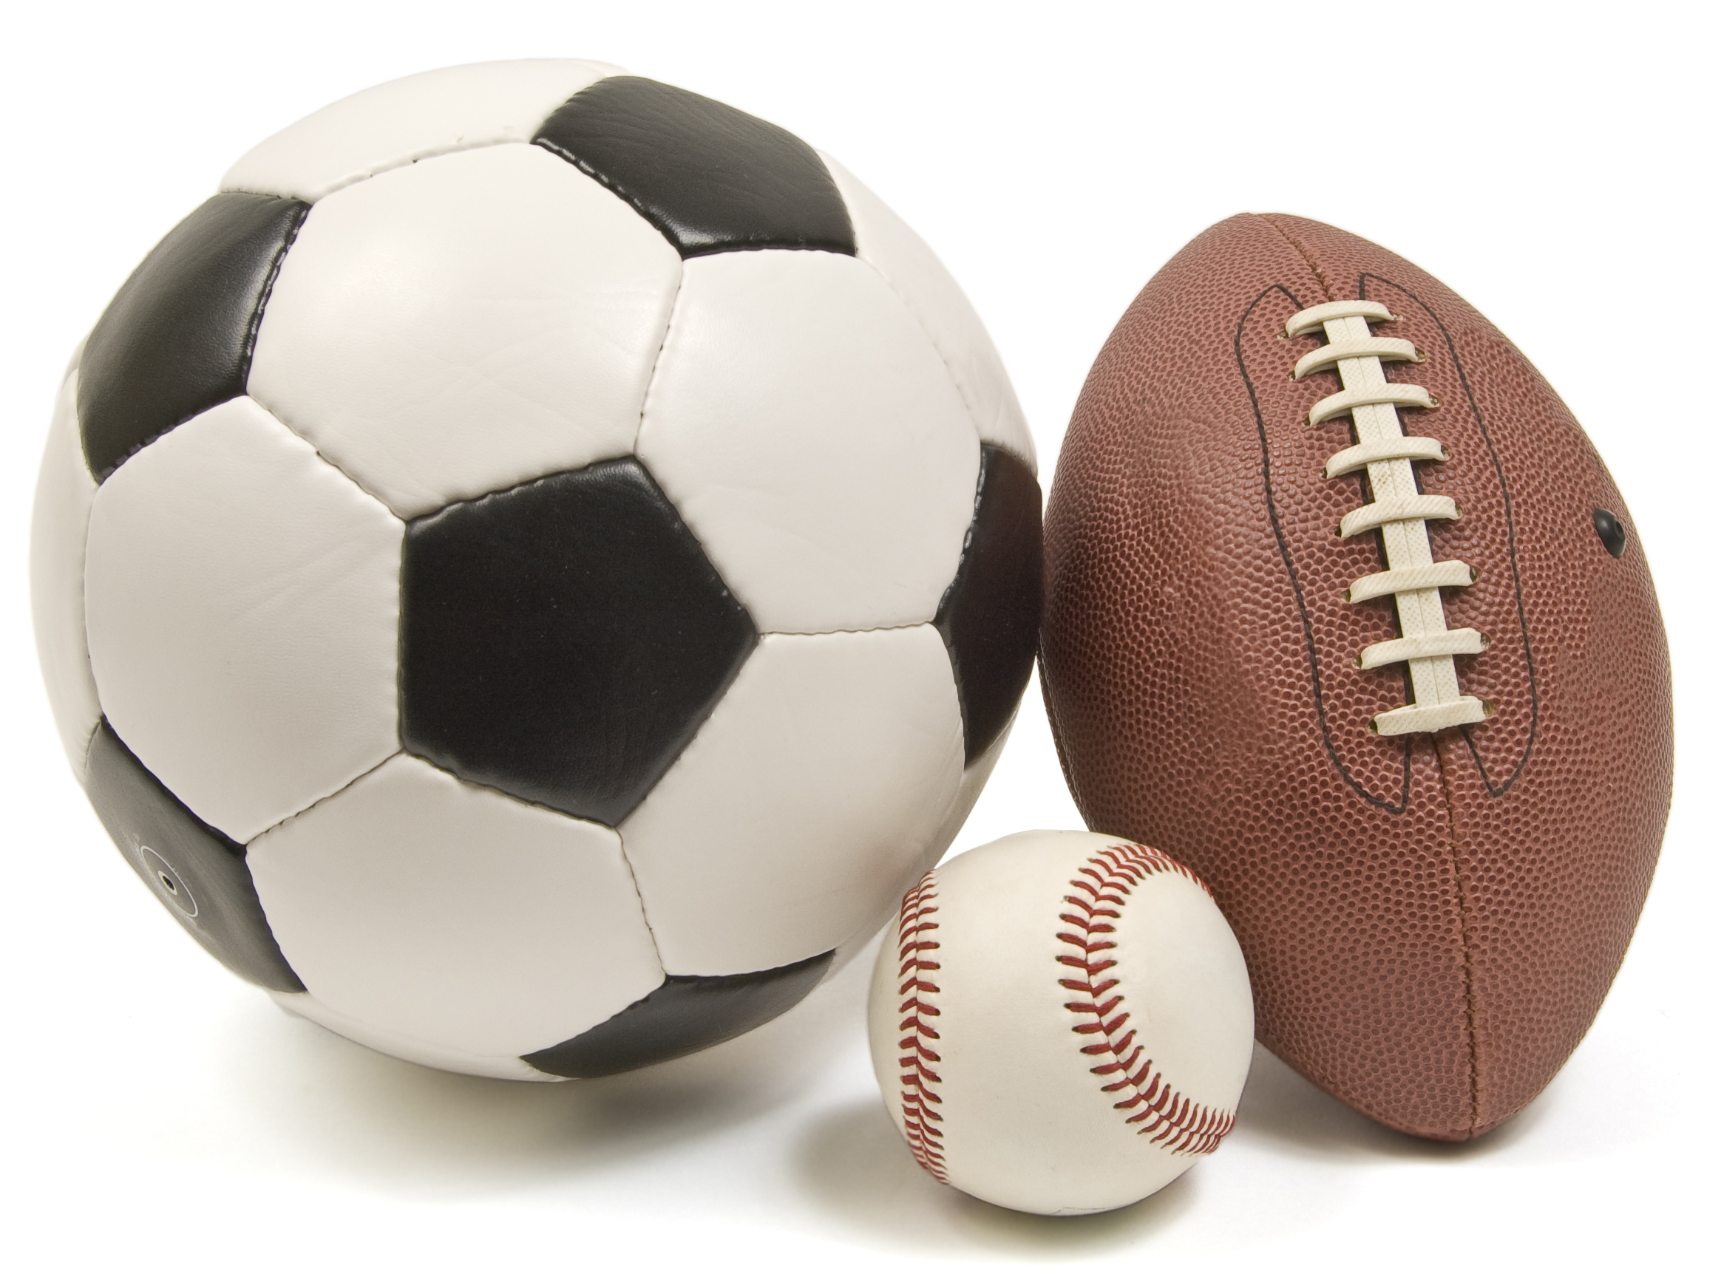
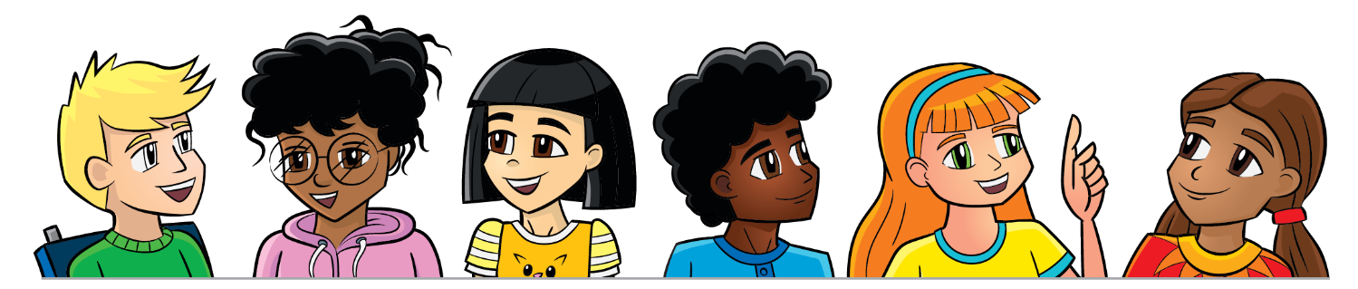
Introduction
Create a sports playing card for each person on the team. You can use these to highlight each person on the team at your event.
Explain about yourself and how you enjoy FIRST® LEGO® League Challenge!
FirstName LastName
Notes:
Facilitator Tips
Provide paper and art supplies for this activity. This activity helps the team to value the contribution made by each member.

Slide 4
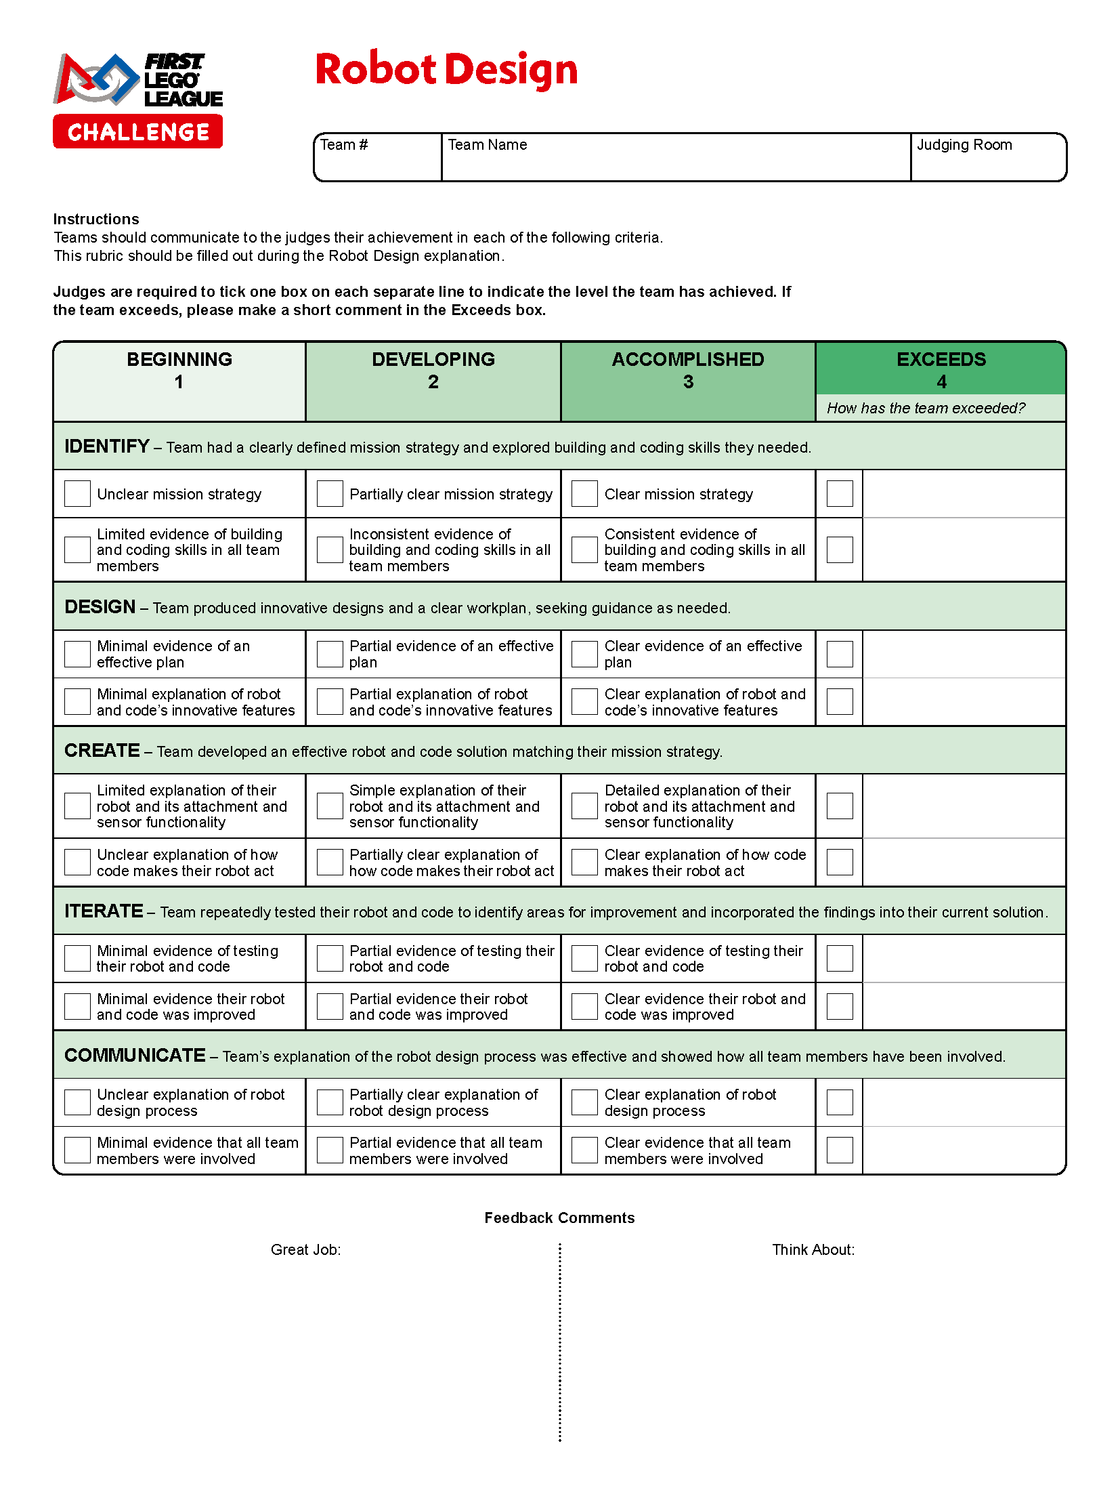
Plan & Practice
Continue working on your Innovation Project presentation.
Plan and write out your Robot Design explanation. Refer to the Robot Design rubric for what to cover.
Make sure everyone can communicate about your design process and programs.
Determine what each person on the team will say.
Practice your full presentation.
Notes:
Facilitator Tips
Practicing how to communicate their Innovation Project solution and explain their Robot Design is important.
Provide the team with the Robot Design rubric. Find it here: firstlegoleague. org/season#resources.
Every team member should be involved in the presentation at the tournament.

Slide 5
Share
Get together at the mat.
Discuss the presentation and each person’s role.
Run a practice 2.5-minute match and explain what missions are done.
Discuss the reflection questions.
Decide what else needs to be done and clean up your space.
Notes:
Facilitator Tips
The team should know who will run the robot during the matches. There can be only two members at the mat at one time.

Slide 6
Reflection Questions
Do you have a plan for what to do if one mission does not work?
Does everyone have a speaking part in the presentation?
Review the Judging Session Flow Chart to see how you will present your Robot Design and Innovation Project.
Notes:
Facilitator Tips
Find the judging session flow chart in the FIRST LEGO League season resources (https://www.firstlegoleague.org/season#resources)

Slide 7

Multimedia Resources
You may wish to embed a relevant, age-appropriate video for your students here. See the Notes for an example.
Notes:
Choose a relevant, age-appropriate video for your students.
Here is one example:
Ford’s Delivery Robot Walks on Two Legs Like a Human from Tech Insider – Length 3:00
https://youtu.be/U8Iey_wfo0I

Slide 8
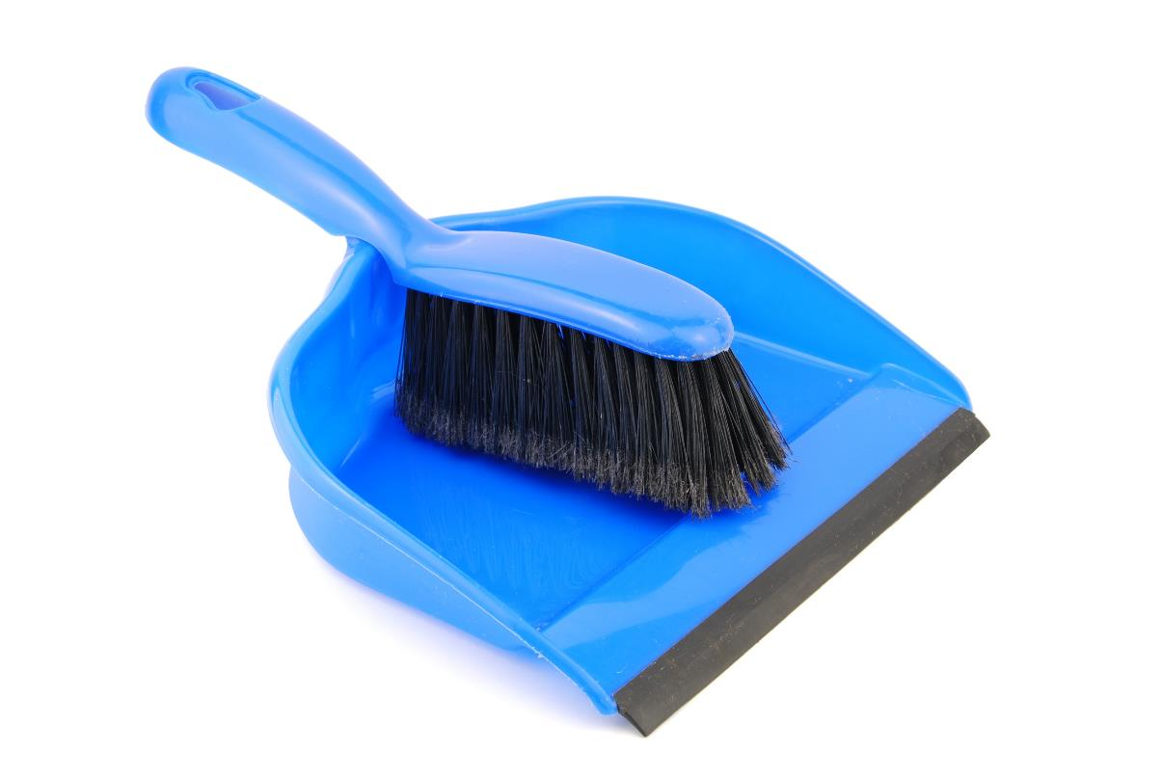
Clean Up

Slide 9
FIRST® and the FIRST® logo are registered trademarks of For Inspiration and Recognition of Science and Technology (FIRST). LEGO® and MINDSTORMS® are registered trademarks of the LEGO Group. FIRST® LEGO® League and CARGO CONNECTSM are jointly held trademarks of FIRST and the LEGO Group. SPIKE™ Prime is a trademark of LEGO® Education. All other trademarks are the property of their respective owners. ©2021 FIRST and the LEGO Group. All rights reserved.

