Slide 1

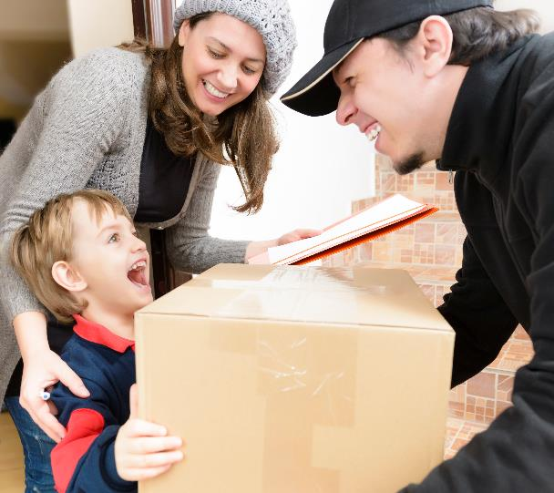
Session 12

Slide 2


Session Overview
Outcomes
The team will practice their Innovation Project presentation and Robot Design explanation.
The team will run practice Robot Game matches.
Notes:
Facilitator Tips

Slide 3
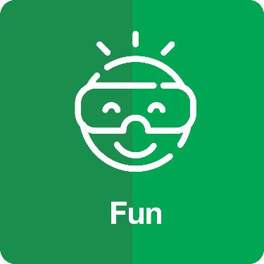
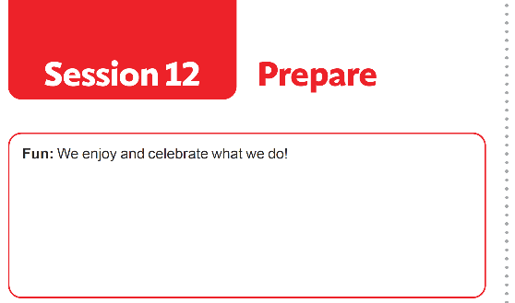
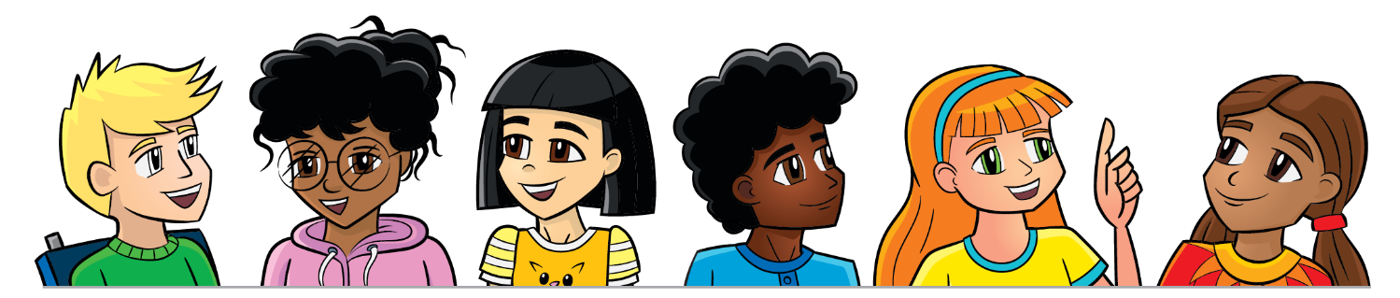
Introduction
Reflect on how your team has had Fun.
Record examples of how your team has had fun throughout this experience.
Notes:
Facilitator Tips
Provide paper and art supplies for this activity. This activity helps the team to value the contribution made by each member.

Slide 4
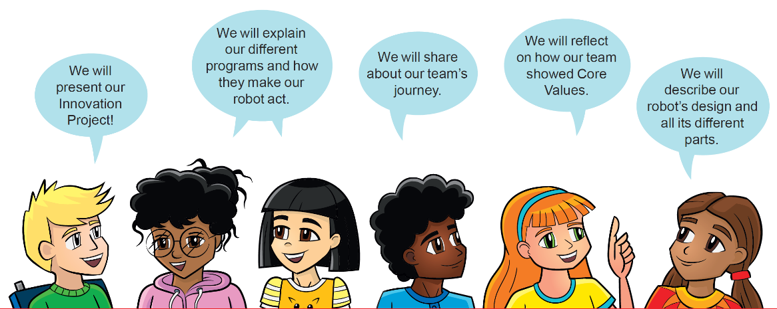
Practice
Rehearse your full presentation communicating your robot and project solutions.
Demonstrate Core Values when you present!
Have practice 2.5-minute Robot Game matches.
Review the Prepare for Your Event page 32.
Notes:
Facilitator Tips
Plan to split the time in this session equally among presentation practice and practice matches.
Encourage the team to practice their presentation before the event. They can practice by sharing their solution with others.
Have the team run their 2.5-minute robot matches. Make sure they practice running their programs in the right order.
If things don’t go as planned during the Robot Game, the team might want a contingency plan for other missions they can run.
Remind the team about Core Values and how they will show them throughout the event including at every Robot Game match.

Slide 5
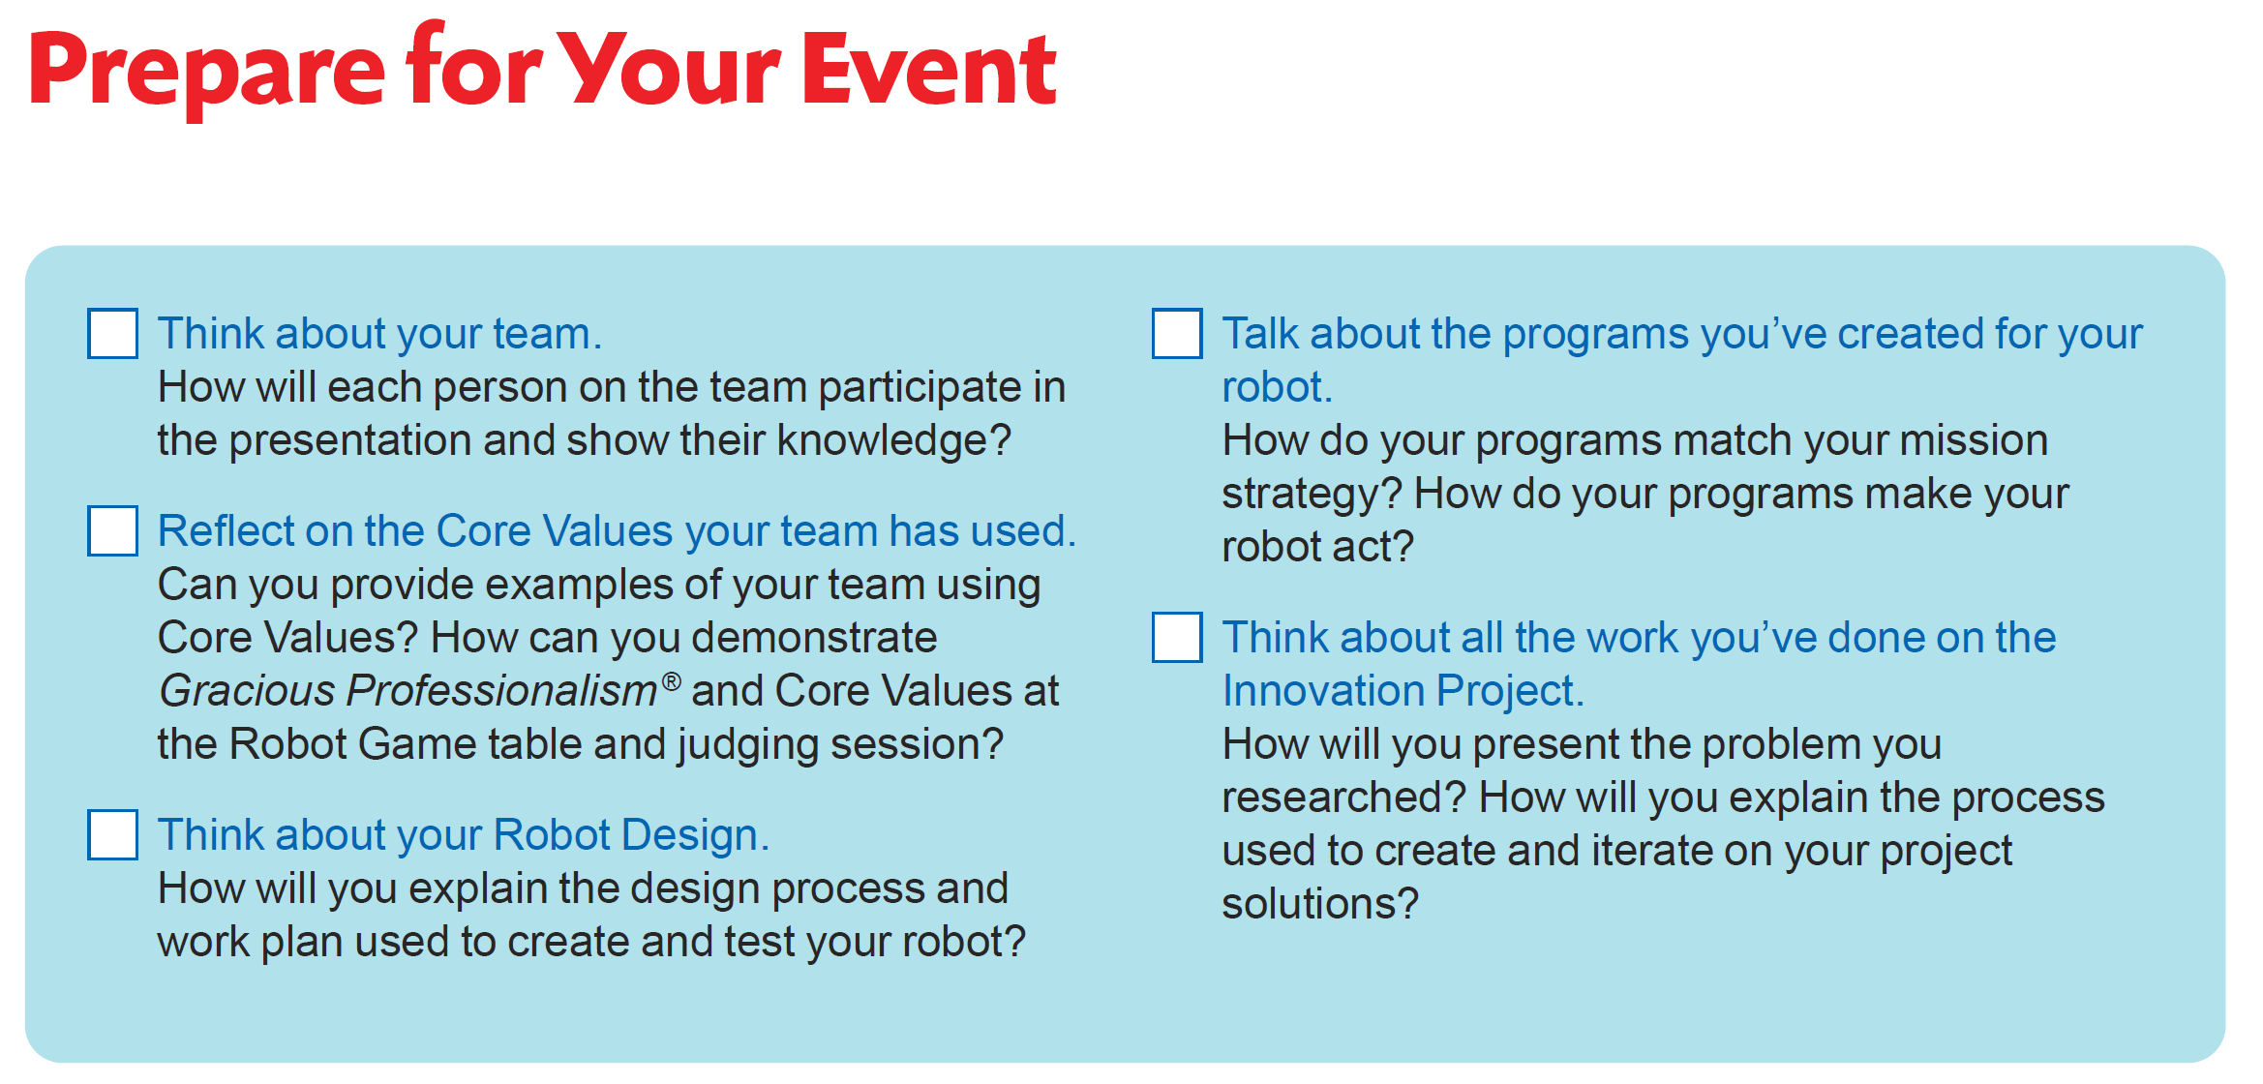
Notes:
Facilitator Tips
Plan to split the time in this session equally among presentation practice and practice matches.
Encourage the team to practice their presentation before the event. They can practice by sharing their solution with others.
Have the team run their 2.5-minute robot matches. Make sure they practice running their programs in the right order.
If things don’t go as planned during the Robot Game, the team might want a contingency plan for other missions they can run.
Remind the team about Core Values and how they will show them throughout the event including at every Robot Game match.

Slide 6
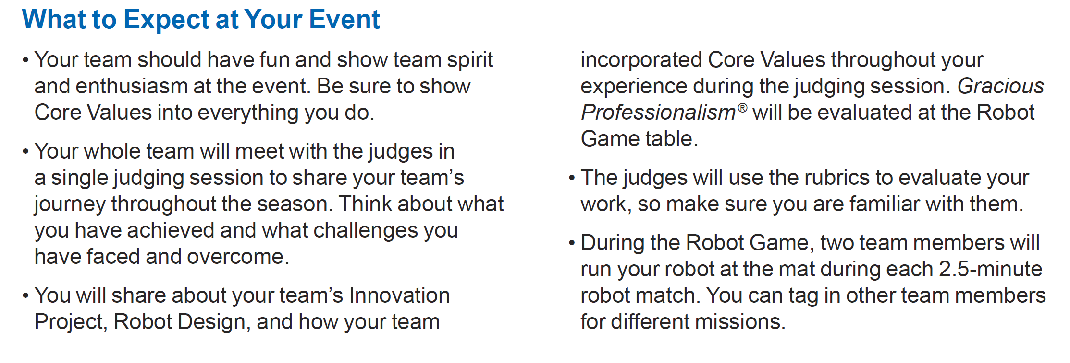
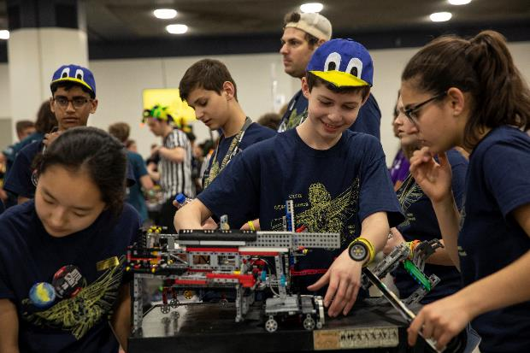
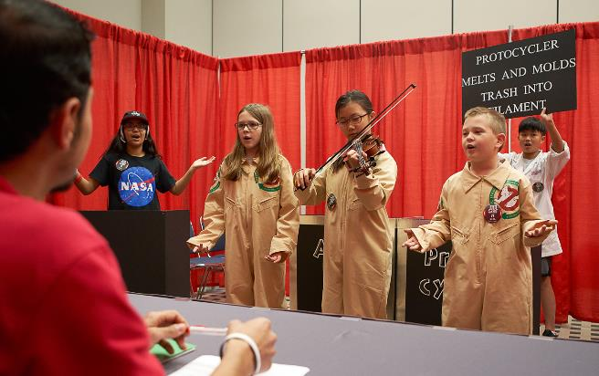
Notes:
Facilitator Tips
Plan to split the time in this session equally among presentation practice and practice matches.
Encourage the team to practice their presentation before the event. They can practice by sharing their solution with others.
Have the team run their 2.5-minute robot matches. Make sure they practice running their programs in the right order.
If things don’t go as planned during the Robot Game, the team might want a contingency plan for other missions they can run.
Remind the team about Core Values and how they will show them throughout the event including at every Robot Game match.

Slide 7
Share
Review all the Core Values, Innovation Project, and Robot Game rubrics.
Provide helpful feedback after the presentation to each other based on the rubrics.
Discuss the reflection questions.
Clean up your space.
Notes:
Facilitator Tips
The team should know who will run the robot during the matches. There can be only two members at the mat at one time.
Find the rubrics in the FIRST LEGO League season resources (https://www.firstlegoleague.org/season#resources)

Slide 8

Reflection Questions
Are all the different LEGO® pieces you need to attach to your robot for each mission ready?
Is everyone ready to speak loudly, smile, and have fun?
Have more time?
Continue solving missions and working on your Innovation Project before your event!

Slide 9

Multimedia Resources
You may wish to embed a relevant, age-appropriate video for your students here. See the Notes for an example.
Notes:
Choose a relevant, age-appropriate video for your students.
Here is one example:
Getting Started with FIRST LEGO League Challenge - the Tournament Experience from the IET in the UK, prepared for the 2020-2021 RePLAY Season – Length 1:55
https://youtu.be/E7XOzjeE7F8

Slide 10
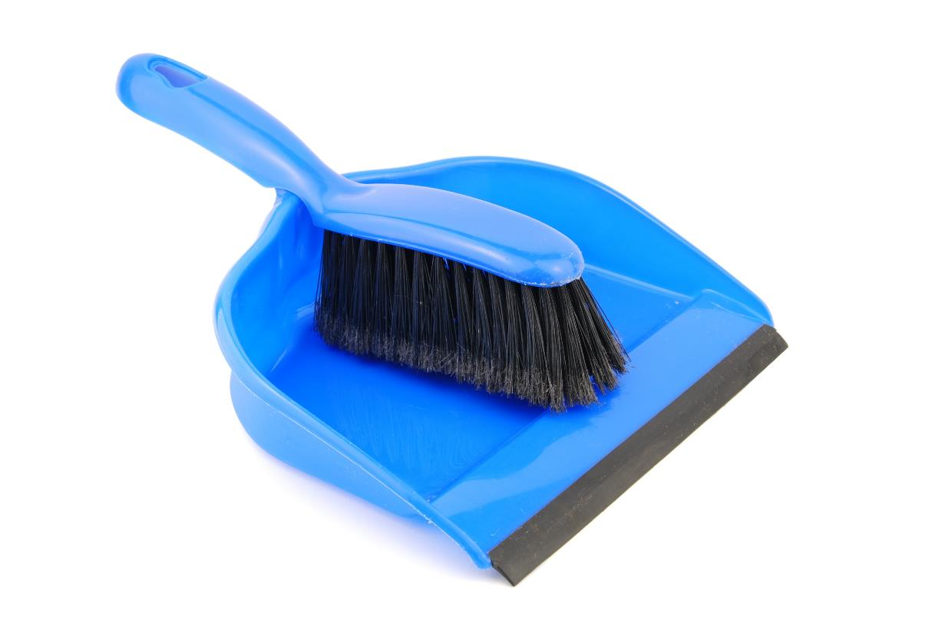
Clean Up

Slide 11

FIRST® and the FIRST® logo are registered trademarks of For Inspiration and Recognition of Science and Technology (FIRST). LEGO® and MINDSTORMS® are registered trademarks of the LEGO Group. FIRST® LEGO® League and CARGO CONNECTSM are jointly held trademarks of FIRST and the LEGO Group. SPIKE™ Prime is a trademark of LEGO® Education. All other trademarks are the property of their respective owners. ©2021 FIRST and the LEGO Group. All rights reserved.

